Slide 1
My Vision is Blurry:
Could it be from any of the medications that I am taking?
Mark T. Dunbar, OD, FAAO
Director of Optometry
Bascom Palme Eye Institute
University of Miami, Miller School of Medicine
Miami, FL 33136

Slide 2
Mark Dunbar: Disclosure
Consultant for Allergan, Carl Zeiss
Optometry Advisory Board
  Regeneron
  Genentech
Mark Dunbar does not own stock in any of the above companies

Slide 3
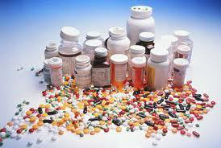
Systemic medication and their ocular side effects
Notes:
Many systemic drugs affect ocular tissue and visual function, that impact patient management
These can vary from transient, mild to severe, or may seriously threaten vision

Slide 4
Systemic Interactions
At least 76 classes of systemic drugs have been associated with ocular side effects
Drug can interact with and disrupt any step of the biochemical process resulting in deleterious effects to the ocular tissues
Drugs may incite an exaggerated immune response within the eye
  Uveitis or retinitis
Penetration by certain systemic meds may cause deposition of the solidified form of the molecule

Slide 5
Systemic Interactions
Medications may cause alteration of the pigment
  Plaquenil -> Bull’s eye maculopathy
Pharmacologic toxicity can occur leading to cell death and loss of function
  Can affect the optic nerve
Patient variability may influence and cause unexpected effects
  Pharmaceutical studies provide statistical evidence supporting appropriate dosage for meds, however individual variation can result in unexpected results

Slide 6
What are your/our obligations in deciding if certain medications that a patient is taking are affecting the patients vision?

Slide 7
How About This One…
37 y/o Hispanic female presented with a recent onset of blurred vision OU X 1 mo – 3 episodes
Currently taking Rifampin, Ethambutol, Clarithromycin 5 mo prior for MAC (Mycoacterium avium complex)
  PCP recommended eye exam when starting meds
VA: 20/20 RE; 20/25 – corrects to 20/20 LE
  Very low hyperopic correction (+0.25)
CVF: FTFC OU, Pupils: Normal
Normal fundus exam

Slide 8
37 y/o Hispanic Female
OD recommends patient get glasses
“Present meds do not document any visual problems.”
(No return appointment given)

Slide 9
How Did the OD Do?
Is there anything else he/she should have done?
Do you think he was aware of ocular side-effects of these meds?

Slide 10
The Rest of the History
Returns to the OD 7 months later
Patient continues to have progressive painless loss of vision (PPLOV) – she says for 2 months
VA: 20/160 RE; 20/300 LE
Color vision – “normal”
Optometrists thinks there is diabetic macular edema (Patient not diabetic)
  Orders diabetes work up – comes back as (-)
  RTC 1 week

Slide 11
37 y/o Hispanic Female
OD sends patient to retinal specialist
Ret specialist can’t find anything but suspects Ethambutolol toxicity
Refers to Neuroophthalmologist
Diagnosis is confirmed

Slide 12
What Do You Think?
Was the OD negligent at the time of the initial exam?
  Never did a visual field
  Color vision not recorded but the Dr. claims he did it
Was he obligated to do any of these things?

Slide 13
What Do You Think?
Was he even aware of the ocular side-effects of this drug?
Just because you can’t see any ocular problems doesn’t mean it’s not there….

Slide 14
Ethambutol Toxic Neuropathy
1st described by Leibold in the 1960’s
Dose dependent
Risk is 6-18% for pts with dose > 30 mg/kg/day (18% at 35 mg/kg/day)
Develops in 1-3% at dose 15-25 mg/kg/day

Slide 15
Anti-tuberculosis drugs
Ethambutol HCL (Myambutol),
Isoniazid (Laniazid)
Rifampin (Rimactane)
Chelates copper, so the decreased levels impair mitochondrial activity of axonal transport in optic nerve leading to optic neuropathy
Ocular side effects
Optic neuritis/neuropathy and blindness.
Change tears, sweat, saliva,urine, feces and contact lenses a red-orange color.

Slide 16
Ethambutol
TB regimens begin at either 50 mg/kg/day (maximum 4 grams) for 2 weeks or 25-30 mg/kg/day (maximum 2 grams) for 3 weeks, and then maintained at 15-20 mg/kg/day (max 2 grams)
For MAC regimens the maintenance dose is 15 mg/kg/day (maximum 2.5 grams).
  Depending on the species of mycobacteria pts, may be treated with a loading dose of 25 mg/kg/day for the first two months of therapy (Mandell et al., 2005; Micromedex 2007).

Slide 17
Anti-tuberculosis drugs
Ophthalmic examinations are recommended by the PDR every month for doses of ethambutol greater than 15mg/kg/day.
No official standard of care exists in dosages less than 15 mg/kg/day.
Optic neuropathy can occur at any dose despite regular ophthalmic exams: vision loss can be severe and irreversible.
Obtain a baseline exam to include a visual field test, color vision test, dilated fundus and optic nerve exam, and visual acuity.
If any visual symptoms occur, patients should discontinue the medication and see an ophthalmologist.

Slide 18
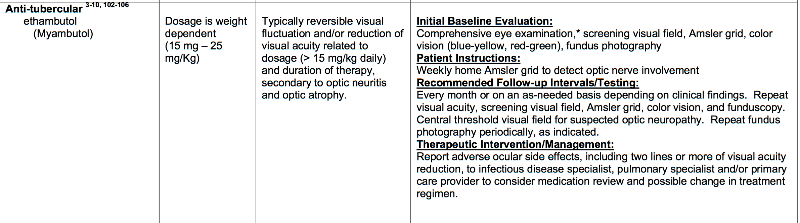
AOA Guidelines

Slide 19
51 y/o White Female
1st presented to OD practice 11/24/09 with blurred vision distance and near
  Also typical dry eye symptoms
Was noted to be on plaquenil 100 mg bid
BCVA: 20/40 each eye with myopic correction (~ -2.50)
Color Vision: 3/5
CVF: FTFC OU – screening perimetry done
Fundus: Normal, screening photo done
Patient Refused Dilation…

Slide 20
51 y/o White Female
Impression
Dry eye
Myopia, astigmatism, presbyopia
Amblyopia, unspecified
Long-term use of hgh risk medication (plauquenil)
RTC 1 yr

Slide 21
1 yr Later: 11/29/10
Pt complaining of blurred vision:
  Reading has become difficult, vision while driving is now impaired, Night-time vision is especially troublesome”
VA: 20/50, 20/30
BCVA: 20/30, 20/40
CVF: Full
Color: 3/5
Normal fundus – usual detail provided
  Pt not dilated

Slide 22
11/29/10
Impression
Amblyopia (368.0)
Long-Term use of high risk medication Plaquenil (V58.69)
Dry eye (375.15)
Plan
Pt counseled on the importance of monitoring as directed. Advised to wear sun protection out doors, consider OCT at next exam with DFE
RTC 1 year

Slide 23
2 Mo Later: 2/1/2011
“Can’t see distance or near”
BCVA: 20/30 each eye
New Rx made with wider seg, transitions

Slide 24
16 mo later: 6/14/2012
“Blurred vision, at all ranges, night blindness or difficulty.”
Entering VA: 20/40
BCVA: 20/30 OU
Fields: full, pupils normal
Color: 3/5
Fundus: seen with 90D, pupil dilation not ordered
  Macula normal

Slide 25
6/14/2012
Impression/Plan
Patient counseled on importance of monitoring as directed
Advised to wear sun correction
Consider OCT at next exam with DFE
…Glasses given, dry eye treated
RTC 1 year

Slide 26
5/23/2013
See’s other OD in community
  VA: 20/30 OU
Orders VF for the next week – 6/10/2013
  Patient returns as directed

Slide 27
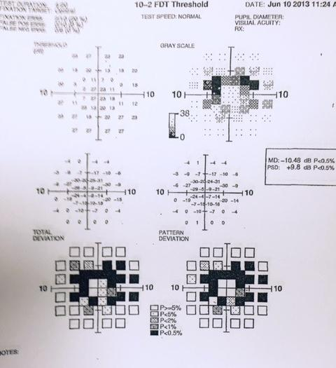
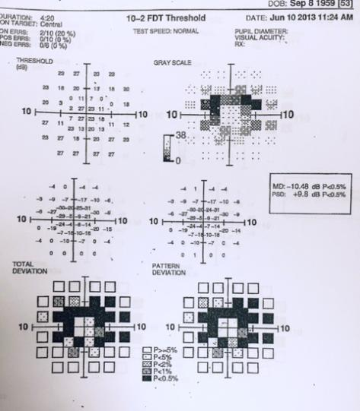

Slide 28
What Went Wrong?

Slide 29
What are your obligations for managing a patient on plaquenil?
What is the risk of having ocular problems from plaquenil?
What testing is necessary?
How often do you need to follow her?

Slide 30
Plaquenil (Hydroxychloroquine)
Prescribed in 200 mg tablets
  Dose is 200mg or 400mg daily
Risks for macular damage include
  Cumulative dose of 1000g
  5-7 years or more of use
    1% risk after 1000g total dose (7 years)
  Renal or hepatic dysfunction (both)
  Pre-existing macular pathology
  Short stature / obesity Age

Slide 31
Plaquenil Screening: Traditionally
Baseline macula photos
Color vision testing
Amsler grid
10-2 Visual fields
Yearly exams

Slide 32
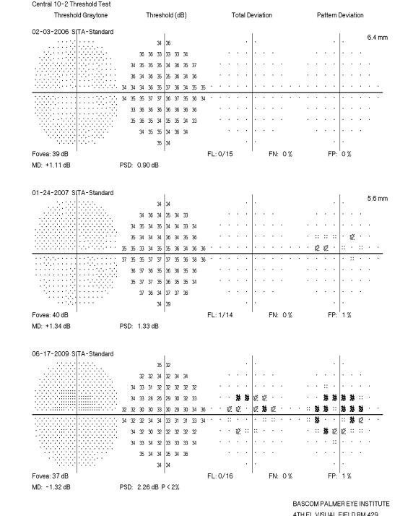
Paracentral Scotomas

Slide 33
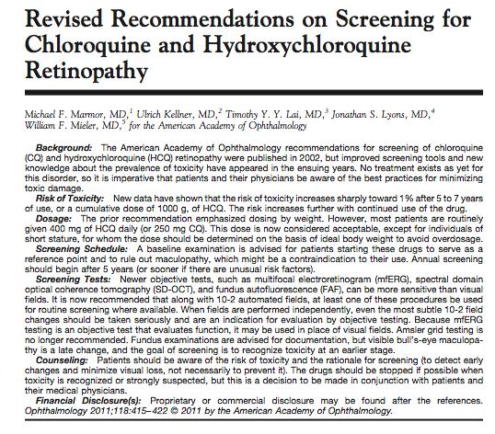
Feb 2011

Slide 34
Revised Recommendations on Screening for Plaquenil Toxicity
Amsler grid testing removed as an acceptable screening technique
  NOT equivalent to threshold VF testing
Strongly advised that 10-2 VF screening be supplemented with sensitive objective tests such as:
  Multifocal ERG
  Spectral domain OCT
  Fundus autofluorescence

Slide 35
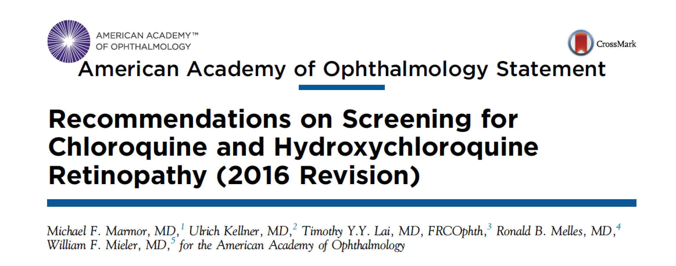
June 2016

Slide 36
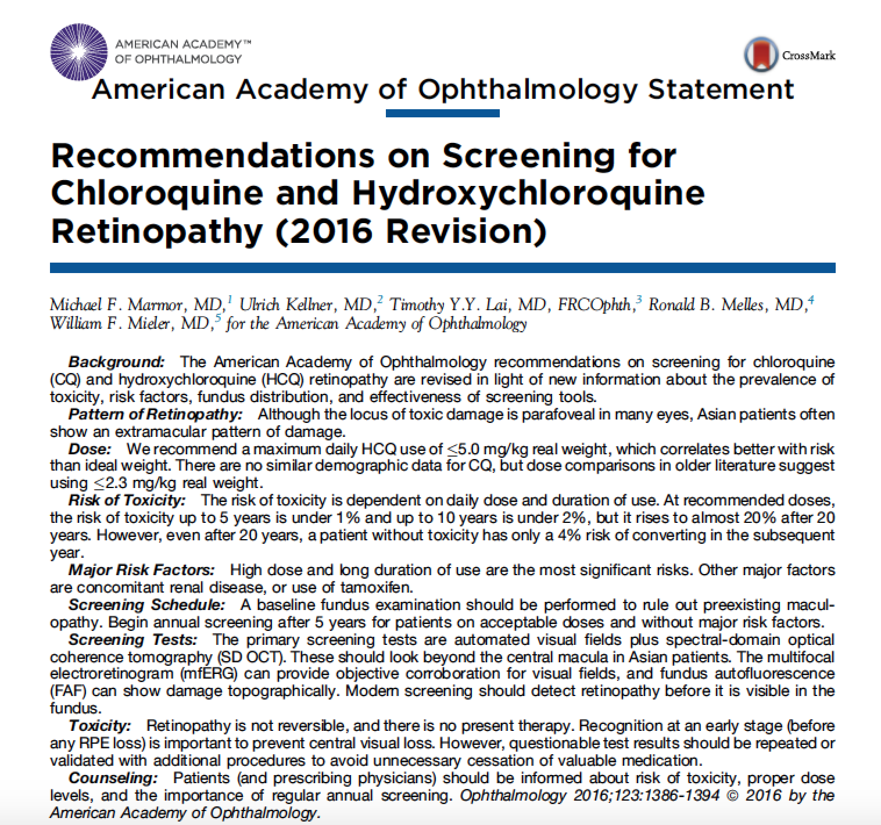

Slide 37
Revised Recommendations on Screening for Plaquenil Toxicity
Amsler grid testing removed as an acceptable screening technique
  NOT equivalent to threshold VF testing
Strongly advised that 10-2 VF screening be supplemented with sensitive objective tests such as:
  Multifocal ERG
  Spectral domain OCT
  Fundus autofluorescence
Ophth Feb 2011
June 2016

Slide 38
Baseline exam performed
Begin screening after 5 years on acceptable doses without major risk factors
Risk factors include concomitant renal disease and use of tamoxifen

Slide 39
Revised Recommendations on Screening for Plaquenil Toxicity
SD-OCT can show localized thinning of the parafoveal retinal layers confirming toxicity
  May be unable to see with TD-OCT
  Changes may be visible prior to VF defects
FAF may reveal subtle RPE defects with reduced autofluorescence
MF-ERG can objectively document localized paracentral ERG depression in early retinopathy

Slide 40
Revised Recommendations on Screening for Plaquenil Toxicity
Parafoveal loss of visual sensitivity may appear before changes are seen on fundus evaluation
Many instances where retinopathy was unrecognized for years as field changes were dismissed as “non-specific” until the damage was severe
  10-2 VF should always be repeated promptly when central or parafoveal changes are observed to determine if they are repeatable

Slide 41
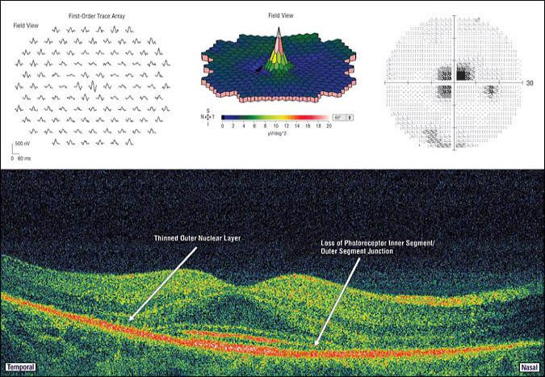

Mild Retinopathy
Rodriguez-Padilla, J. A. et al. Arch Ophthalmol 2007;125:775-780.

Slide 42
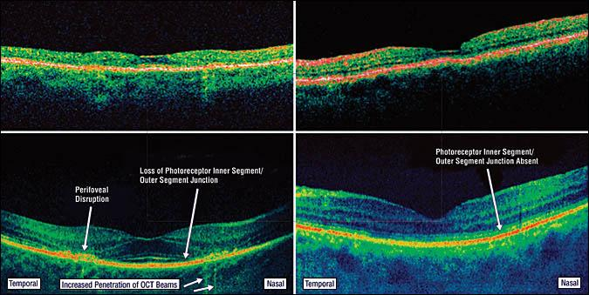
Comparison of Stratus (upper panels) and Cirrus (lower panels) in 2 patients with hydroxychloroquine toxicity
Rodriguez-Padilla, J. A. et al. Arch Ophthalmol 2007;125:775-780.

Slide 43
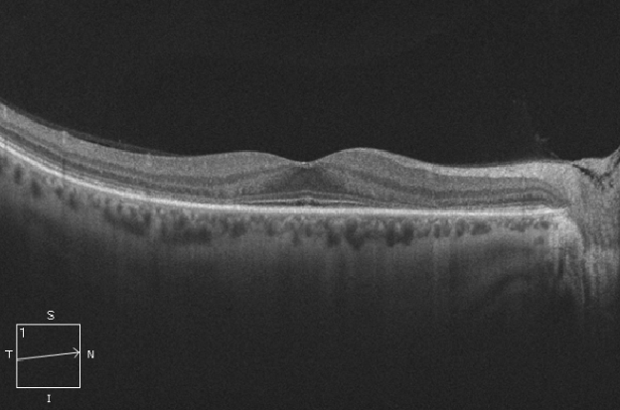
Plaquenil Toxicity

Slide 44
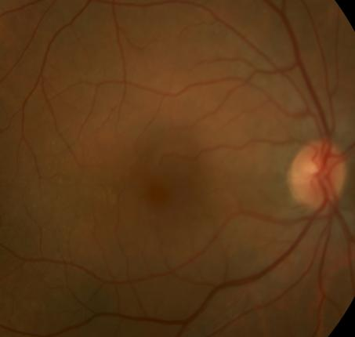
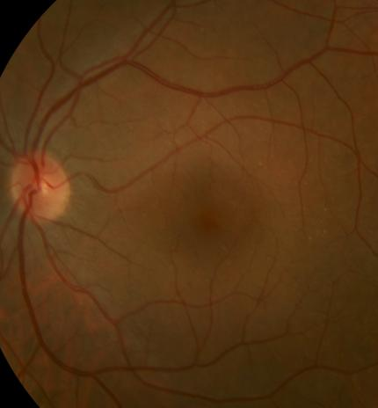
Plaquenil Toxicity
1/13/2010

Slide 45
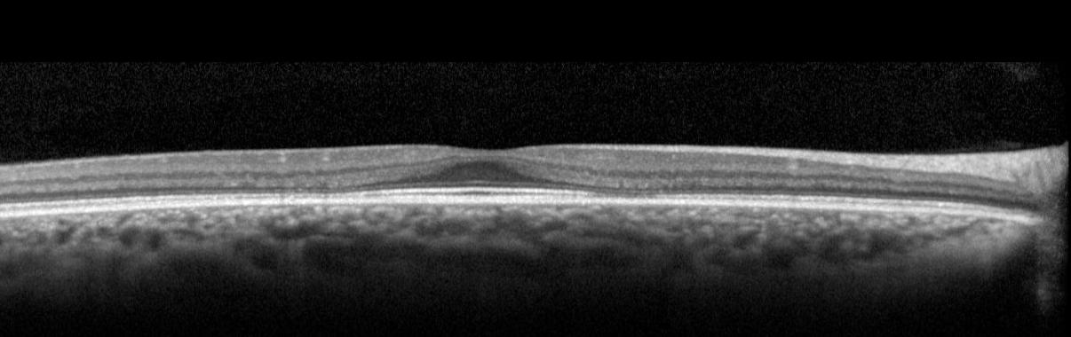
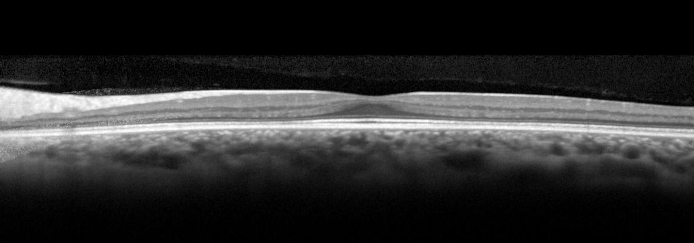

Slide 47
Paracentral Scotomas

Slide 48
Revised recommendations on screening for retinopathy
Older literature focused on daily dose/kg
Newer literature emphasizes cumulative dose as the most critical factor
Initial baseline
    Within 1 year of beginning medication
  Then screening for toxicity should be initiated no later than 5 years after starting the medication

Slide 49
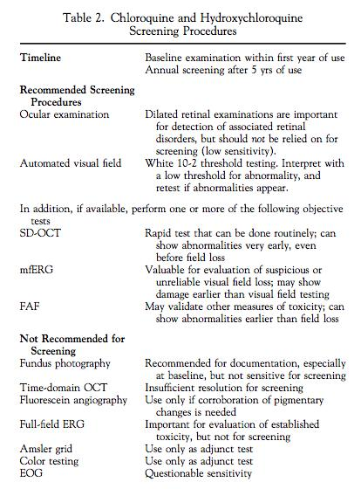
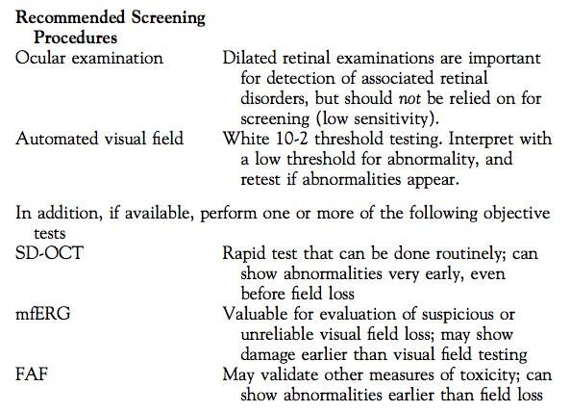

Slide 50
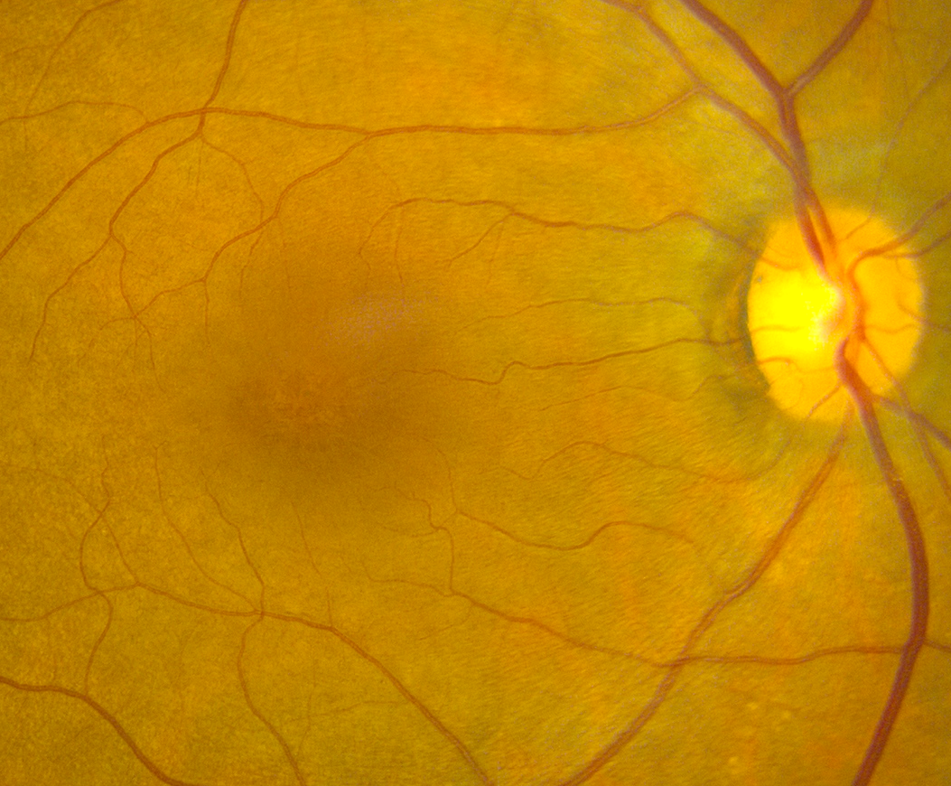
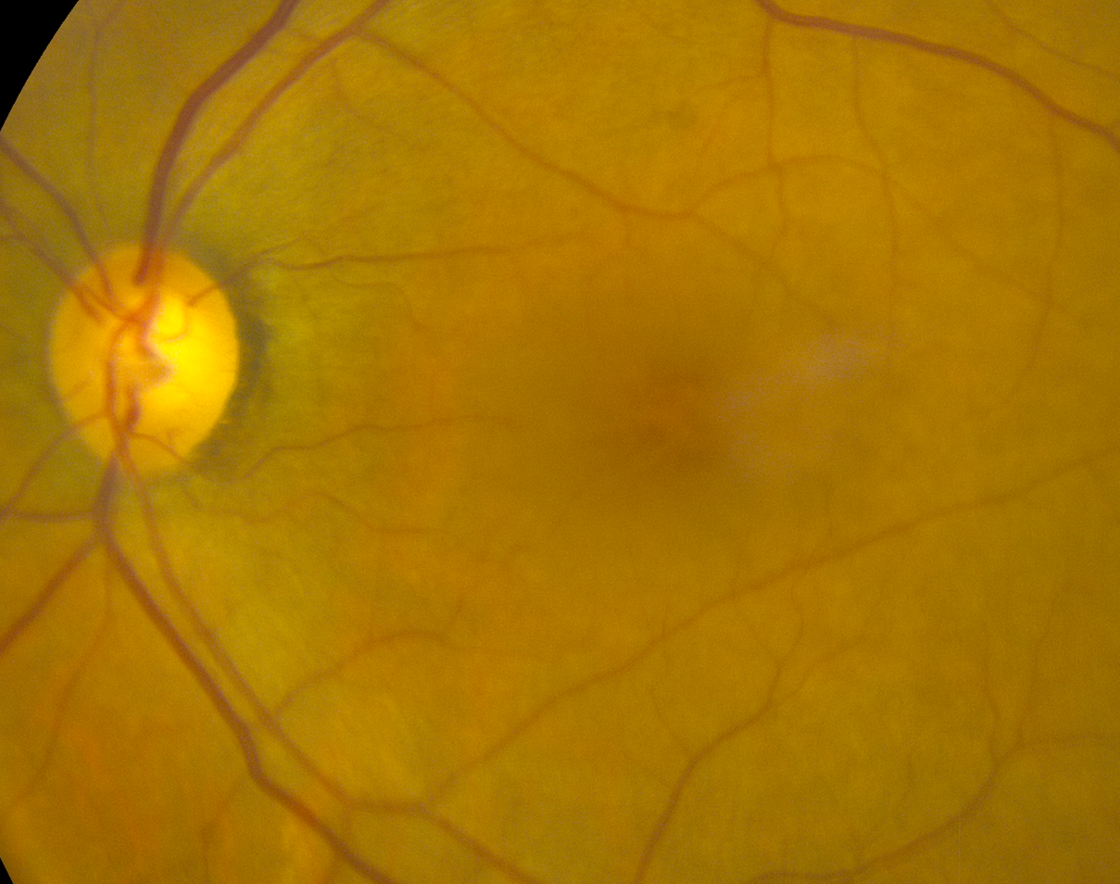
65 y/o Hispanic Female
History of Metastatic Beast Ca
On Chemo: Abraxane, Gemzar
Blurred VA OU X 2 mo

Slide 51
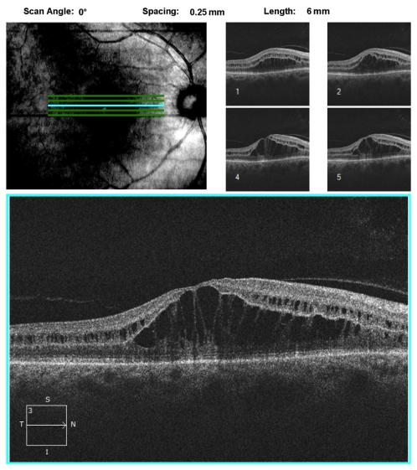
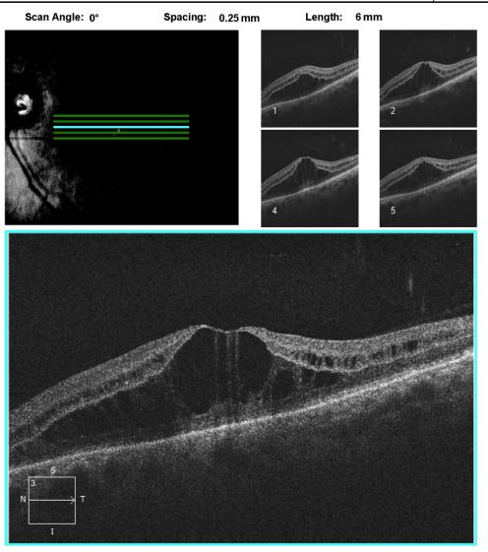
SDOCT

Slide 52
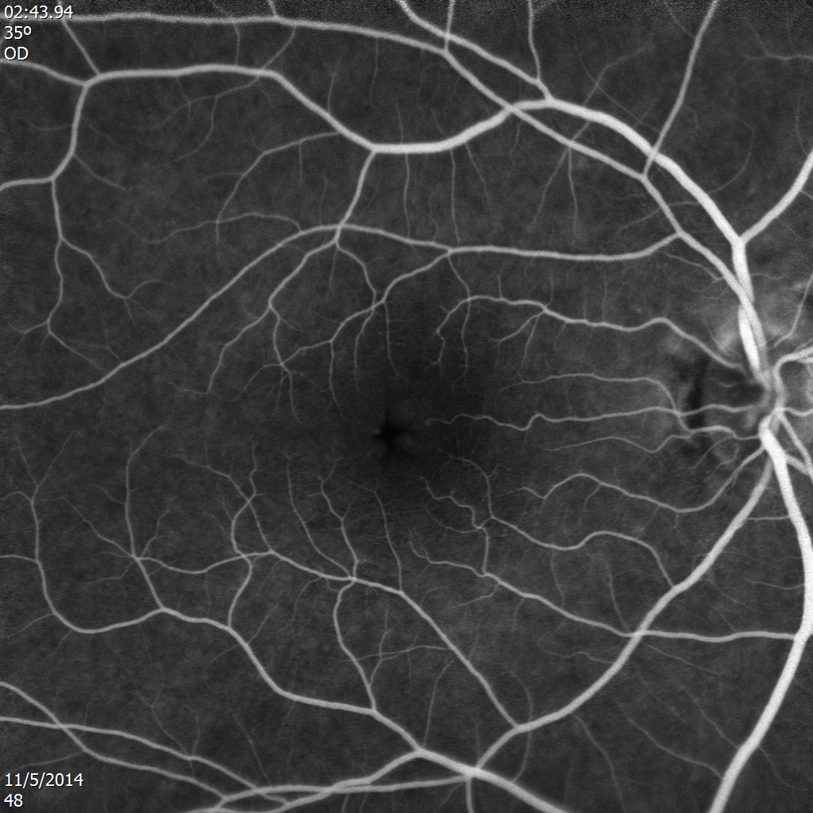
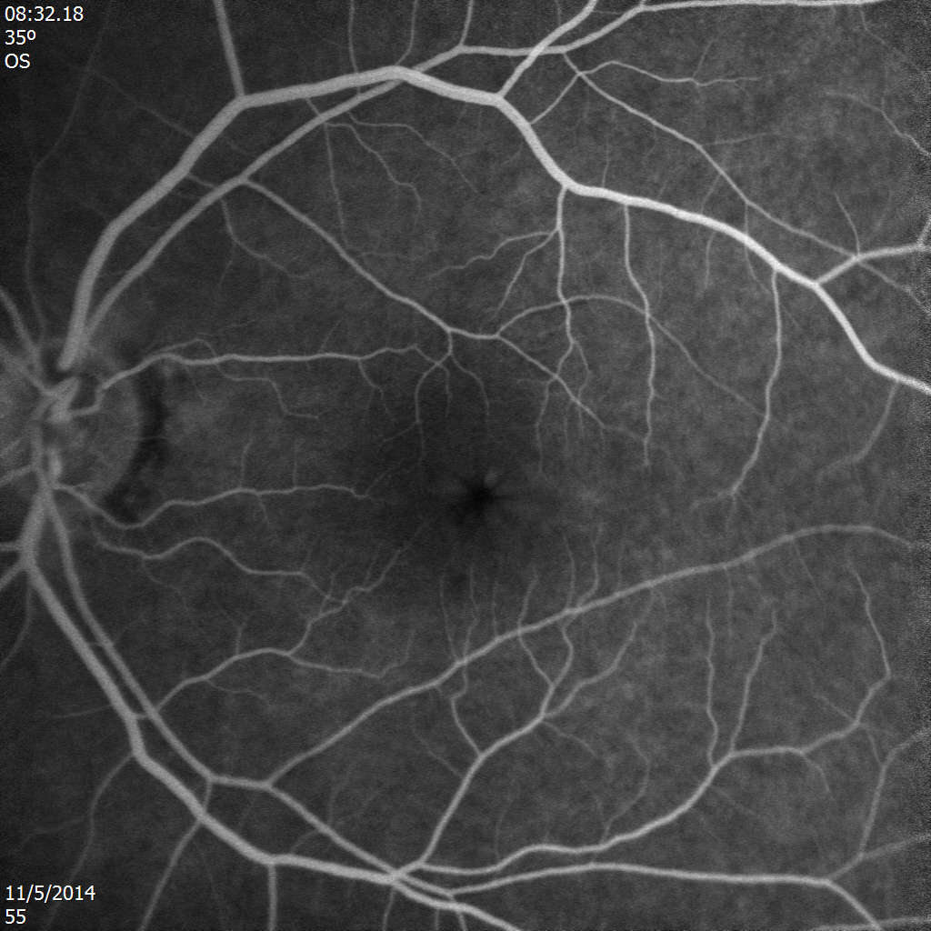
Late Fluorescein Angiogram

Slide 53
Impression
Severe Non-Staining CME
No Pertinent Ocular History to Explain
Lets look at the literature:

Slide 54
Abraxane (Paclitaxel)
Member of the “taxane family” of microtubule stabilizing agents that has demonstrated clinical efficacy in multiple human malignancies¹
Toxic effects to bone marrow is the predominant adverse effect
Ophthalmic adverse effects include: decreased vision, scintillating scotomas, and abnormal VEP’s.
Non-staining CME was 1st reported in 2007 and other cases have since been reported.
Joshi MM, Garretson BR. Paclitaxel maculopathy. Arch Ophthalmol. 2007;125:709–710.

Slide 55
What Does Evidence Based Medicine Mean to You?

Slide 56
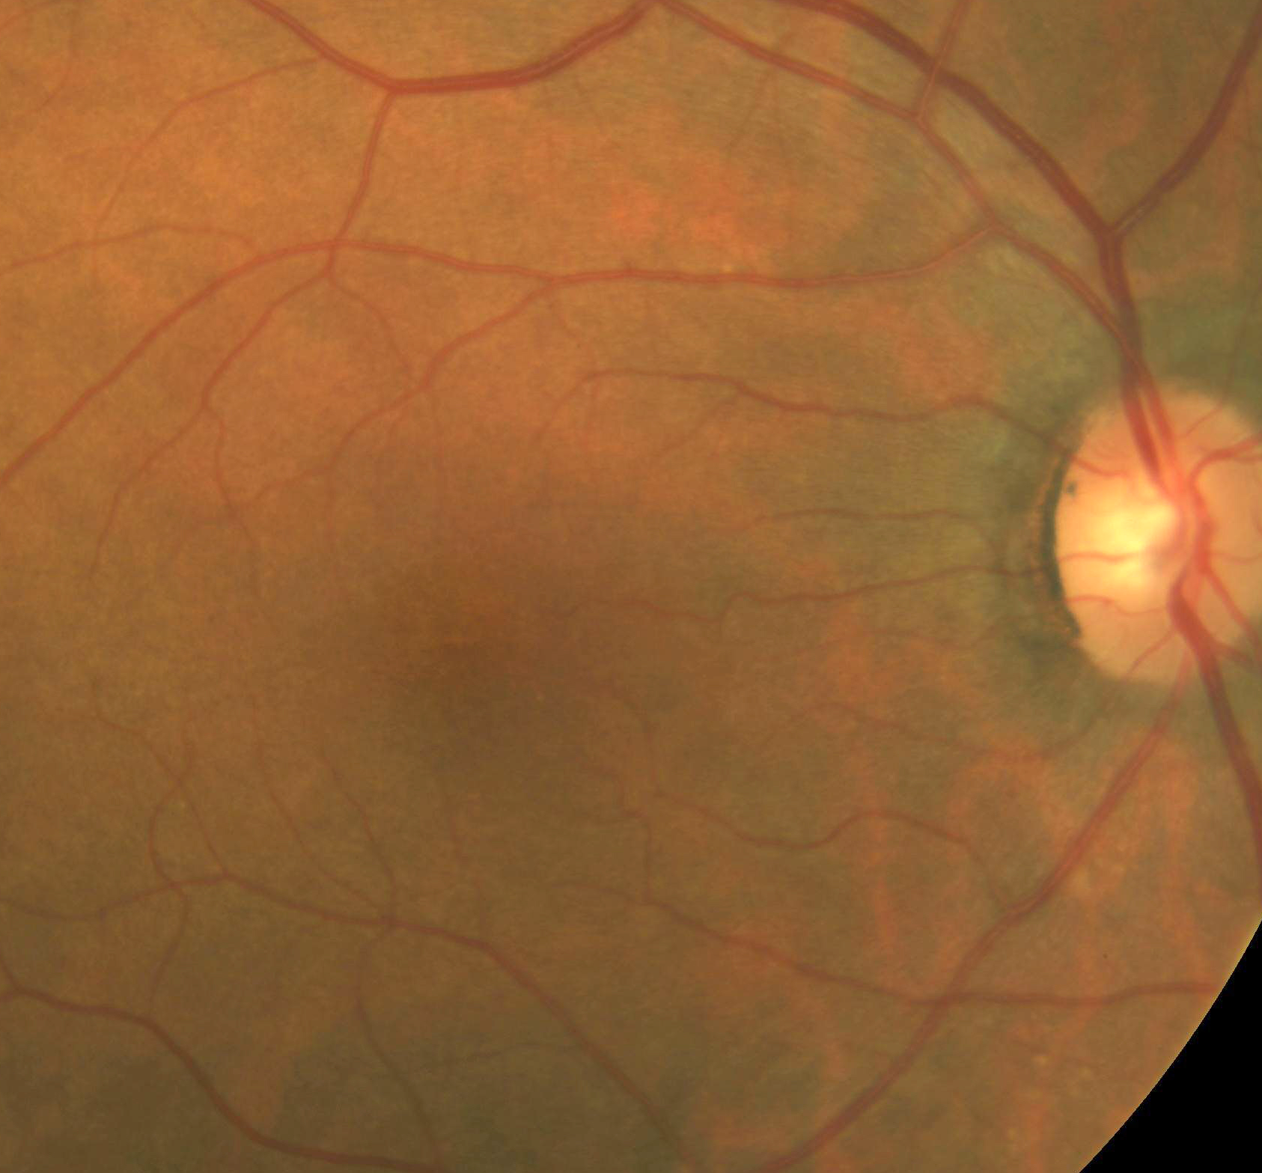
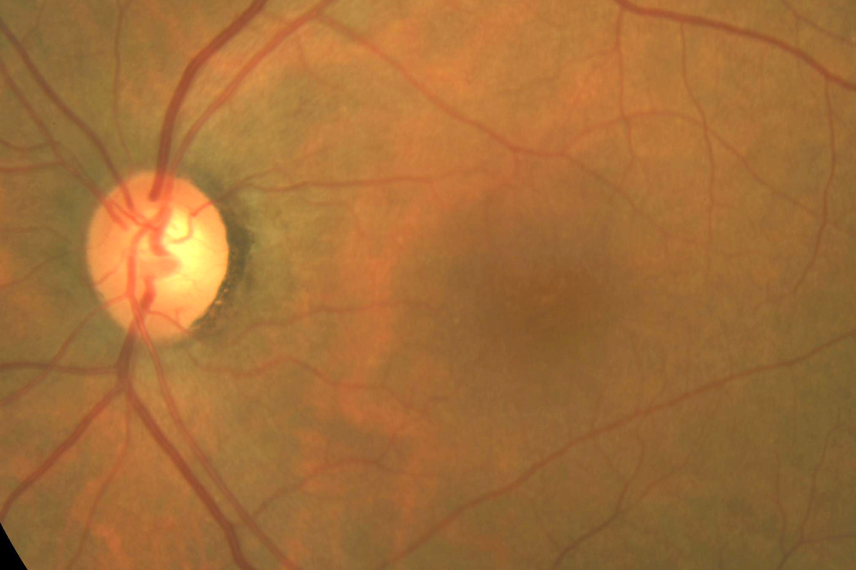
Follow Up
Informed oncologist and medications stopped
  Different medications started
CME Resolved and Vision Returned to 20/25 OU

Slide 57
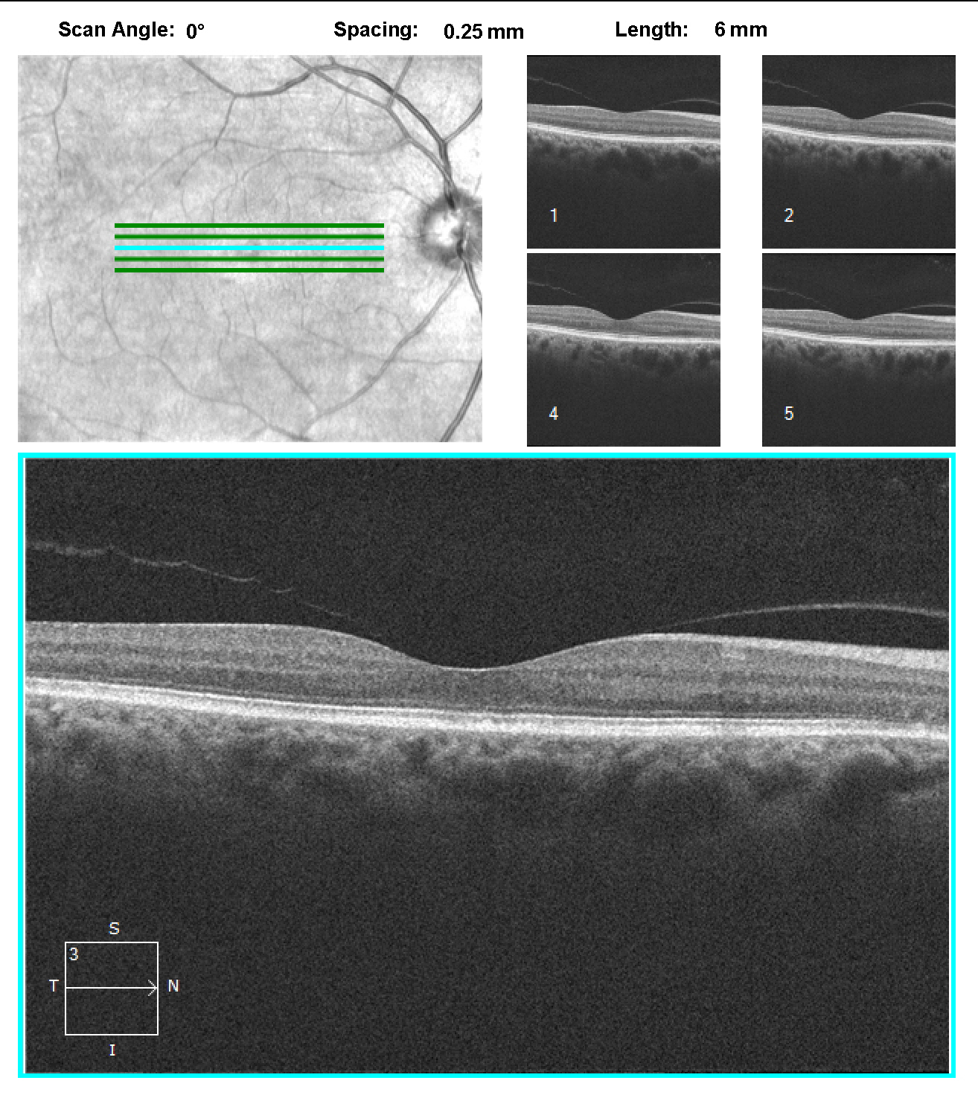
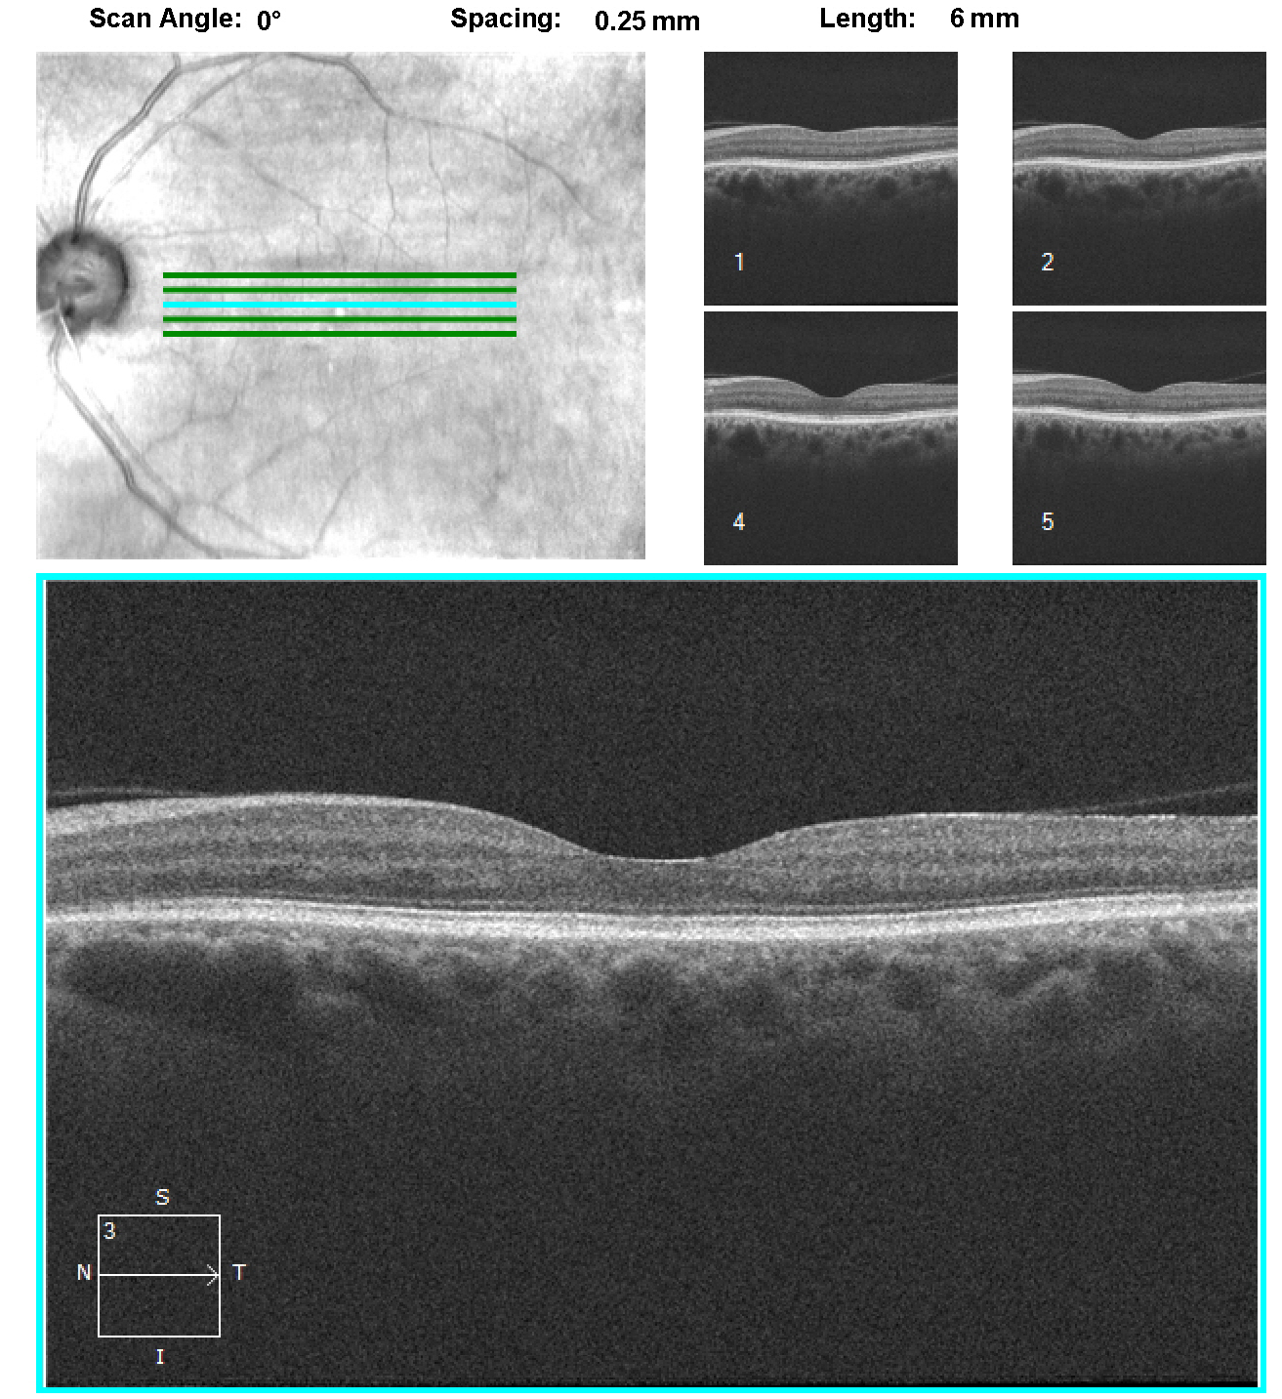

Slide 58
What is the class of drugs used to treat hepatitis and multiple sclerosis?

Slide 59
57 y/o White Female
Presented on 2/29/08 with decreased vision, near > distance
2º CC: can my medicine affect my eyes
  Meds
    Pegasys
    Copegus
    Visine prn
LEE: 1970’s

Slide 60
Patient History
Social Hx
1 pack/day tobacco usage X 40 yrs
20 drinks/day x 40 yrs, quit 2007 in AA
IV drug usage X 10 yrs, quit 1970

Slide 61
Patient History
Ocular Hx
Punched in her eyes
Penetration of tree bark into eye socket
Metal fragments in eyes
No glasses
Medical Hx
Hepatitis C (2006)
ADHD
MVA (2000) resulting in positional vertigo
Basal cell carcinoma X 3 (arm, chest)

Slide 62
Clinical Exam
BCVA: 20/20 OD (+1.25 DS), +2.00 add
20/20 OS (+1.25 DS)
Confrontation: FTFC OU
EOM: full
External: unremarkable
Pupils: 3 mm OU, PERRL, (-) APD
BP: 133/79 mmHg @ 3:00p

Slide 63
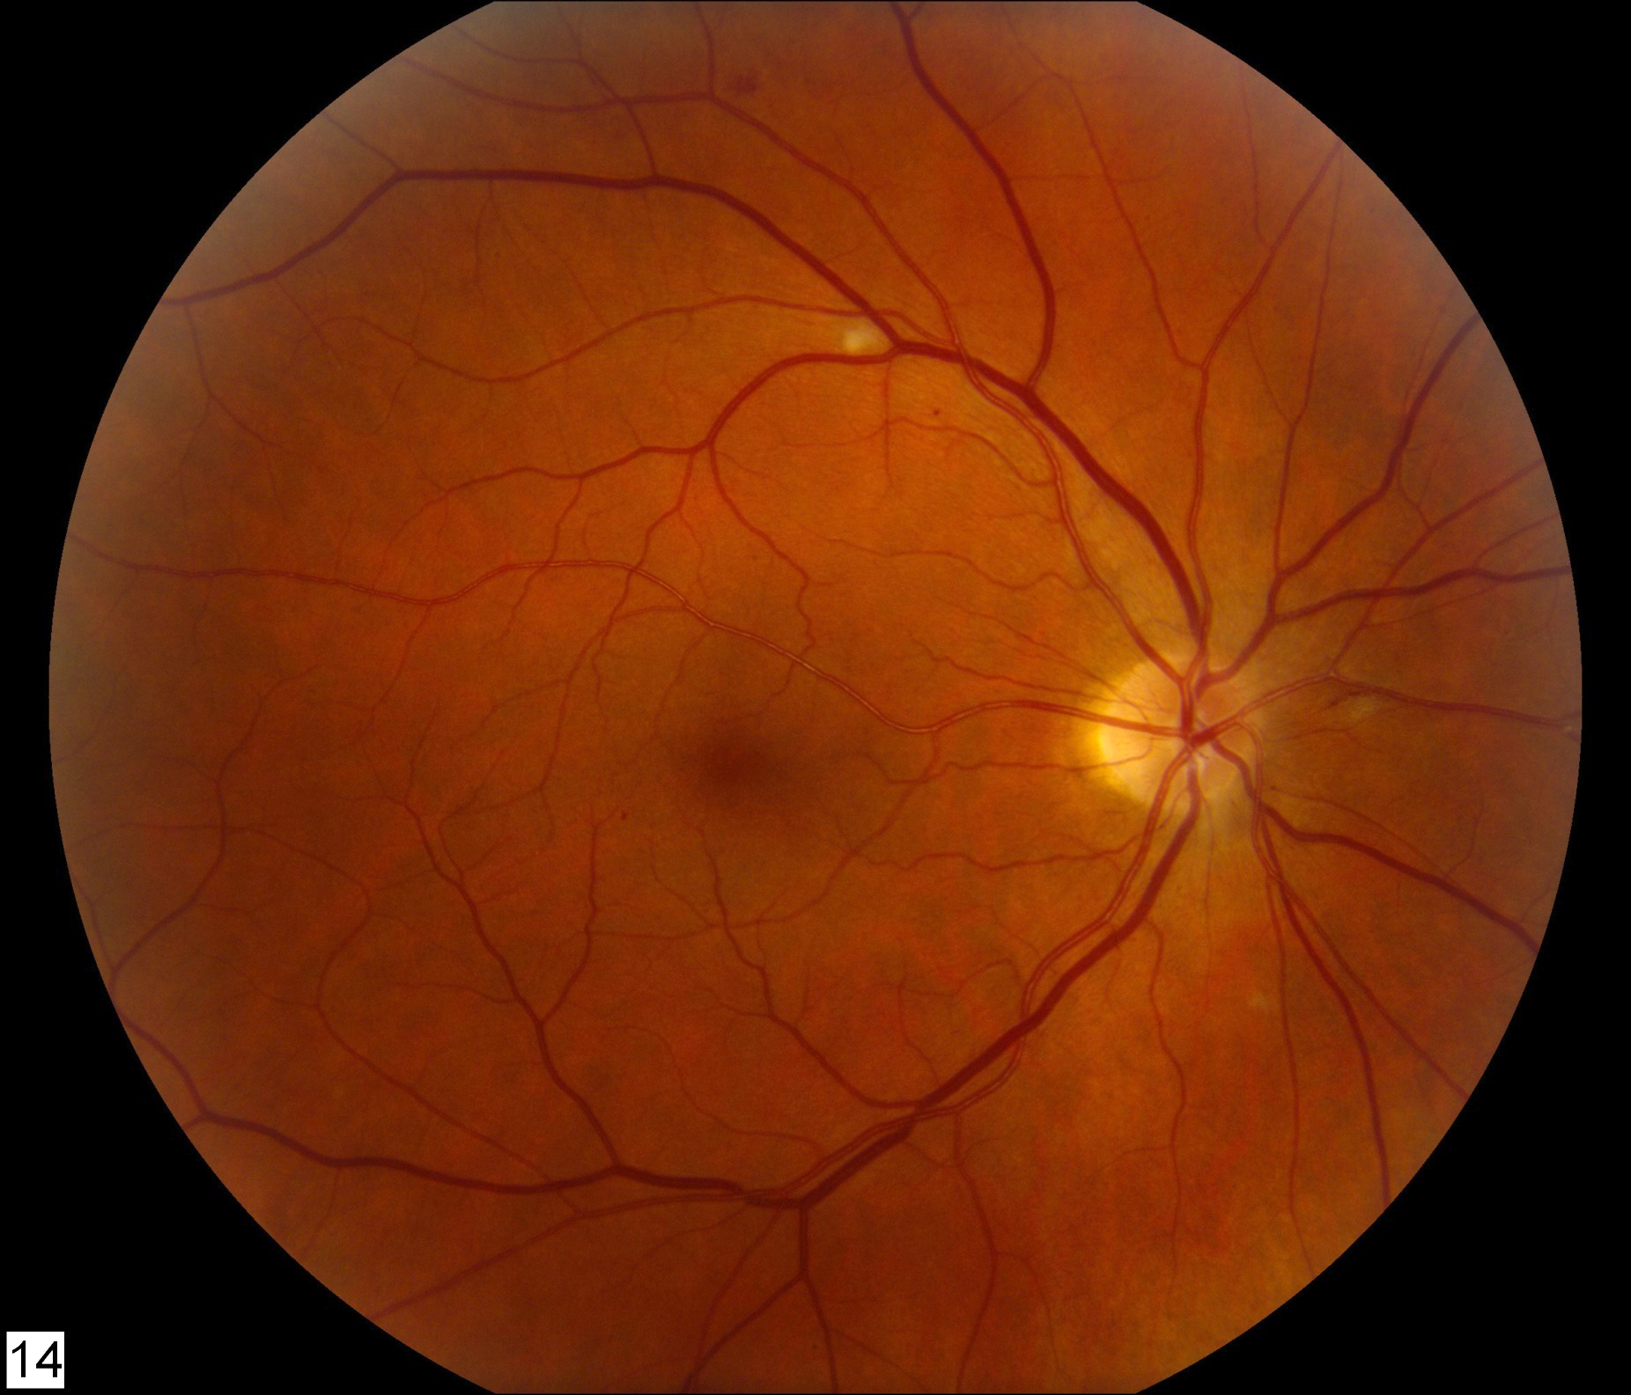
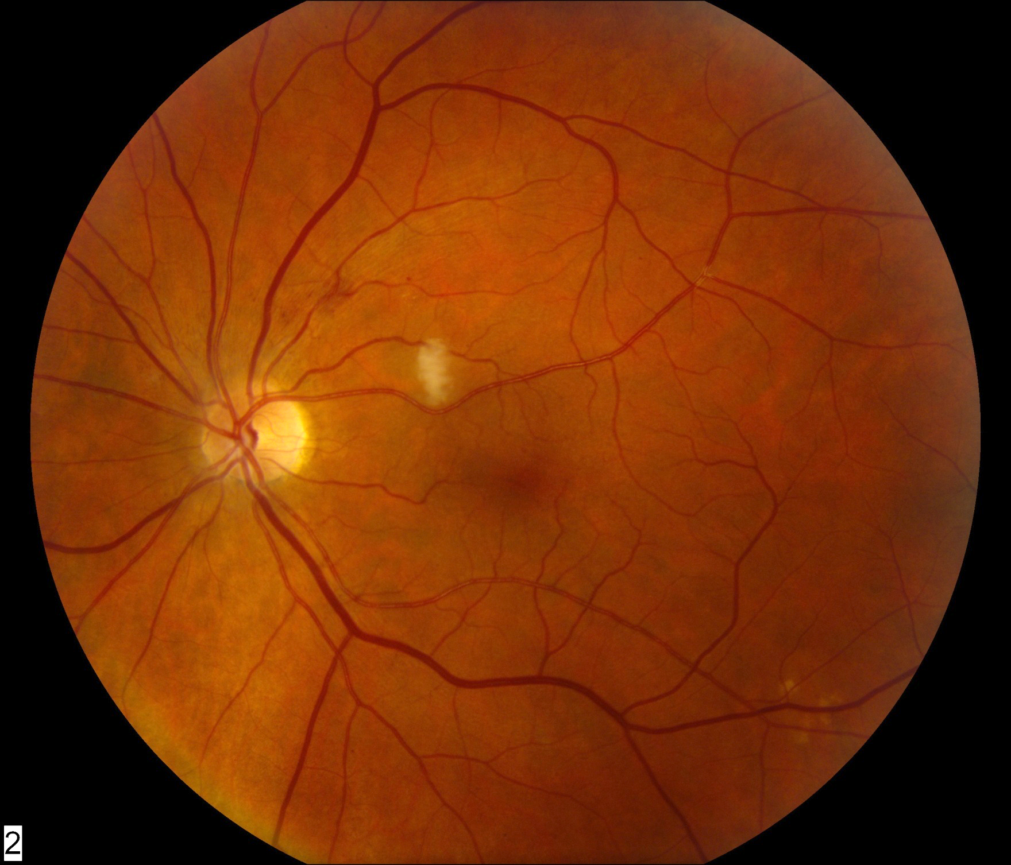
Fundus Photos

Slide 66
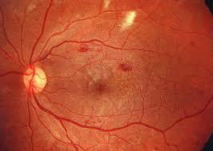
Interferons
(Intron A/Avonex/Pegasys)
Interferons
  Delayed type hypersensitivity reaction.
  In many infectious and systemic diseases, the deposition of immune complexes with subsequent complement activation is a major pathogenic mechanism for the development of uveitis
Ocular Side Effects:
Cotton wool spots
Optic neuritis
Ocular pain
Conjunctivitis
Pronounced dry eye
Dilated Eye exam prior to treatment and 2-4 weeks after treatments

Slide 67
“The vision in the upper right corner of my field of vision is missing…”

Slide 68
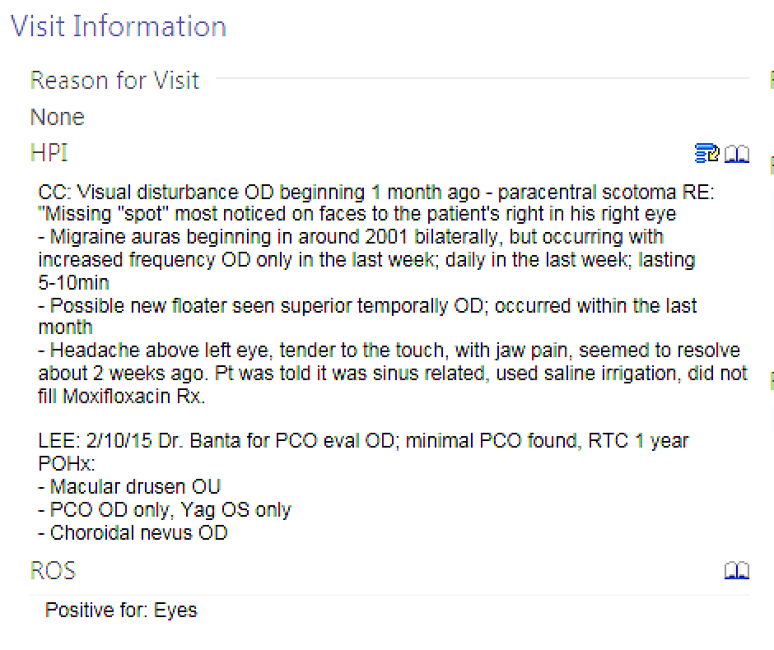
Mr. Martin
December 2015
Visual disturbance began
1 mo ago – paracentral scotoma RE: “Missing spot” most noticed on faces to the patients right in his right eye

Slide 69
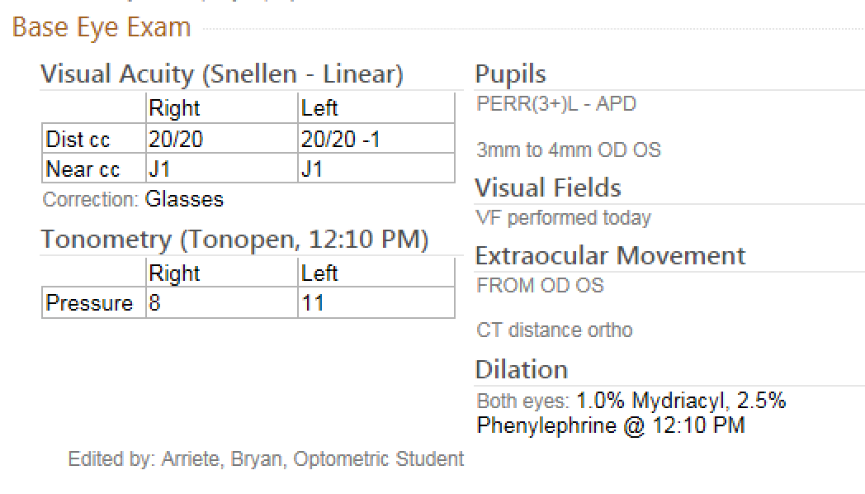

Slide 70
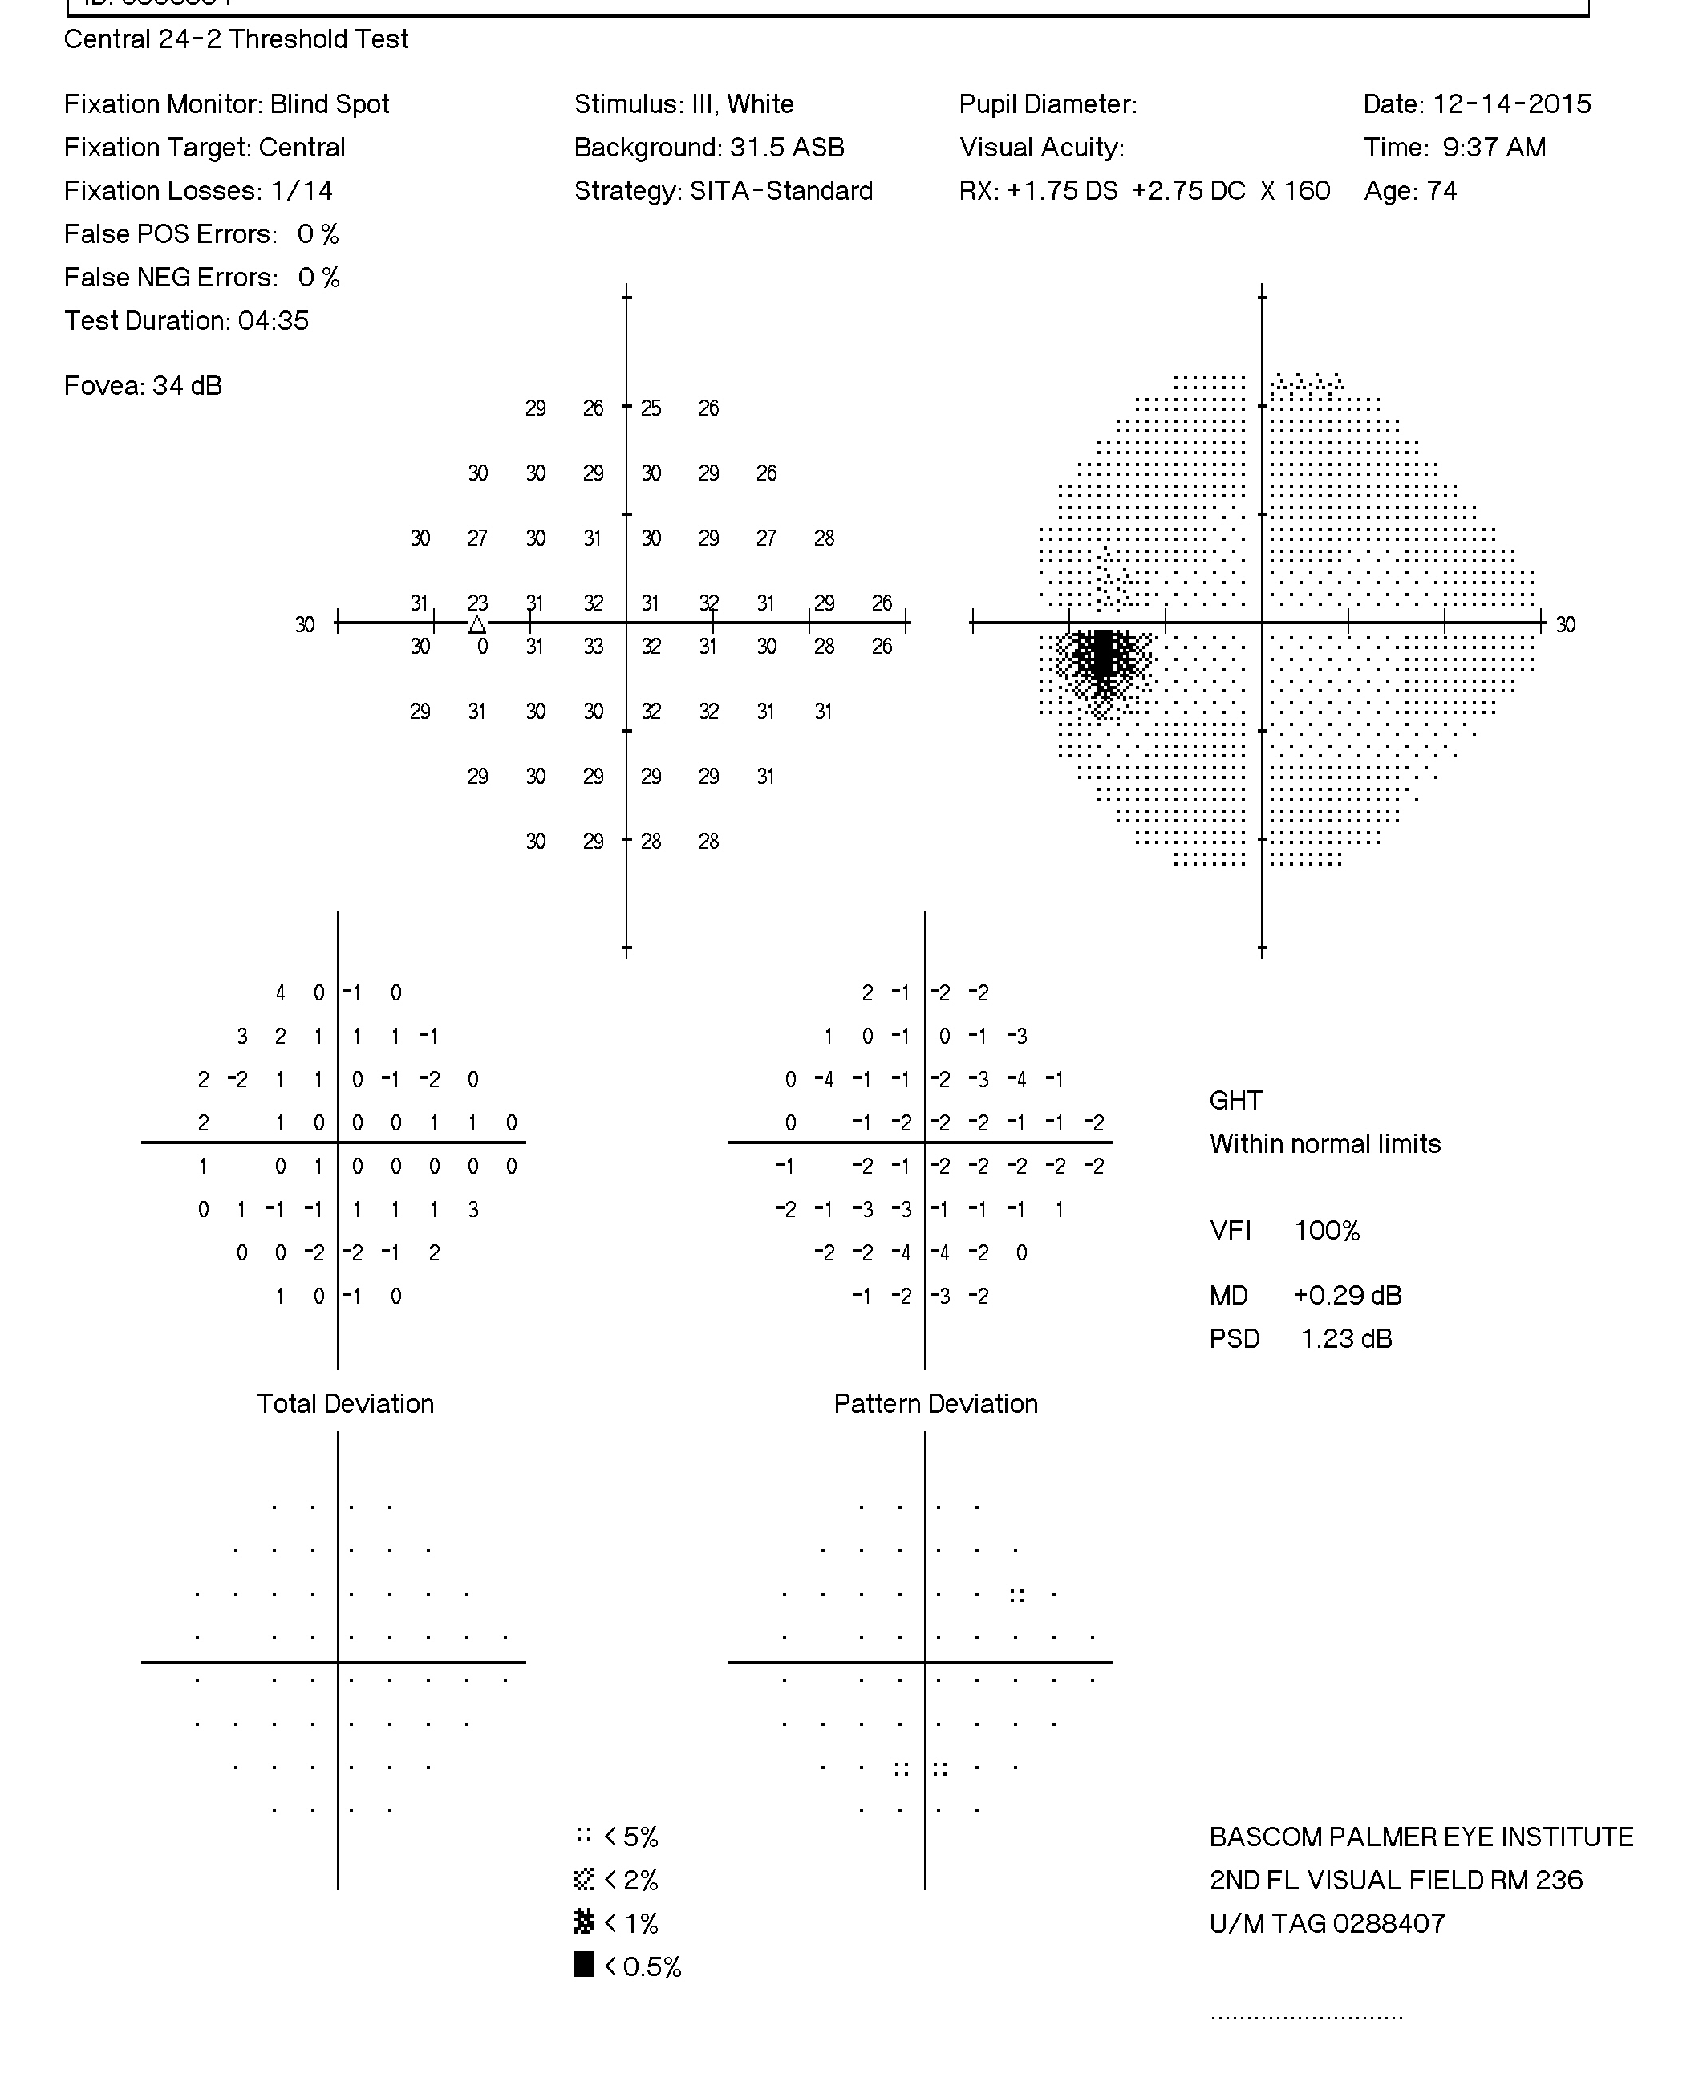
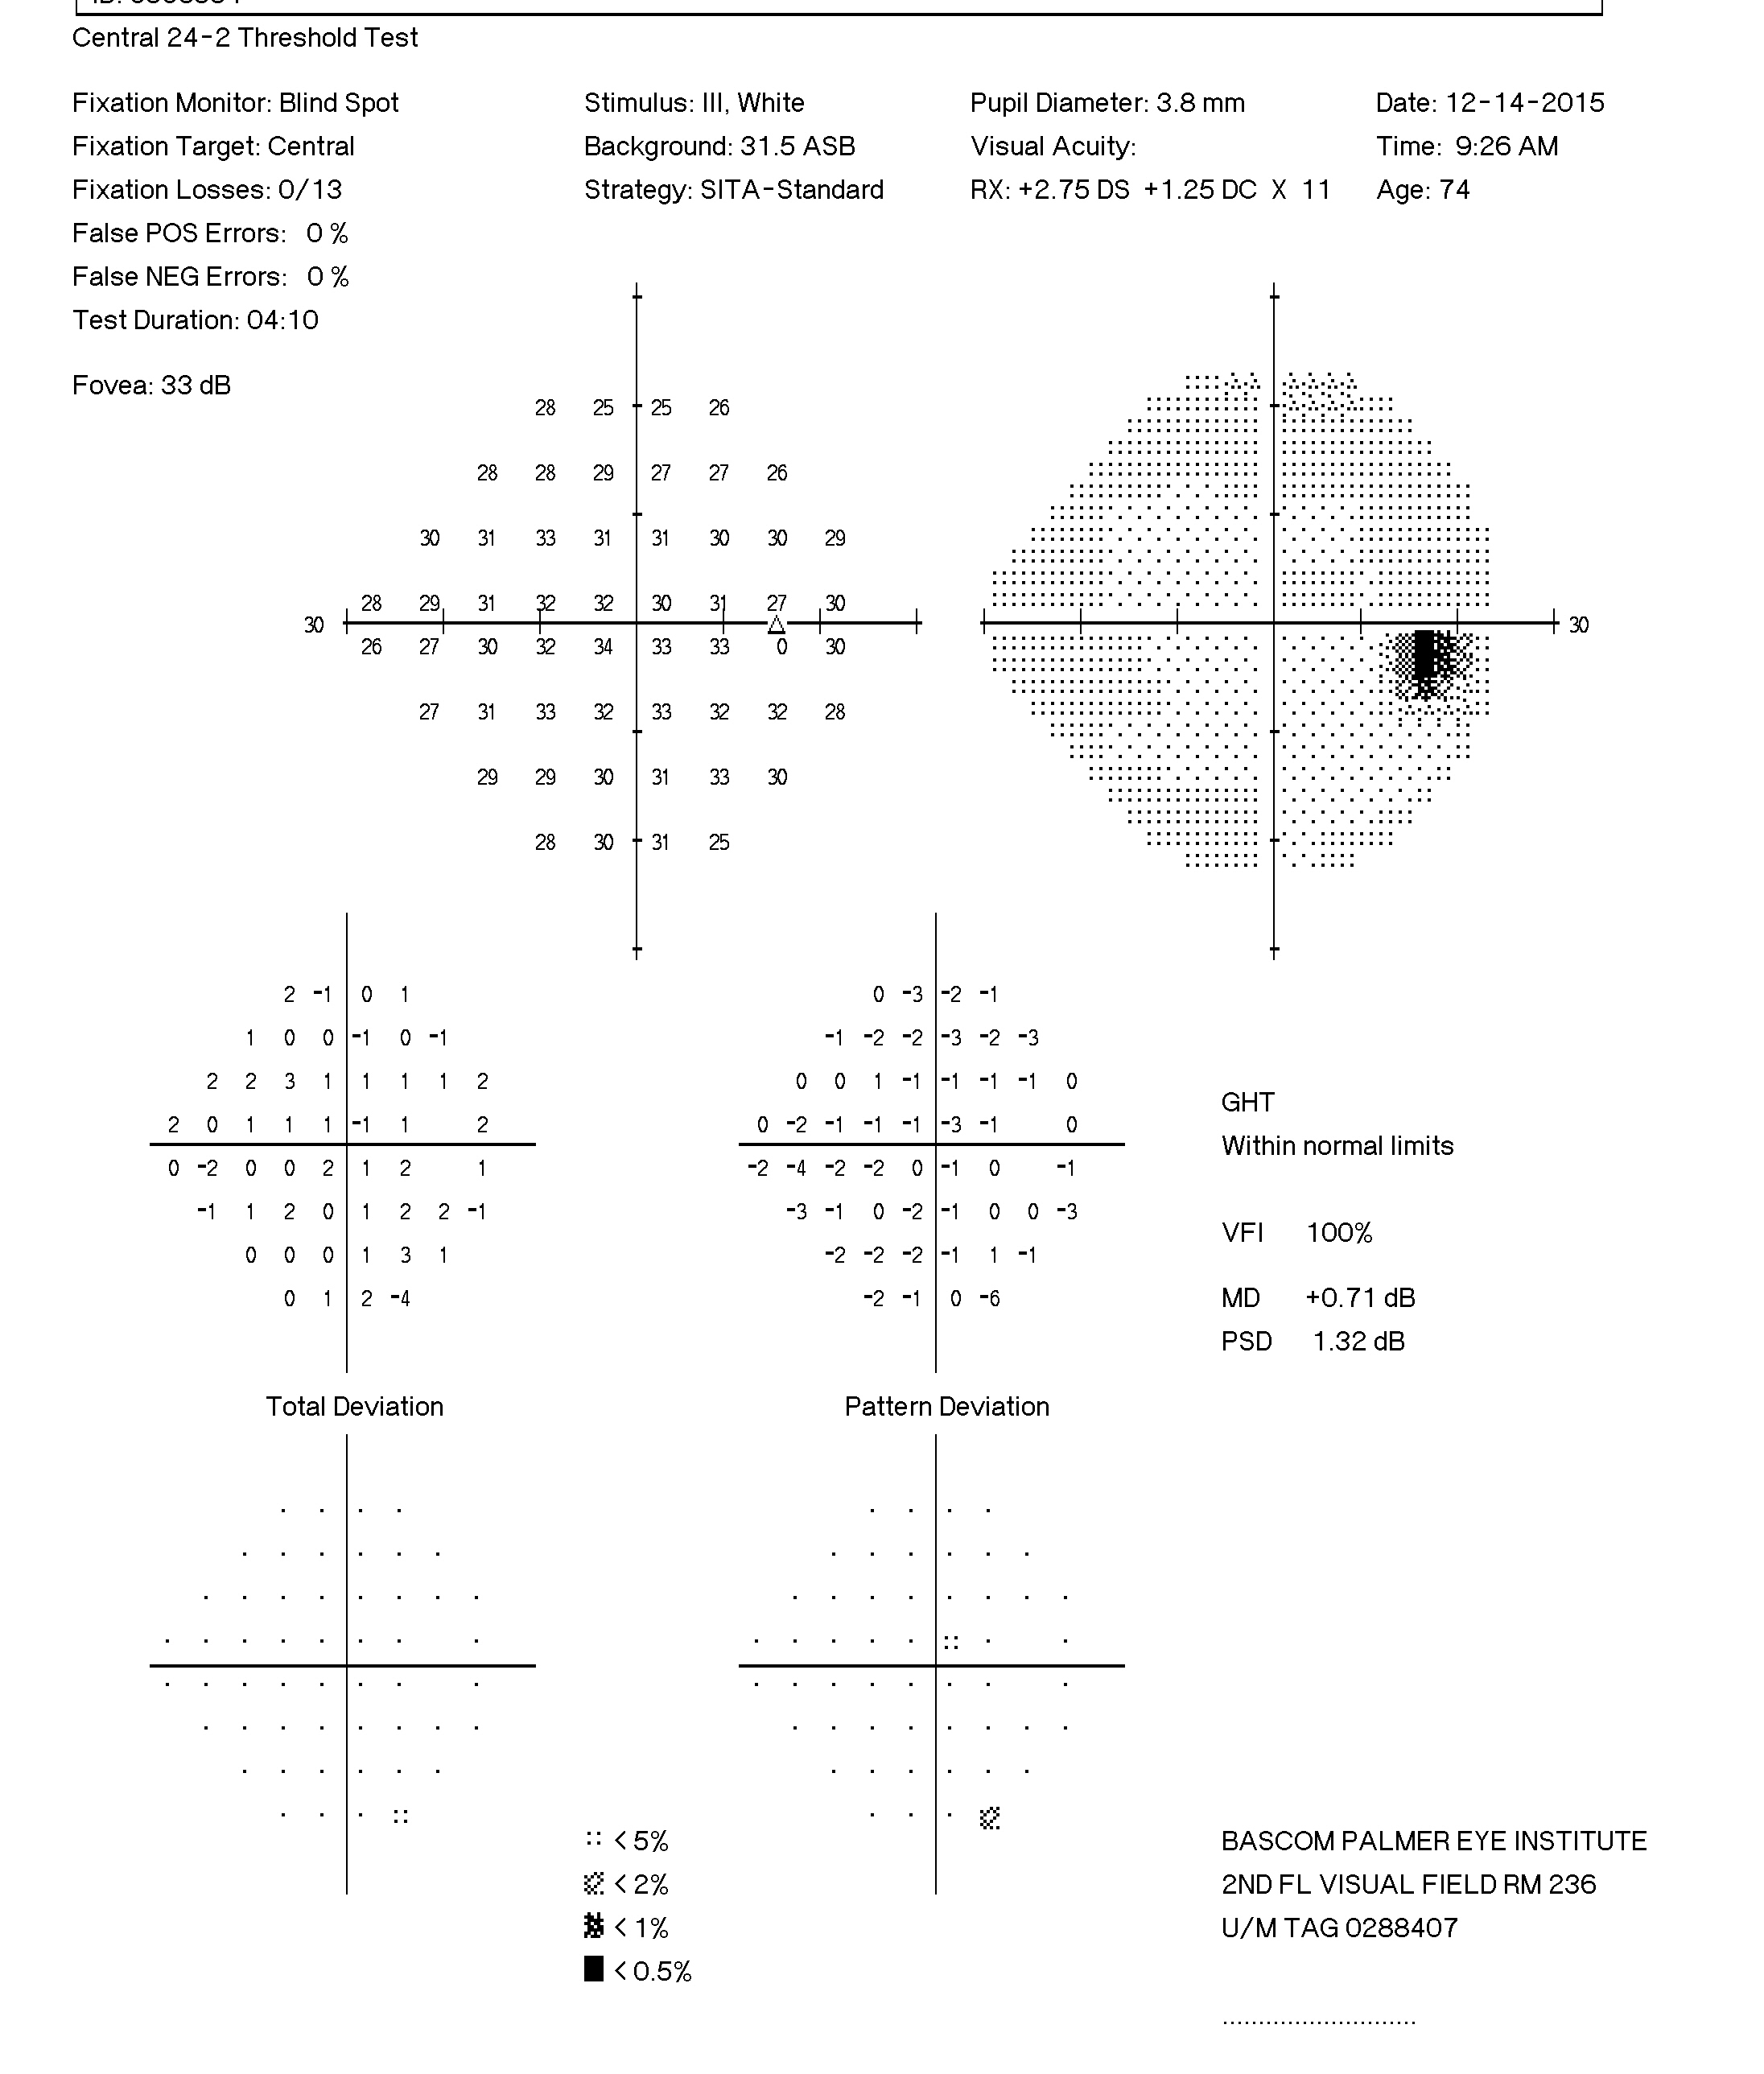
12/14/2015

Slide 71
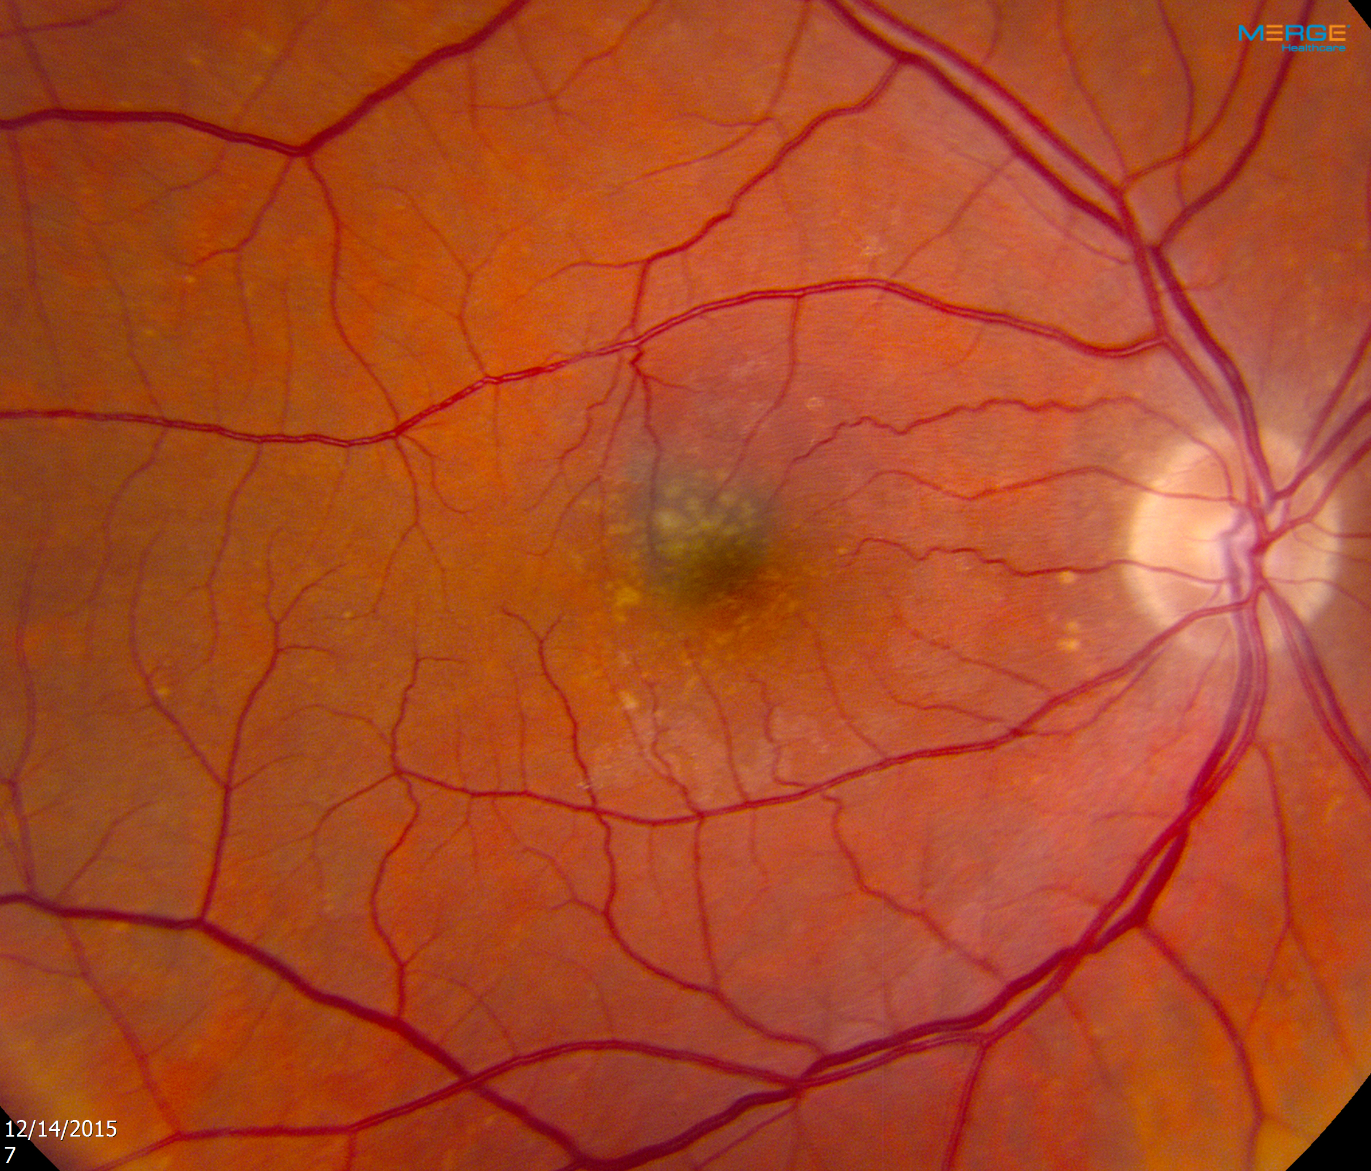
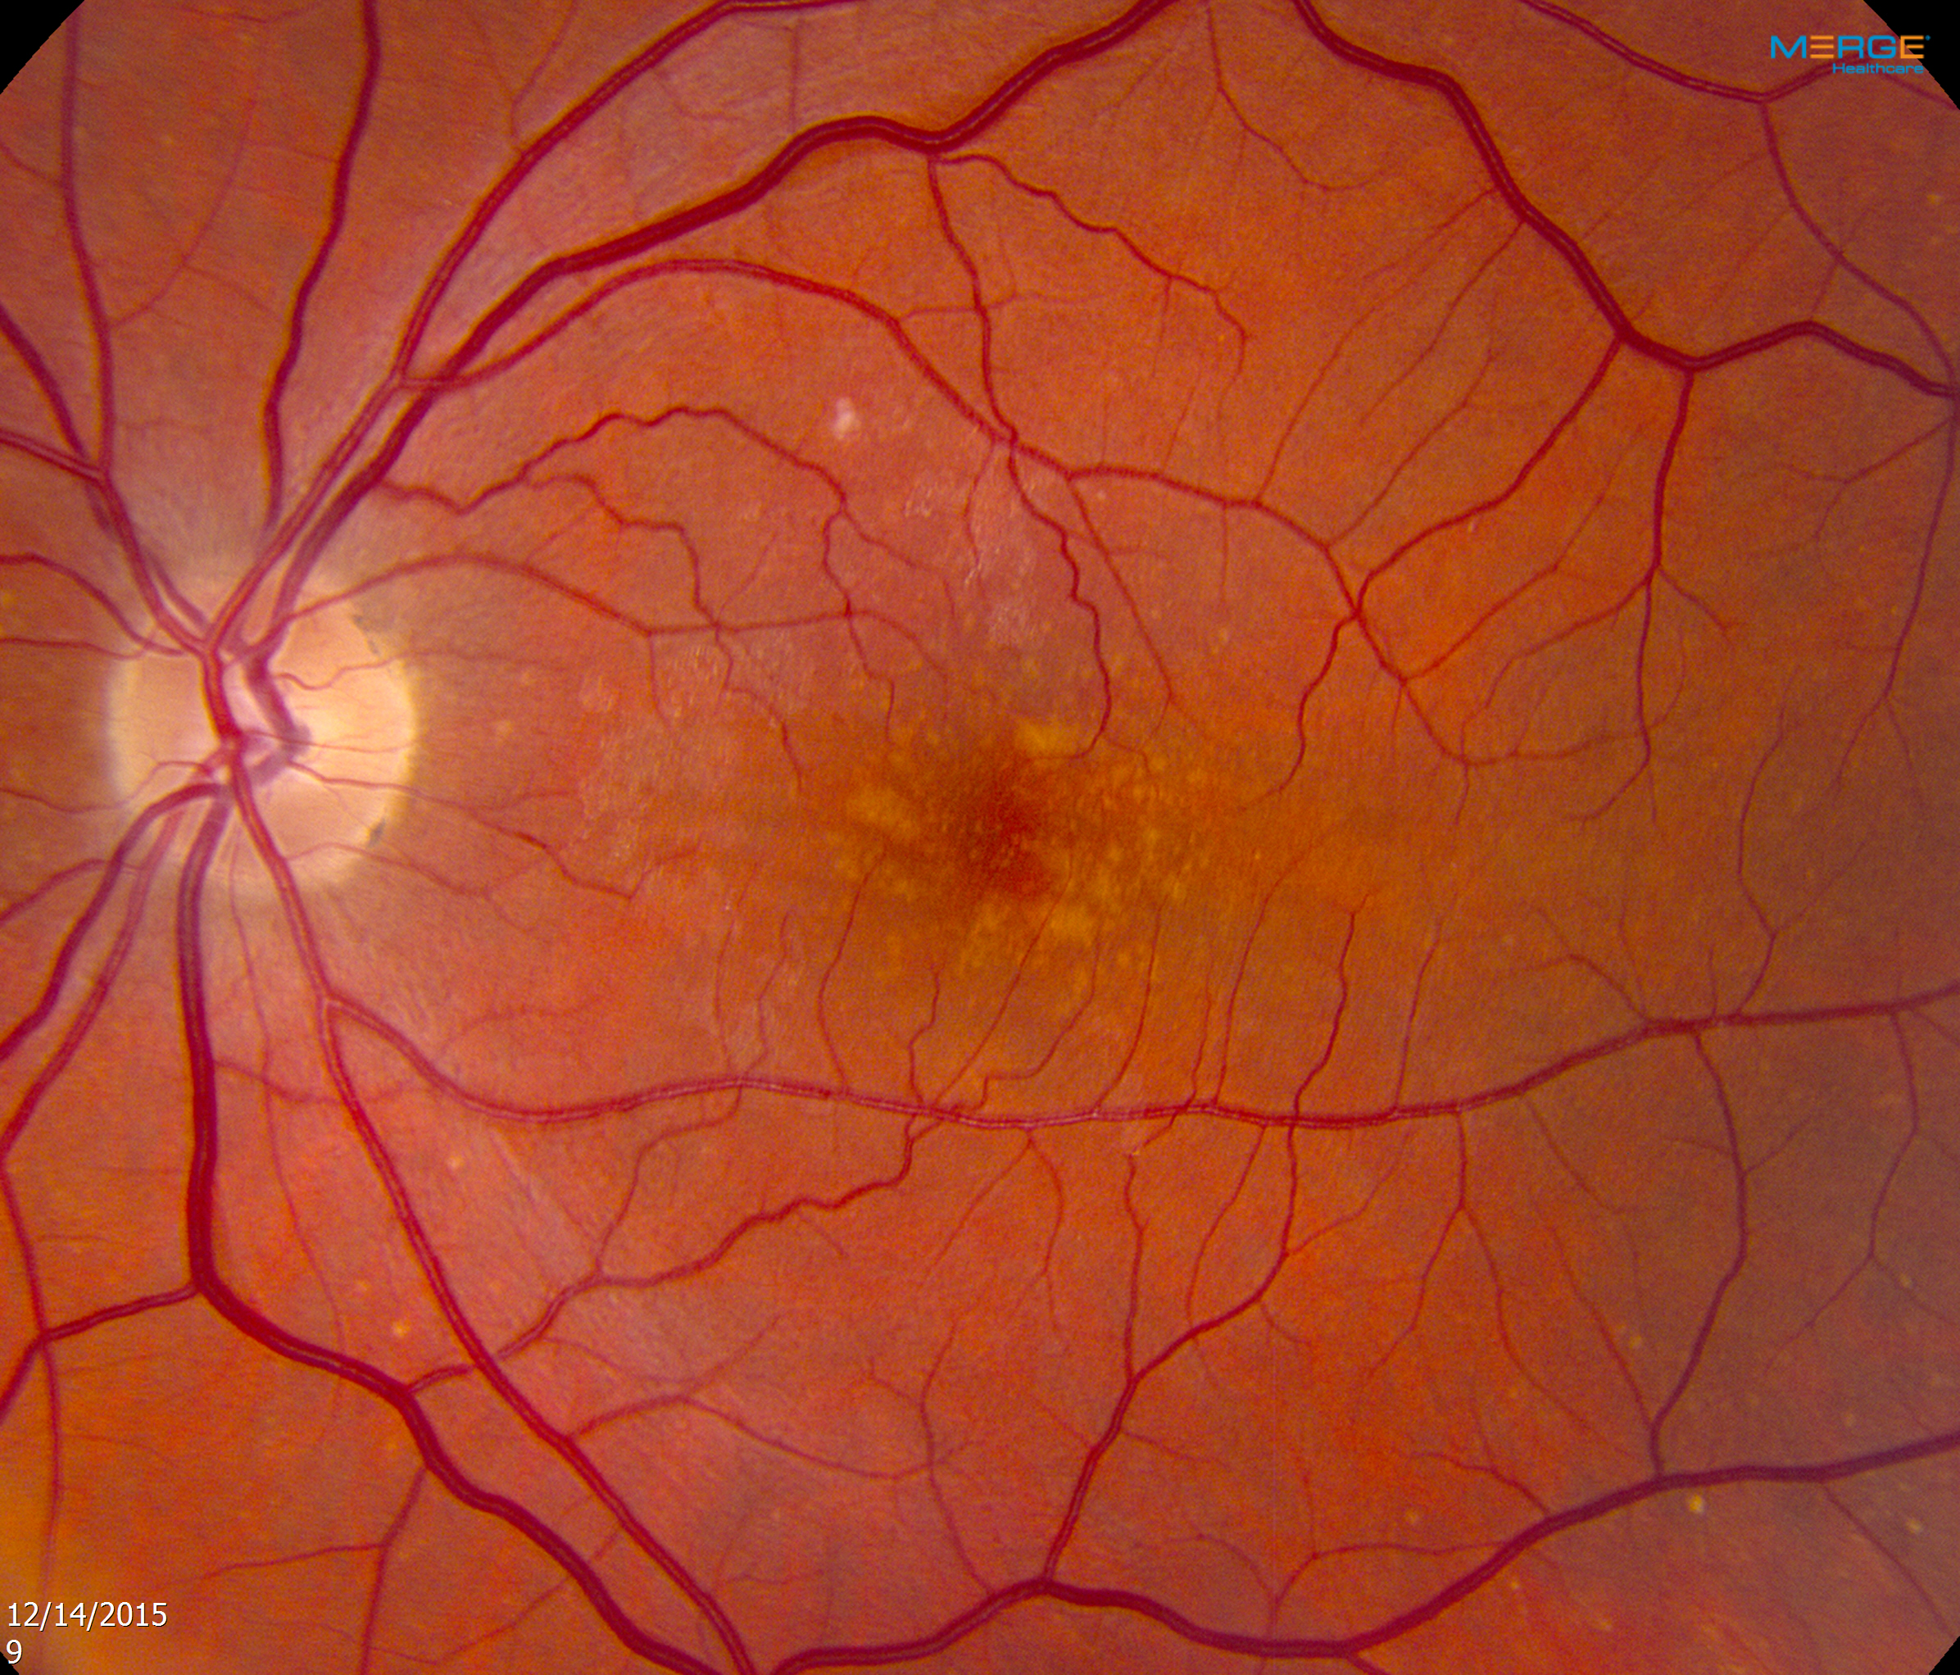

Slide 72
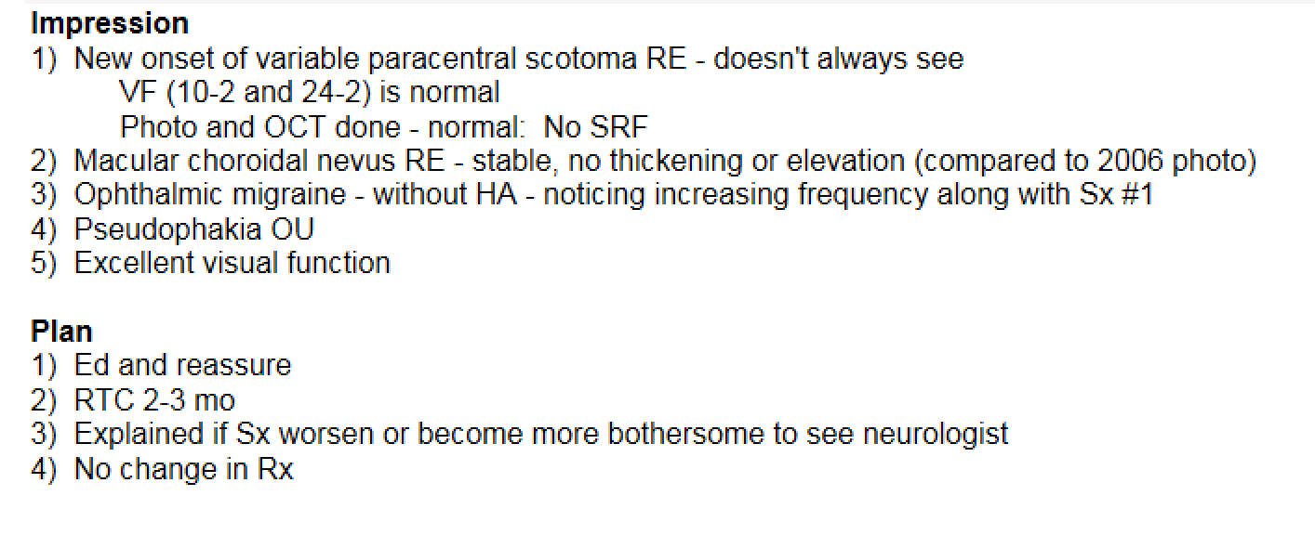

Slide 73
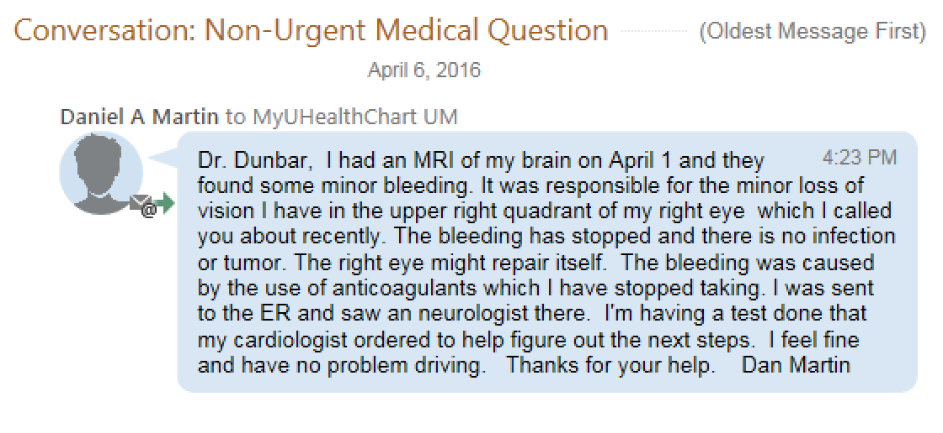

Slide 74
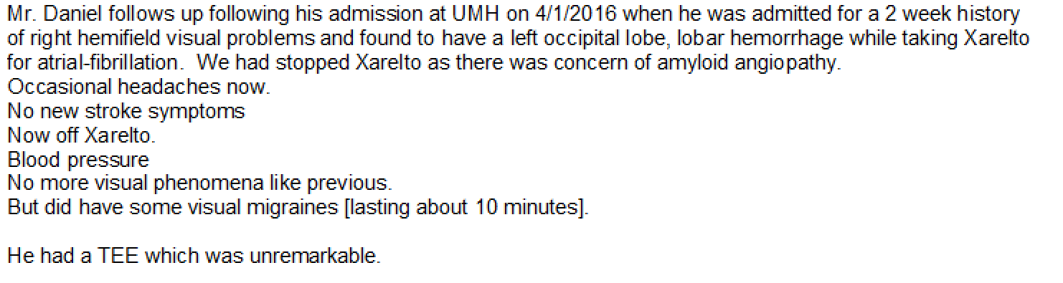
Reviewing Medical Record

Slide 75
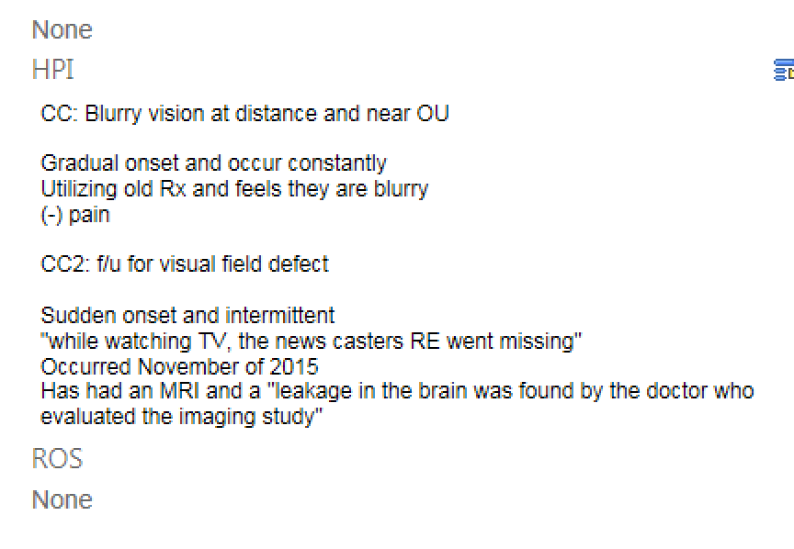
June 6, 2016
VA: 20/20 OU
Pupils: No APD

Slide 76
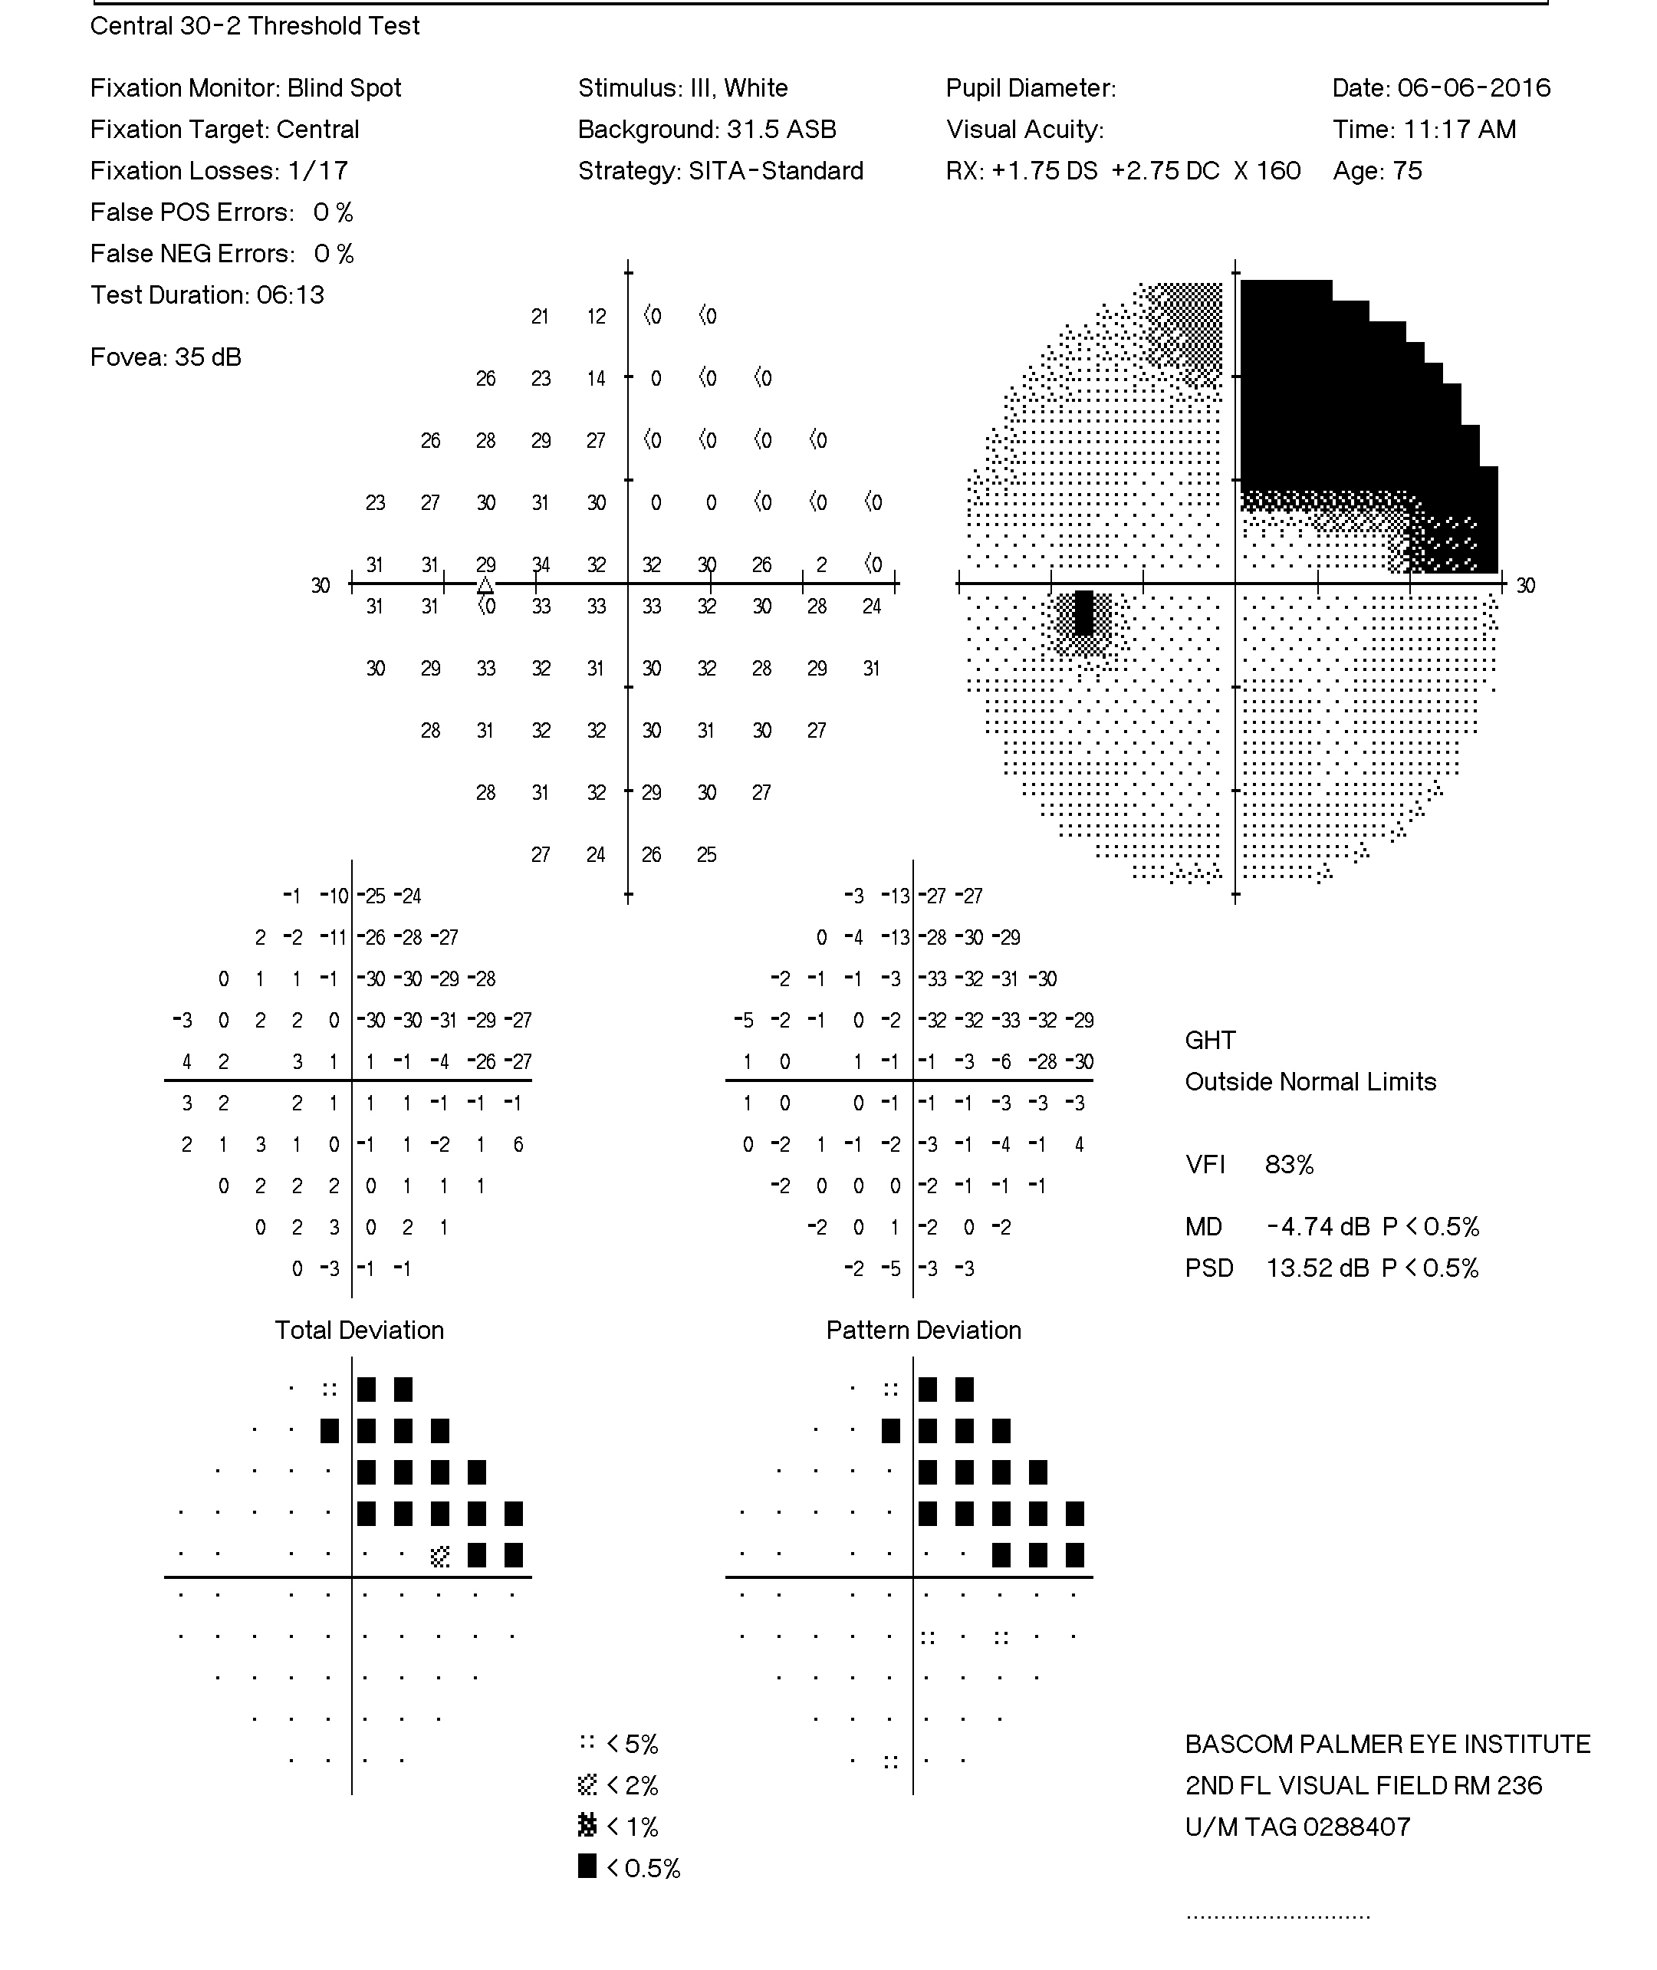
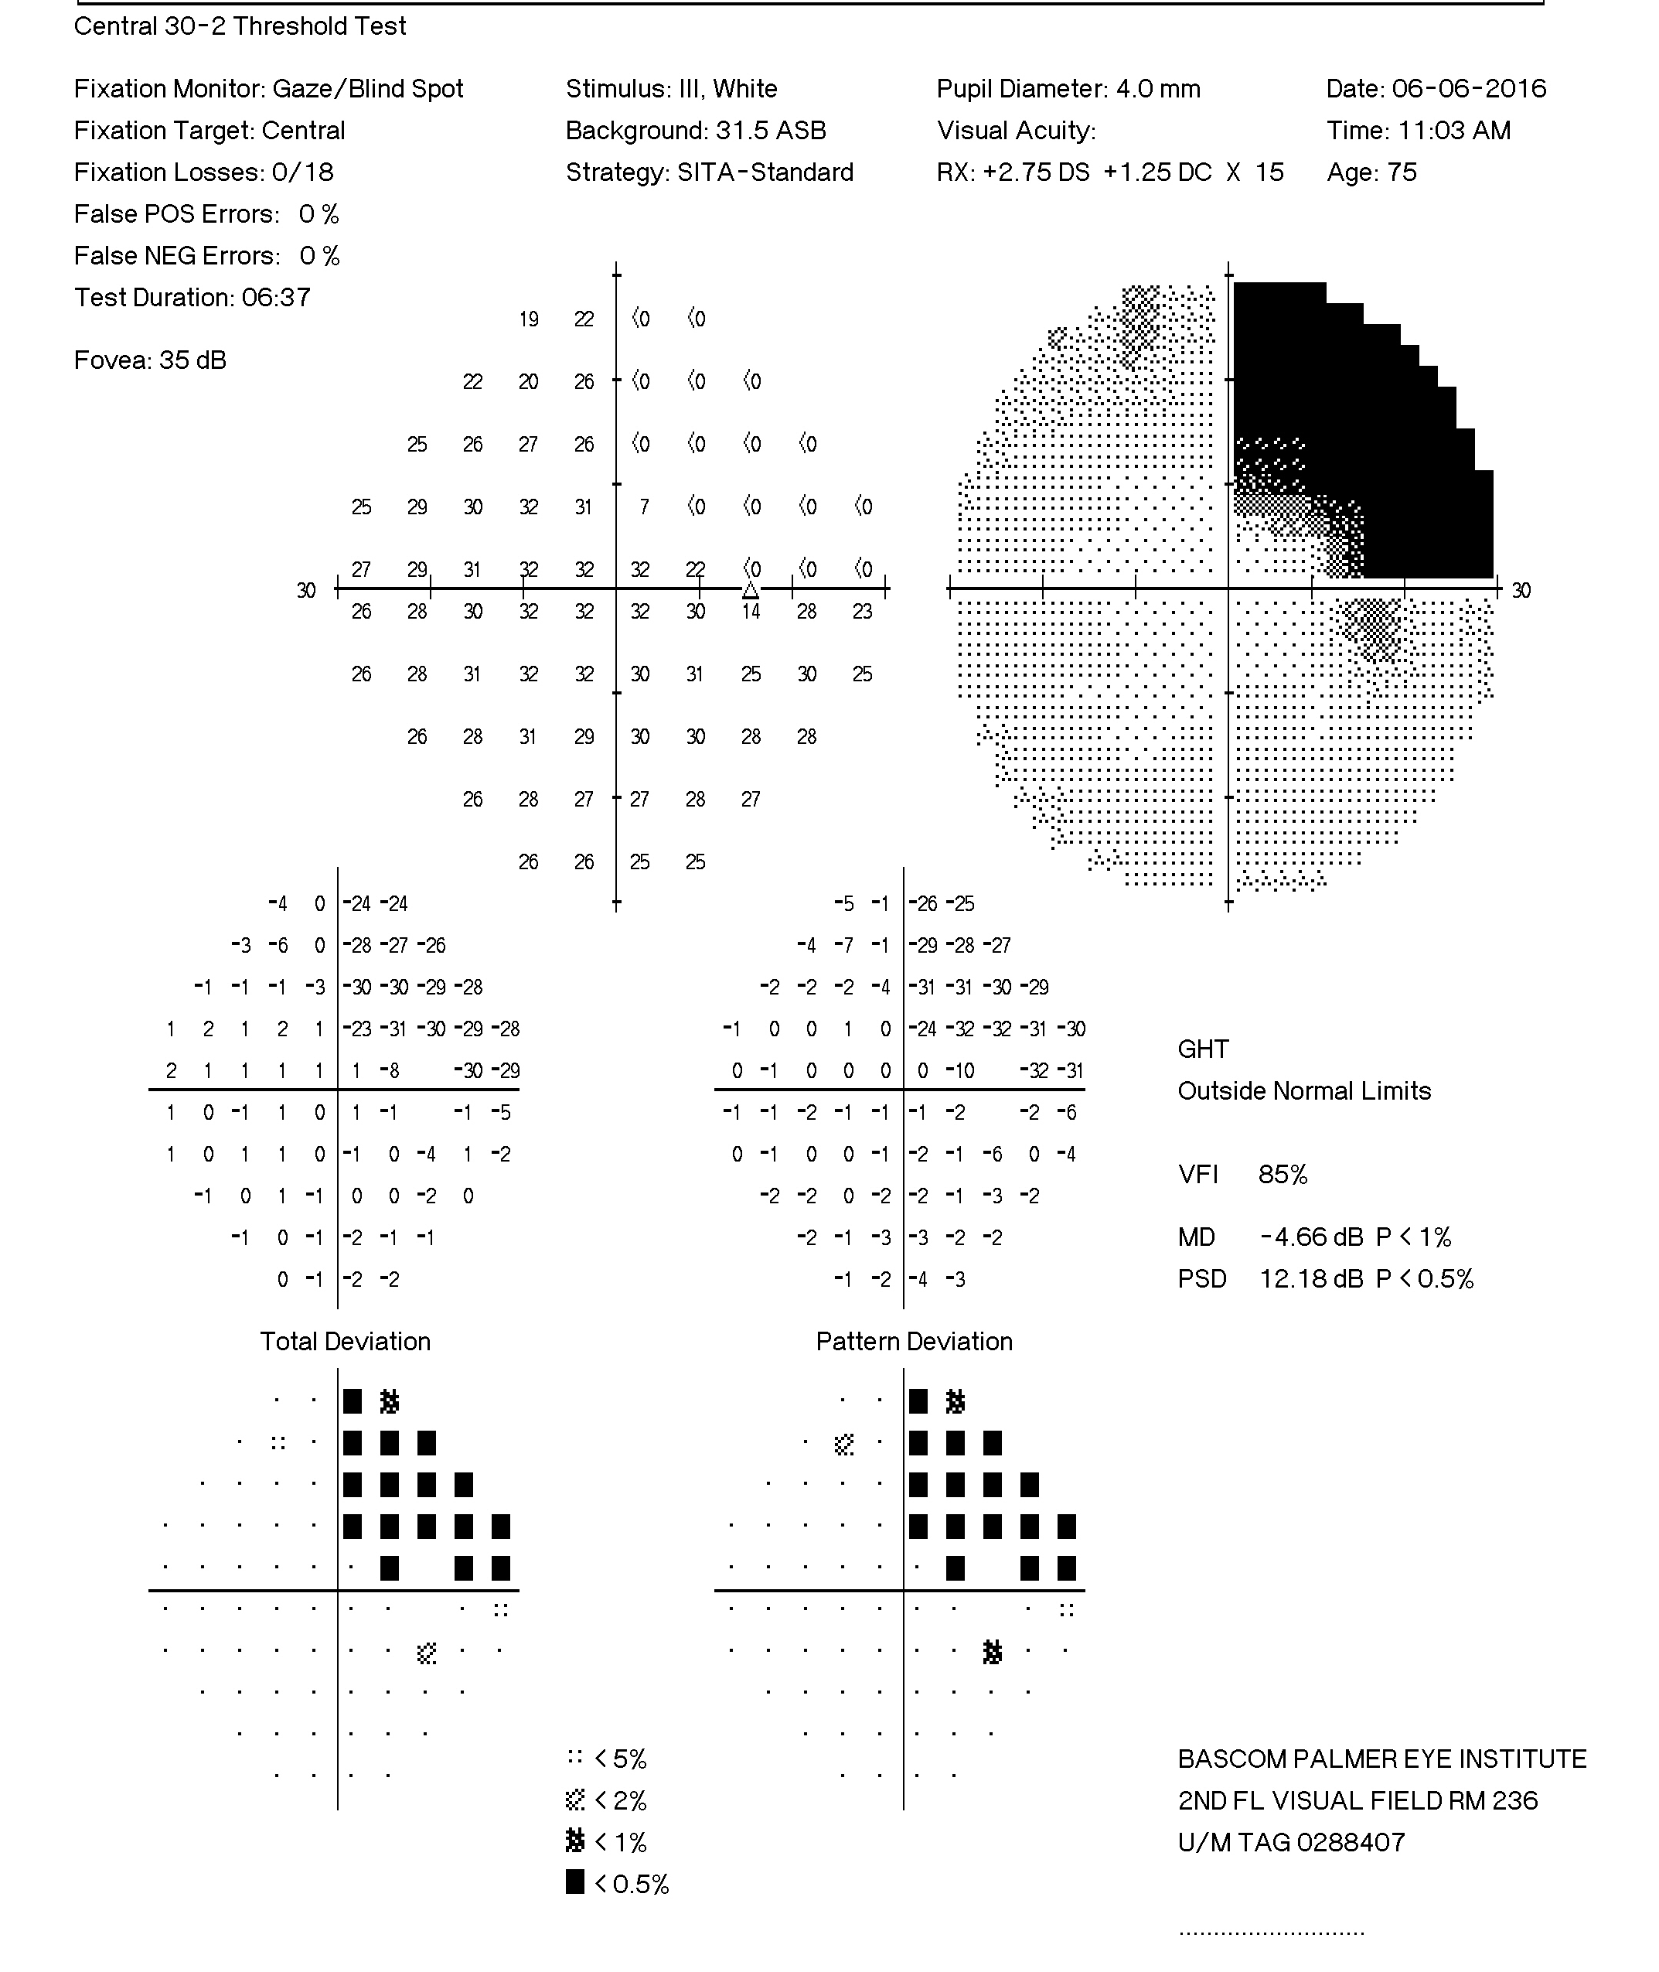

Slide 77
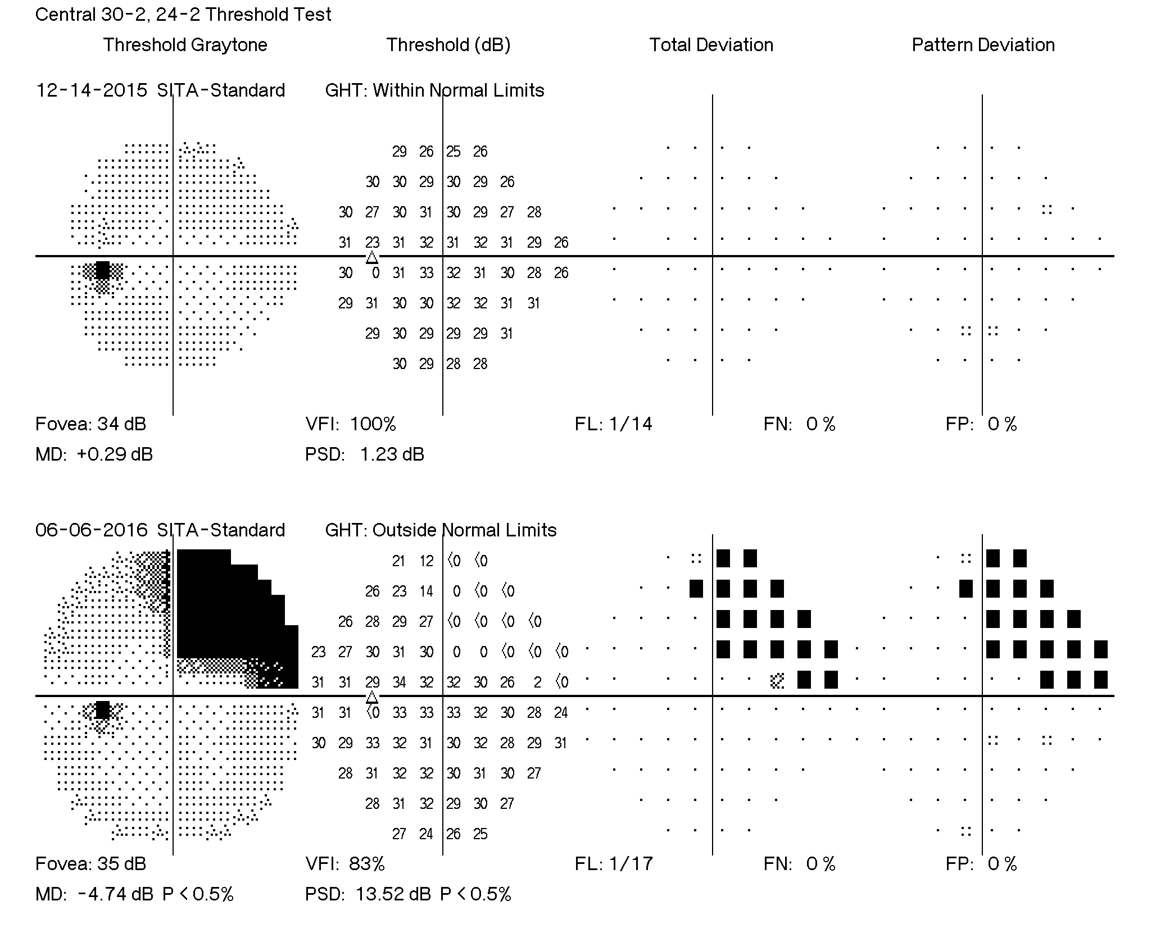
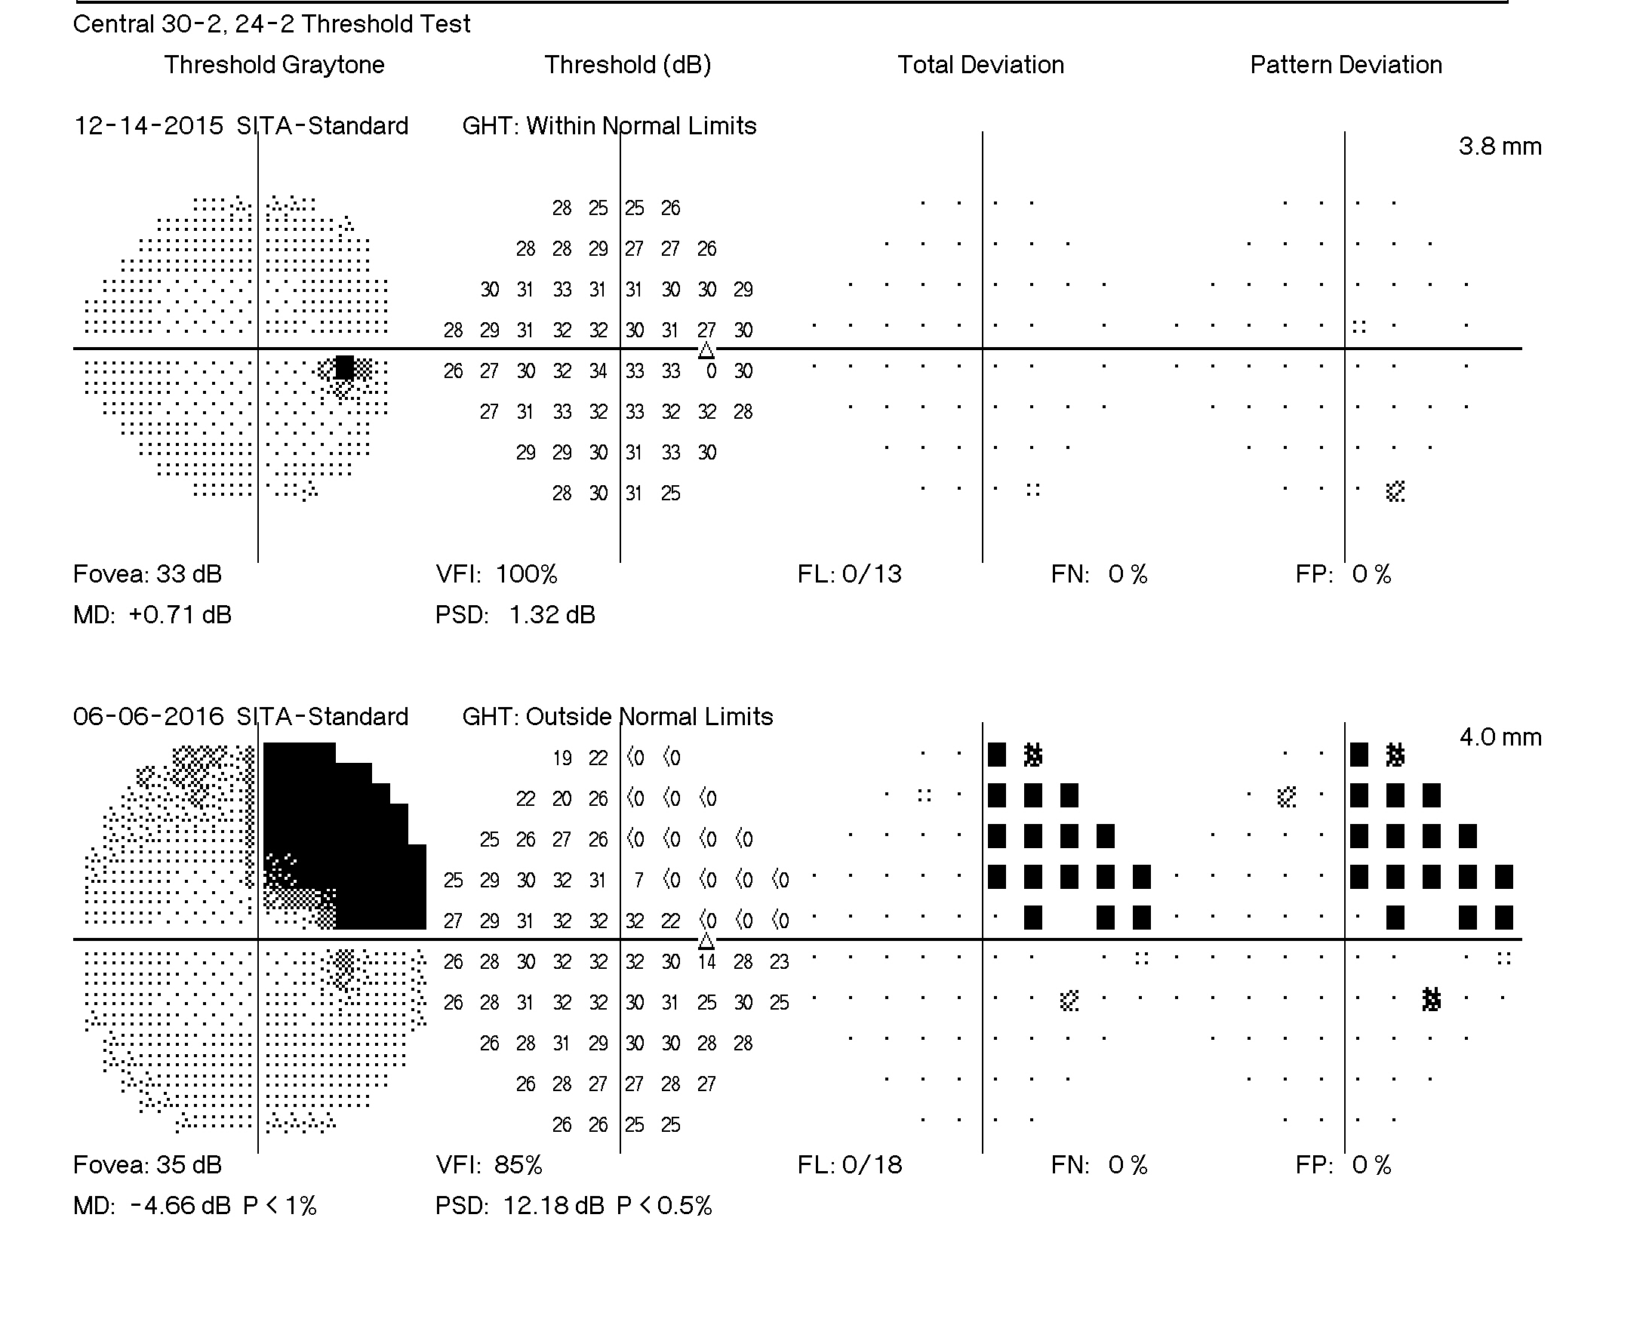

Slide 78
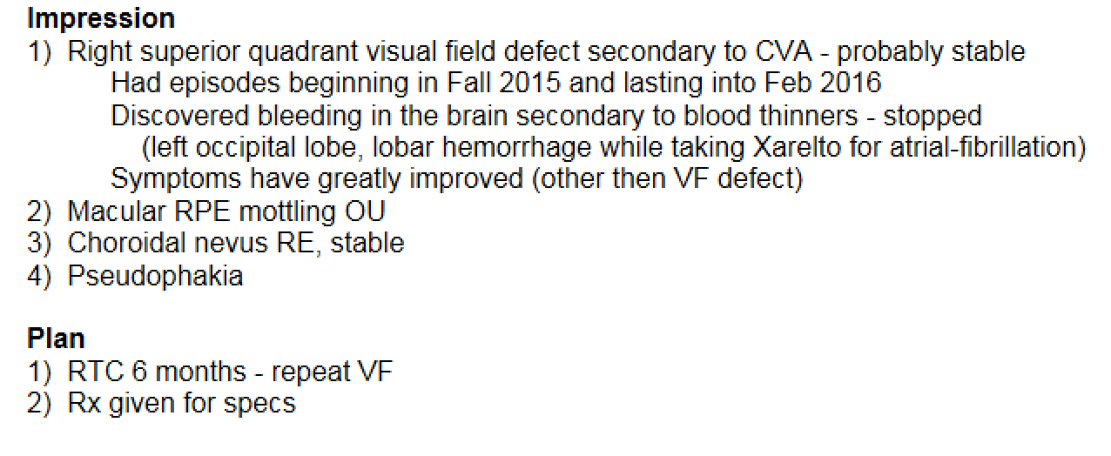
June 6, 2016

Slide 79
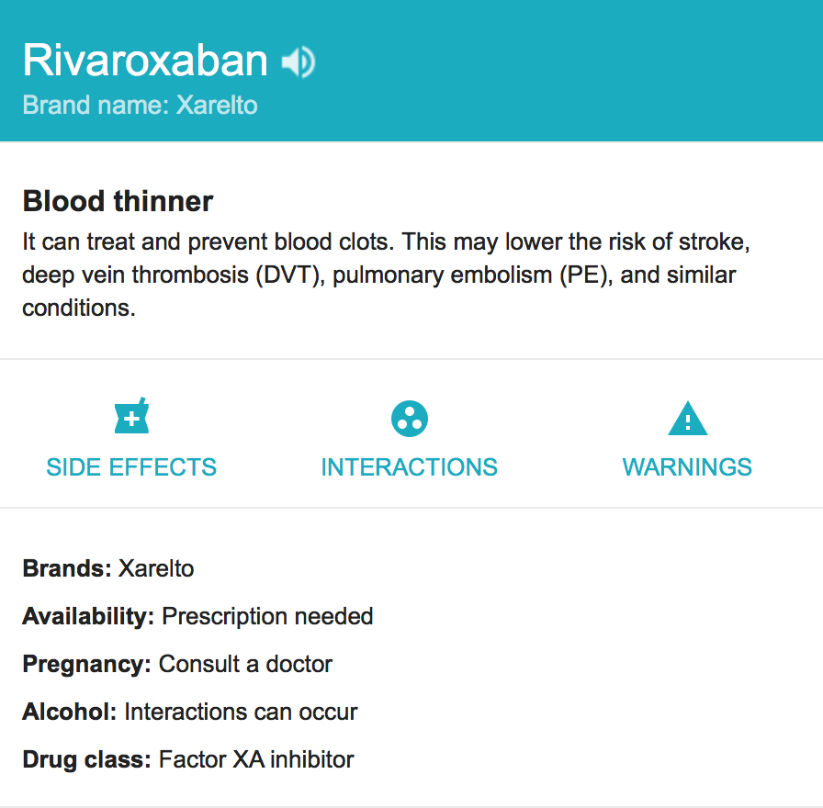

Slide 80
42 yo Hispanic Female
Suffers from severe migraine headaches
  Has tried countless therapys
Her physician recently put her on Topamax ~ 2-3 months ago
  Almost immediately began experiencing bilateral flashes of light in both eyes only at night
Is this related to the Topamax?

Slide 81
Topamax
Brand name for Topiramate
Sold under the trade names
  Topamax®(Janssen Pharmaceuticals, Belgium)
  Trokendi XR® (Supernus Pharmaceuticals
Sulfa-derivative monosaccharide
Over 32 million prescriptions have been written for topiramate

Slide 82
Topamax
Original FDA approval in 1996 to treat epilepsy and in 2004 for migraine prophylaxis
In last decade numerous uses have been suggested in the literature:
Bipolar disorder - Alcohol dependence
PTSD - Eating disorders
Obesity - Obsessive-Compulsive Disorder
Tobacco dependence - Essential tremor
Tourette’s disorder - Postherpetic neuralgia

Slide 83
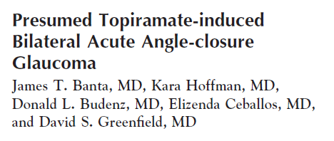
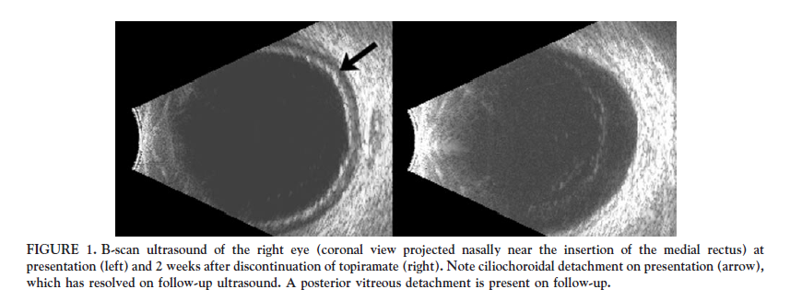
51-year old man who developed bilateral angle closure
Intraocular pressure was 32 OD and 38 OS
Occurred 2-weeks after beginning topiramate
Am J Ophthalmol 2001; 132(1):112-4.

Slide 84

Risk of developing glaucoma on topiramate
Only 1956 patients followed after receiving first prescription for topiramate
Glaucoma diagnosis: Topiramate Control
First month 0.36% 0.04%
Second to third month 0.05% 0.11%
Fourth to twelfth months 0.66% 0.46%
Taking topiramate represents 7.41x increase risk for developing of glaucoma
Am J Ophthalmol 2013;155:336-341

Slide 85
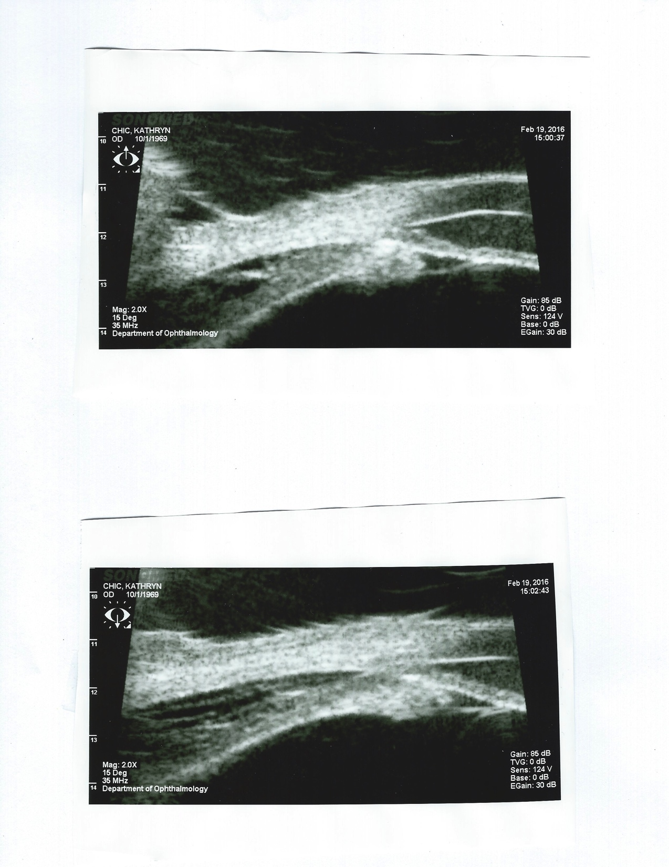
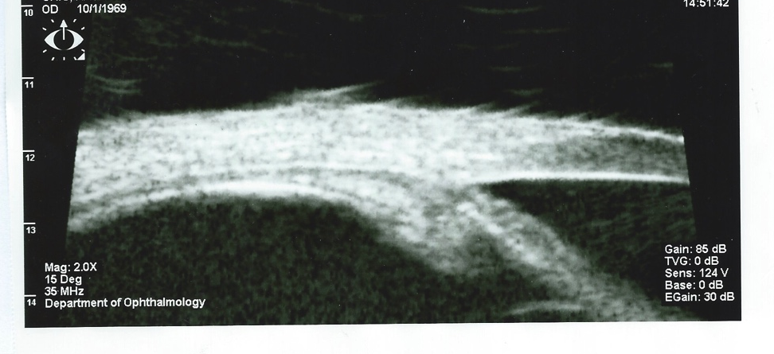
Mechanism of topiramate induced angle-closure
Induction of ciliochoroidal effusions
Ciliary body edema and anterior rotation of the ciliary body
Forward displacement of the lens-iris diaphragm
Swollen cilary body results in relaxation of zonular traction causing anterior – posterior lens thickening
Craig. Am J Ophthalmol 2004;137(1):193-4

Slide 86
Sitting in a CE Lecture in Colorado by Andrew Mick, OD
Described a 48 yo Hispanic Female that presented with acute angle closure glaucoma
TA: 26/25
Irregular pupils
Gonio: appositional closure 360 OU
Slit lamp examination:
- Anterior chambers were noted to be extremely narrow OU
- 4+ conjunctival hyperemia OU
- 2+ anterior chamber reaction OU
- Posterior synechiae 6:00 – 10:00 OD

Slide 87

UBM Images: 360 degree ciliochoroidal effusions OU

Slide 88
Patient was seen 1 week Earlier in Local ER
Bilateral red eyes
Diagnosed with Viral conjunctivitis
Presented to the VA for 2nd opinion
Was concerned it was not just viral conjunctivitis
They recommended stopping the Topamax

Slide 89
Back to my patients
Persistent flashes after starting Topamax
Has been on the medication for around 3 months
  Feels it has not made a difference in the migraines
Her slit lamp finding were normal
  Anterior chamber angle deep
TA 16 OU

Slide 90



Slide 91

Antiarrhythmics
Amiodarone (Cordarone)
Photosensitizer, tendency towards lipid storage in the cornea and lens
Dose and duration dependent, usually reversible
Ocular side effects
Vortex Keratopathy
  Nearly 100% pts treated greater than 6 months
  <10% bothered by blurred vision or haloes
Anterior and posterior subcapsular lens changes
Optic neuropathy

Slide 92
Antiarrhythmics
Digoxin (Digitek)
Inhibition of Na+K+ ATPase which plays a vital role in maintaining normal cone receptor funtion and
ciliary epithelium responsive for active transport of sodium necessary for aqueous secretton
Ocular Side Effects
Affects cone receptor function
11-25% of patients red-green color defects
Yellow tinged vision (xanthopsia)
Snowy, hazy, or dimming vision
Flickering or flashes of light, and colored spots
Reduces aqueous secretion and IOP

Slide 93


Ever wonder why there is a predominance of the color yellow in most of Van Gogh’s works?
In the 19th century, Digitalis was widely used; often to treat epilepsy, mania, asthma, and among others.
Vincent van Gogh was diagnosed as having Epilepsy and Mania
He was said to have been prescribed Digitalis by his attending physician, who was interestingly enough, painted by Van Gogh beside a Foxglove plant, where Digitalis is derived
Digitalis was widely used and plasma level controls were non-existent. One can, therefore imagine how easy it was to prescribe an overdose of digitalis at the time.
Van Gogh suffered from Xanthopsia, a distortion in color vision, in which objects appear more yellow than they truly are; a usual sign of Digitalis Toxicity.

Slide 94

Starry Night
Van Gogh also suffered from glaucoma making him see haloes around lights

Slide 95
What drug is prescribed for breast cancer and reducing the incidence of breast cancer among high-risk women?

Slide 96


Tamoxifen citrate
Tamoxifen citrate
  Tamoxifen competitively binds to estrogen receptors on tumor cells and other tissue targets, producing a nuclear complex that decreases DNA synthesis and inhibits estrogen effects
Ocular Side Effects:
Crystalline retinopathy
Treatment involves withdrawal of the drug as it is reversible
Ocular complications are rare (0.6%)

Slide 97


Edward Calvin Kendall was awarded the 1950 Nobel Prize for Physiology or Medicine for discovery of this molecule.
First produced commercially by Merck & Company on September 30, 1949.

Slide 98


Corticosteroids
Prednisone
To treat inflammatory and allergic conditions.
They are very effective for acute disease states as well as chronic conditions
Ocular Side Effects
Posterior subcapsular cataract
Elevated intraocular pressure
Papilledema
Exacerbation of herpetic keratitis

Slide 99

Corticosteroids
Cataracts resulting from steroid use are well known and occur with topical, systemic, and nasal administration.
The development of cataract is related to the cumulative dose of prednisone; 25% of patients who use 15 mg/day for 1 year or more will get cataracts that interfere enough with vision to require surgical removal
The etiology is unknown, the drug may react with amino groups of crystalline lens fibers causing protein complexes to aggregate

Slide 100
A man reports discoloration of vision after taking a medication from his pill box last night?

Slide 101


ERECTILE DYSFUNCTION
Viagra (sildenafil citrate)
Cialis (tadalafi)
Levitra(vardenafil)
Staxyn( vardenafil HCl)
Stendra (avanafil)
inhibits phosophodiesterase-5 (PDE-5) which results in vasodilation of smooth muscle.
Ocular Side Effects
Objects have color tinges—usually blue or blue-green, may be pink or yellow
11% of patients on 100mg perceive a blue haze up to four hours
Dark colors appear darker
Visual disturbances
NAION

Slide 102
ERECTILE DYSFUNCTION
Ocular side effects are dose-dependent with all three drugs.
For sildenafil side effects occur at the following incidences:
  50mg 3%
  100mg 10%
  200mg 40-50%
The side effects based on dosage with sildenafil start 15-30 minutes after ingestion of the drug, and usually peak 60 minutes after ingestion.

Slide 103
ERECTILE DYSFUNCTION
Patients who should not take phosphodiesterase type 5 inhibitors are those who have previously suffered ischemic optic neuropathy (NAION) in one eye or anyone who experiences transitory visual loss while on these medications.
These patients may be more prone to developing NAION in the same or fellow eye if sildenafil or other medicines in this class are ingested.
Notes:
Sildenafil has recently become a controversial drug due to the media spotlight on the risk of NAION. To date, the literature contains 14 case reports, including a single report of positive rechallenge (recurrence of NAION when drug therapy was restarted). Spontaneous reporting systems record 86 cases of visual disturbances associated with sildenafil therapy. From this poorly documented data, the association between sildenafil and NAION is “possible” according to WHO criteria requiring that a clinical event occur within a reasonable time from drug administration. There is no well-researched explanation as to how sildenafil therapy could cause NAION. Over 27 million men have used sildenafil. Most are vasculopathic and fall into an age group in which they are already at risk for NAION.
There are four published cases of macular edema(Allibhai et al 2004, Quiram et al 2005) and another seven in the National Registry (Fraunfelder and Fraunfelder 2007). Four of these cases have positive rechallenge of serous macular edema associated with erectile dysfunction drugs at normal or elevated dosages. Included are cases of chronic macular edema, which would not resolve until the drug was stopped. While these data are suggestive, the nature of non-drug- induced serous macular edema is recurrent and transitory. Further data are necessary.
Ioannides et al reported 10 men on erectile dysfunction agents who developed full blow acne rosacea. While ocular rosacea was not mentioned in this dermatologic study, this side effect should be considered.

Slide 104
What is the OD’s Responsibility in Determining if Meds are Causing Ocular Side-effects?
It’s impossible to be aware of every class of meds and their possible side-effects!
If a patient specifically asks (or is sent by physician) it is your responsibility/obligation to find out the answer
  Just because the eye exam seems normal doesn’t mean that it is….
Don’t be afraid to admit that you don’t know
  “Let’s look it up…”

