Slide 1
Caring for the Patient with Diabetes:
Then and Now
Mark T. Dunbar, OD, FAAO
Bascom Palmer Eye Institute
University of Miami
Miami, FL 33136
mdunbar@med.miami.edu

Slide 2
Mark Dunbar: Disclosure
Consultant for Allergan
Optometry Advisory Board for:
  Allergan
  Carl Zeiss Meditec
  Regeneron
  Genentech
Mark Dunbar does not own stock in any of the above companies

Slide 3
Fact 1:
Diabetes is occurring at near-epidemic proportions!

Slide 4
Much of this increase in Diabetes is occurring in developing countries
  Usually most commonly above retirement age
Growing incidence of Type 2 Diabetes at a younger age
  Increase obesity in children

Slide 5

Diabetic retinopathy is the primary cause of vision loss in adults aged 20–74 years^{1–3}
Of ~422 million
people with diabetes mellitus worldwide,⁴ 35% (145 million)
have a form of DR^{1–4}
11%
(45 million)
have vision-threatening DR^{3,4}
In the
United States, it is estimated that
4.1 million
have DR⁵ and
746,000
have DME⁶
1.07%
of blindness worldwide could be attributed
to DR⁷
…these numbers are estimated to rise
as the prevalence of diabetes increases^{1–2,4}
1. Lee R et al. Eye Vis (Lond). 2015;2:17; 2. Ting DSW et al. Clin Exp Ophthalmol. 2016;44:260-277; 3. Yau JWY et al. Diabetes Care. 2012;35:556-564; 4. IAPB Vision Atlas. Diabetic Retinopathy. http://atlas.iapb.org/vision-trends/diabetic-retinopathy/ [last accessed March 2018]; 5. CDC Diabetic Retinopathy factsheet, https://www.cdc.gov/visionhealth/pdf/factsheet.pdf [last accessed Sept 2018]; 6. Varma et al. JAMA Ophthalmol. 2014 Nov;132(11):1334-1340; 7. Flaxman SR et al. Lancet Glob Health. 2017;5(12):e1221-1234. DME, diabetic macular edema; DR, diabetic retinopathy.
Notes:
As the primary cause of vision loss in adults between the ages of 20 and 74 years, diabetic retinopathy poses a substantial worldwide public health burden.
This slide provides a global estimate of the prevalence of diabetic retinopathy and vision-threatening stages of diabetic retinopathy using individual-level data. These numbers are expected to rise as the prevalence of diabetes increases.
---
Background notes:
Note: the absolute values from the literature vary a bit depending on which year they reflect (e.g., 2010 vs 2015)
IABP estimate of approximately 422 million people with diabetes is for 2014; 145 million with DR in 2015
Yau et al. found that the prevalence estimates of any DR and VTDR were similar in men and women and were highest in African American populations and lowest in Asian populations [Yau 2012]
United States estimates are from analyses of the 2005 to 2008 National Health and Nutrition Examination Survey [CDC Diabetic Retinopathy factsheet; Varma 2014]

Slide 6
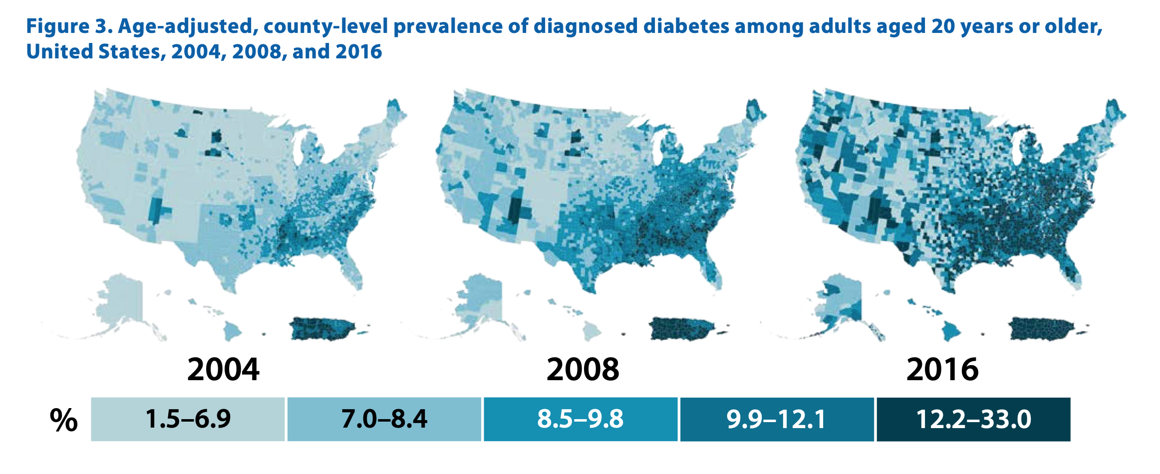

Slide 7
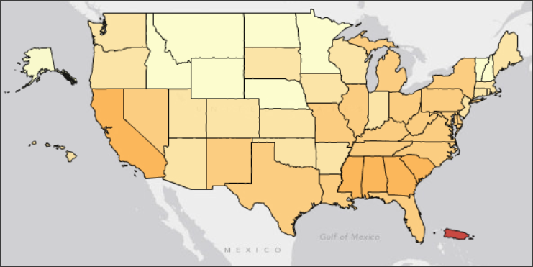
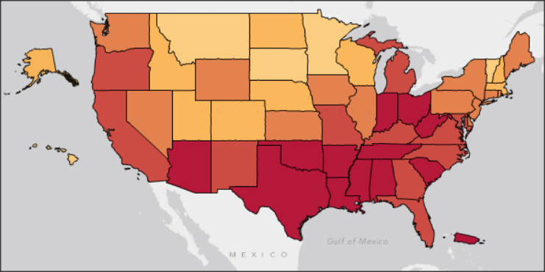
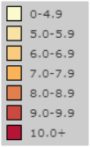
Prevalence of Diabetes Mellitus
Affects 9.3% of the US population (29.1 million people)¹
Seventh cause of death in the US¹
  By 2050 between 1 in 5 and 1 in 3 US adults (estimated) will be diabetic
Age-adjusted Prevalence
2000: 6.0%³
2012: 9.3%¹
 | 2000 | 2012
Diabetes Incidence (cases/1000) | 6.0⁴ | 7.8¹
Obesity Prevalence (%) | 20.1⁵ | 27.6⁶
Notes:
Diabetes affects 9.3% of the US population (29.1 million people), and is the seventh leading cause of death in the United States¹
An additional 86 million adults have prediabetes and are at risk to develop diabetes³
The prevalence and incidence of diabetes have increased considerably over the past decade, and diabetes is now considered to be an epidemic in the United States
These charts show the change graphically—deeper red colors indicate higher rates of diabetes. In 2000, no state was deep red, while by 2012, large parts of the country were deep red, indicating a diabetes prevalence of 9.0% or higher²
The age-adjusted annual incidence of diabetes has also increased, from 6.0 new cases per thousand in 2000 to 7.8 cases per thousand in 2012^{1,3}
One of the major drivers for this increase is obesity, which is a major risk factor for type 2 diabetes (T2D). Rates of obesity have also increased, from 20.1% in 2000 to 27.6% in 2012, and the increasing prevalence of obesity is probably a driver of the increase in diabetes rates^{4,5}
References
Centers for Disease Control and Prevention. National diabetes statistics report, 2014. Atlanta, GA: US Department of Health and Human Services, Centers for Disease Control and Prevention, 2014. http://www.cdc.gov/diabetes/pubs/ statsreport14/national-diabetes-report-web.pdf. Accessed June 30, 2014.
Centers for Disease Control and Prevention. Diabetes interactive atlas. CDC Web site. http://www.cdc.gov/diabetes/atlas/obesityrisk/atlas.html. Accessed July 25, 2014.
Centers for Disease Control and Prevention. Crude and age-adjusted incidence of diagnosed diabetes per 1,000 population aged 18–79 years, United States, 1980–2011. CDC Web site. http://www.cdc.gov/diabetes/statistics/incidence/fig2.htm. Accessed February 28, 2014.
Centers for Disease Control and Prevention. Prevalence and trends data overweight and obesity (BMI)—2010. CDC Web site. http://apps.nccd.cdc.gov/brfss/list.asp?cat=OB&yr=2000&qkey=4409&state=All. Accessed February 28, 2014
Centers for Disease Control and Prevention. Prevalence and trends data overweight and obesity (BMI)—2012. CDC Web site. http://apps.nccd.cdc.gov/brfss/list.asp?cat=OB&yr=2012&qkey=8261&state=All. Accessed February 28, 2014.

Slide 8

Complications of Diabetes
Patients with diabetes go on approximately 24 doctor visits per year¹
Macrovascular:
Microvascular:
Cardiovascular disease²
Cardiovascular
mortality 1.7x
Stroke²
Stroke
hospitalizations
1.5x
Diabetic foot²
60% of nontraumatic
lower-limb amputations
73,000 amputations
in 2010
Diabetic nephropathy
Up to 40% of diabetics³
Causes ≈44% of
kidney failures²
Diabetic neuropathy²⁻⁴
60-70% of diabetics
Painful in 10%
Diabetic retinopathy (DR)²
21% of diabetics⁵
4.4% at risk for
severe vision loss²
Notes:
Diabetes causes macrovascular and microvascular complications¹
The major macrovascular complications—meaning those resulting from damage to large blood vessels—include cardiovascular disease, stroke, and diabetic foot¹
Cardiovascular disease and stroke are major complications for patients with diabetes. Diabetes is associated with high risks of stroke and death due to cardiovascular disease, with rates approximately 1.5 and 1.7 times higher, respectively, among patients with diagnosed diabetes than among those without diabetes¹
Patients with diabetes may develop diabetic foot disease. About 60% of nontraumatic lower-limb amputations occur in people with diabetes, and 73,000 individuals with diabetes underwent nontraumatic lower-limb amputations in 20101
The major microvascular complications—meaning complications resulting from damage to microscopic blood vessels—are diabetic nephropathy, diabetic neuropathy, and diabetic retinopathy (DR)¹
Diabetic nephropathy develops in up to 40% of patients with diabetes,² and was listed as the primary cause of kidney failure in ≈44% of all cases in 2011¹
Diabetic neuropathy affects 60% to 70% of patients with diabetes and causes pain in 10%^{2,3}
Diabetic retinopathy is present in approximately 21% of patients with diabetes⁴ and is severe—putting patients at risk for severe vision loss—in about 4.4%.¹ We’ll discuss DR later in this program
References
Centers for Disease Control and Prevention. National diabetes statistics report: Estimates of diabetes and its burden in the United States, 2014. Atlanta, GA: US Department of Health and Human Services, Centers for Disease Control and Prevention, 2014. http://www.cdc.gov/diabetes/pubs/ statsreport14/national-diabetes-report-web.pdf. Accessed June 30, 2014.
Brownlee M, Aiello LP, Cooper ME, Vinik AI, Nesto RW, Boulton AJM. Complications of diabetes mellitus. In: Melmed S, Polonsky KS, Larsen PR, Kronenberg HM, eds. Williams Textbook of Endocrinology. 12th ed. Philadelphia, PA: Elsevier Saunders; 2011;1462-1551.
Centers for Disease Control and Prevention. National diabetes fact sheet: national estimates and general information on diabetes and prediabetes in the United States, 2011. Atlanta, GA: US Department of Health and Human Services, Centers for Disease Control and Prevention, 2011. http://www.cdc.gov/diabetes/pubs/pdf/ndfs_2011.pdf. Accessed March 25, 2014.
NHANES 2005-2008, projected to 2012 US population.

Slide 9
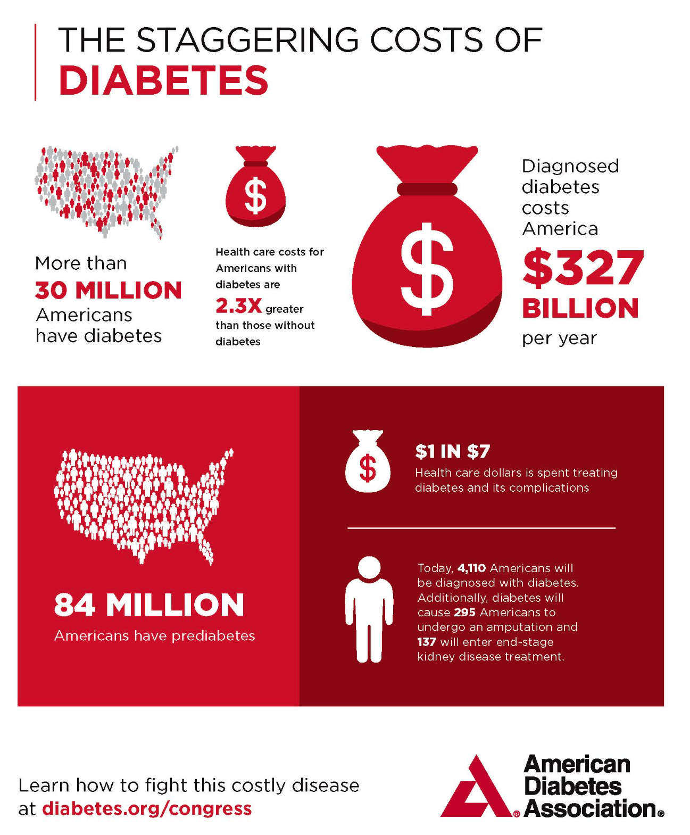

Slide 10
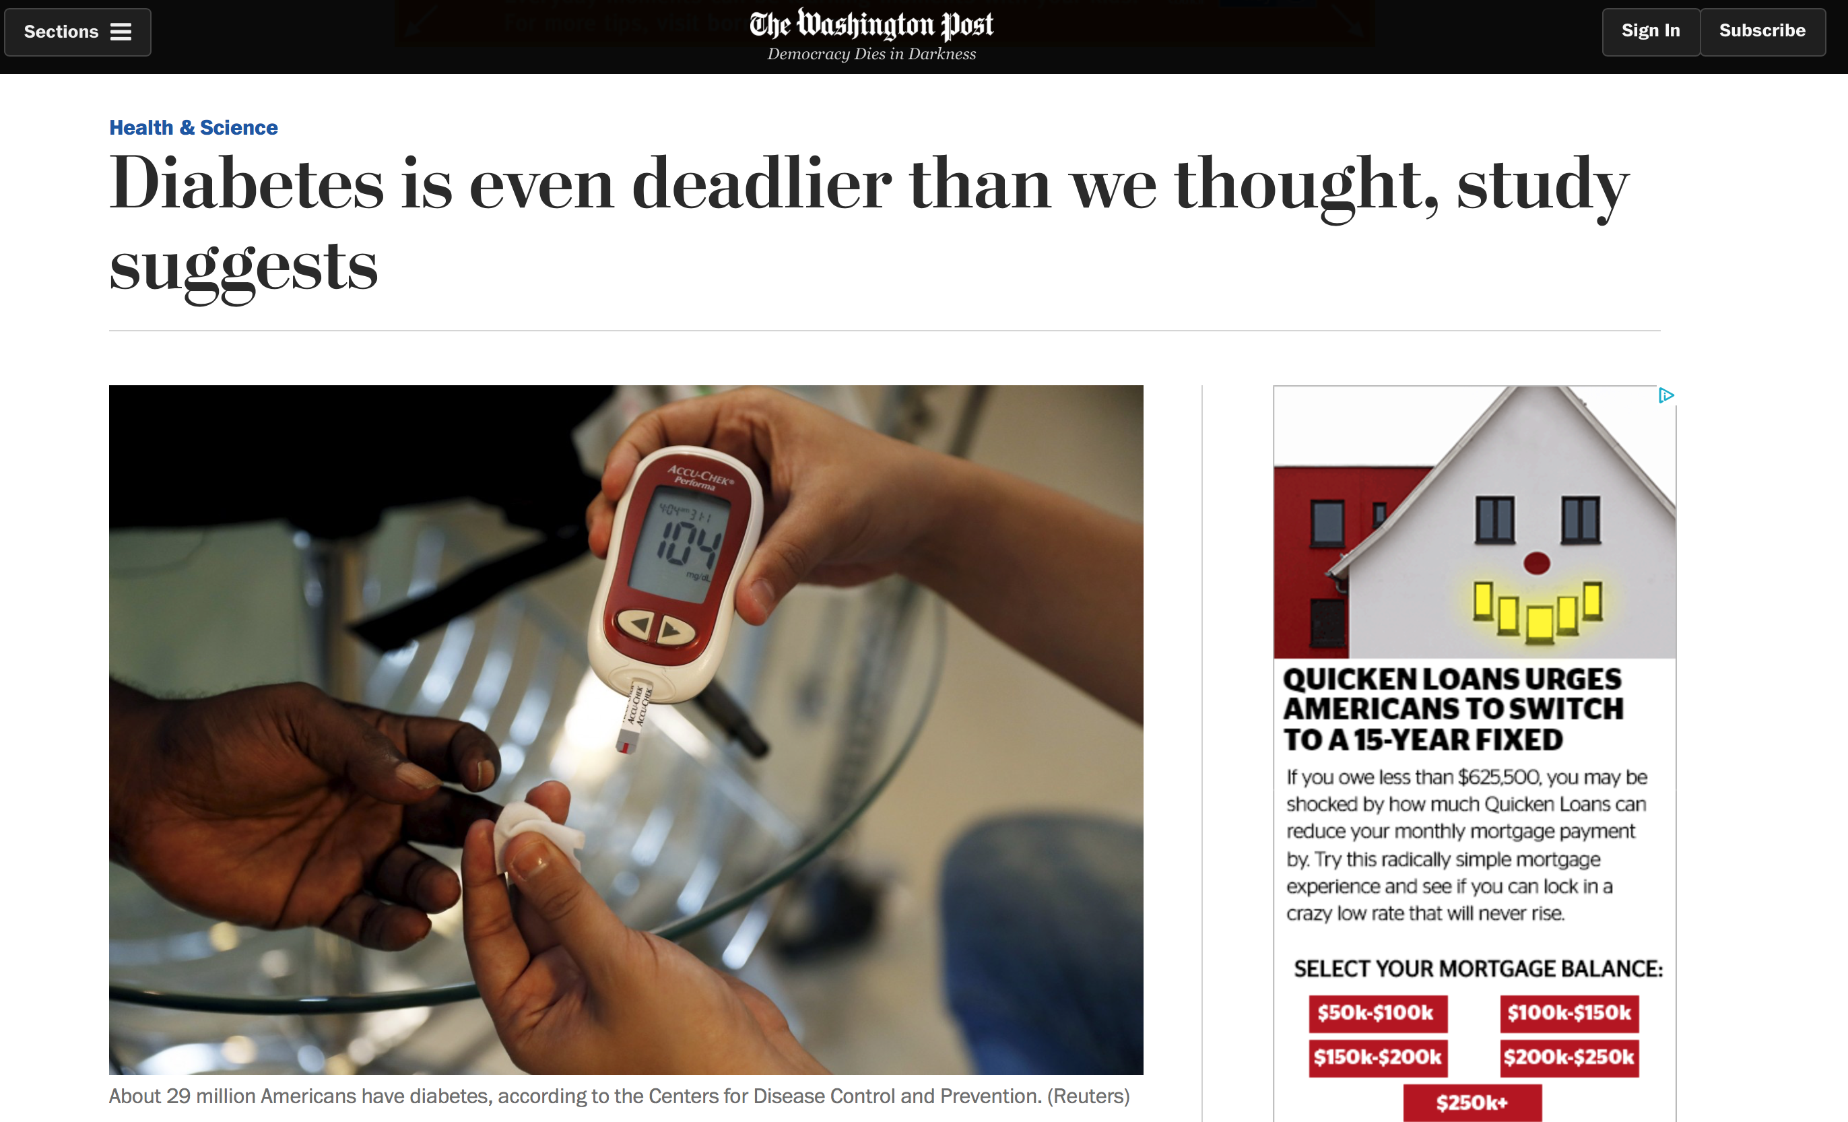
April 7, 2017
4X more people die from diabetes
#3 leading cause of death
DM is responsible for 12% of deaths

Slide 11
The ABC’s of Diabetic Care
A1C
BS
Control BP

Slide 12
Hemoglobin HbA1
HbA1C can tell you how high blood glucose has been on average over the last 8-12 weeks
Normal non-diabetic HbA1C is 3.5-5.5%
  In diabetes 4-6% is acceptable
  > 7% is considered too high
HbA1C test is currently one of the best ways to check if diabetes is under control

Slide 13
Glycemic Control Is the Key Modifiable Risk Factor Associated With Diabetic Retinopathy
10-Year Diabetic Retinopathy Incidence (%)
10-Year Diabetic Retinopathy Progression (%)
Klein EK et al. Diabetes. 2015;64:341-343.
Notes:
These figures, derived from the Wisconsin Epidemiologic Study of Diabetic Retinopathy, show the estimated 5-year incidence (figure on left) and progression (figure on right) of DR by level of HbA1c and duration of diabetes. In a general population, those with type 1 diabetes and HbA1c of 7.8% (about the same HbA1c level of the intensive and conventional groups after the DCCT), were likely to develop DR or have their DR progress within a 5-year interval. Even those with HbA1c levels of 6.0% (a level that most patients do not achieve or sustain) and a short duration of diabetes were likely to have incident or progressive retinopathy within 5 years. The risk of incidence and progression rose for individuals with higher levels of HbA1c.

Slide 14
Time in Range (TIR)
The percentage of how long your glucose value was within the target range during a defined period
  For patients using Continuous Glucose Monitoring (CGM)
Normal range is from 70 mg / dl to 180 mg / dl (3.9-10 mmol / l)
  Target range may vary from person to person
Sometimes referred to as “hours in target range”
If a person has a TIR of 50%, that indicates that glucose levels were within the target range for approximately 12 hours on any given day

Slide 15
Time in Range (TIR)
Average time in range in people with diabetes is typically around 50% to 60%.
The higher the time in the range percentage, the lower the risk of developing complications
  The lower the TIR, the higher the glucose variability and thus the risk of possible complications.
Non diabetes patients: 97% TIR with a target range of 70 to 140 mg / dl (3.9-7.8 mmol / l) and an average glucose value of 99 mg / dl (5.5 mmol / l) with only slight variation
Mapping the high's and low’s via TIR offers a fuller view of the day-to-day management for a person with diabetes.

Slide 16
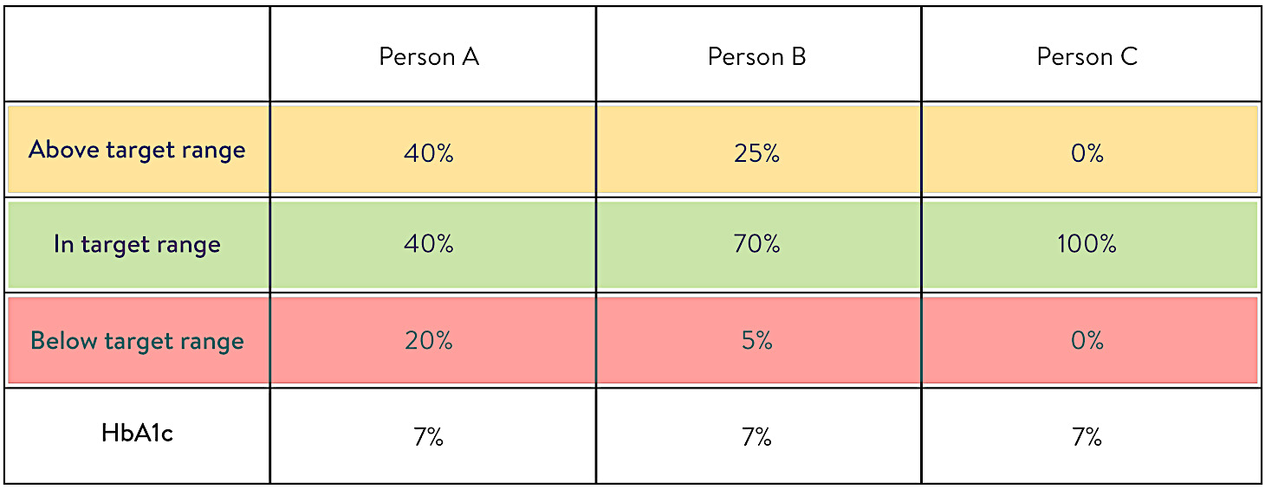

Slide 17
TIR vs. HbA1c
There is a strong correlation between TIR and risk for DR and other secondary diseases
A1c only represents the average glucose value over the past 2 to 3 months as a single snapshot
TIR maybe a superior indicator of complications vs HbA1c

Slide 18
Monitoring Blood Sugar:
Then and Now

Slide 19

Monitoring Blood Sugar
Finger stick
Continuous Glucose Monitor (CGM)

Slide 20
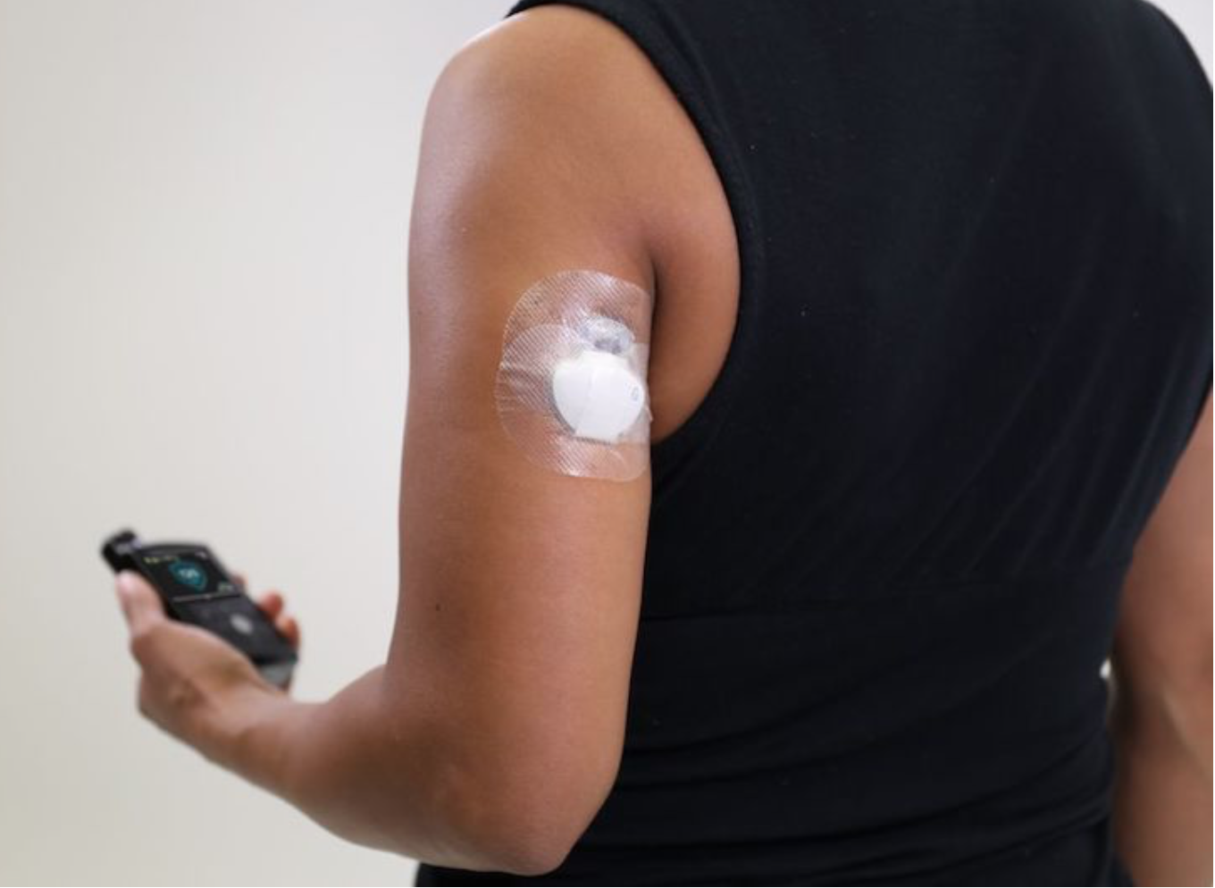
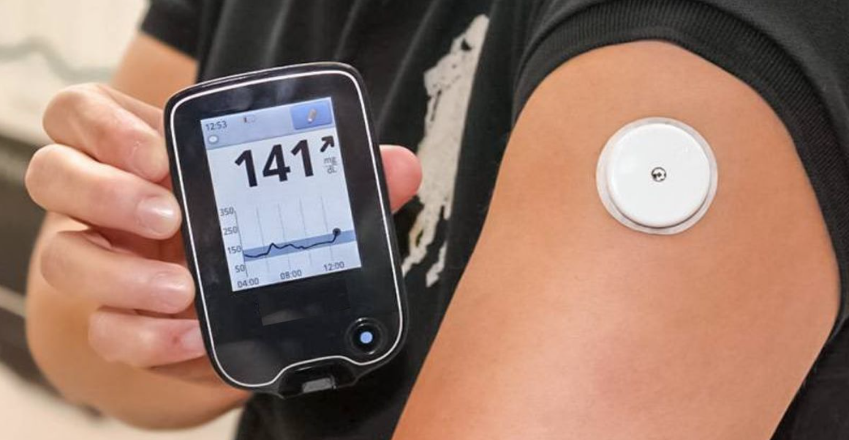
Continuous Glucose Monitor (CGM)

Slide 21
CGM
Continuously monitors blood sugar levels in more or less real time
One-time per day measurement vs. dynamic information every 5 minutes
  Roughly 288 readings in a day
Empowerment
4 FDA approved devices

Slide 22
Obstacles for Accessing CGM Devices
By prescription
Requires prior authorization

Slide 23
Requirements/Proving Medical Necessity
Type 1 diabetes diagnosis
Completion of a comprehensive diabetes education program
Requires multiple, daily insulin injections or insulin pump therapy with frequent dosage adjustments
Documented average frequency of glucose self-testing greater than 4 times/day during the previous 2 months
Intention to use monitoring device as an adjunct to standard care
Frequent unexplained, hypoglycemic episodes or frequent nocturnal hypoglycemia

Slide 24
Cost of CGM
Dexcom G5/G6: $300 for the transmitter, $600 for the receiver, and $80 per sensor (G5 sensor life: 7 to 14 days; G6 sensor life: 10 days).
Abbott FreeStyle Libre: $60 for the sensor scanner, $40 per sensor (10-day life).
Medtronic Guardian Connect: $1,000 for the transmitter, $80 per sensor (7-day life).
Senseonics Eversense (while still available): $1,400 for the initial package (sensor, transmitter, adhesives, start guide), $200 to $300 for insertion (90-day life), and $300 to $400 for removal and reinsertion.

Slide 25
Medications in Diabetes:
Then and Now

Slide 26
Sulfonylureas (SFUs)
Stimulators of insulin release (Insulin Secretagogues)
  increase insulin secretion from the pancreas
Side Effects: Hypoglycemia and Weight Gain
First approved ~ 1984
Glipizide
  Glucotrol®
  Glucotrol XL®
  various generics
Glyburide
  Micronase®, DiaBeta®
  various generics

Slide 27
Sulfonylureas (SFUs)
Concerns regarding the cardiovascular safety of sulfonylureas
Sulfonylureas have been associated with weight gain, fluid retention, and hypoglycemia, which are all known cardiovascular risk factors

Slide 28
The Landscape of Diabetes Medications
Drugs that increases insulin production by the pancreas
  Glipizide (Glucotrol), Glyburide (Diabeta), Nataglinide (Starlix), Repaglinide (Prandin)
Drugs that decrease sugar absorption by the intestines
  Acarbose (Precose), Miglito (Glyset)
Drugs that improve how the body uses insulin
  Pioglitazone (Actose), Rosiglitazone (Avandia)
Drugs that decrease sugar production by the liver and improve insulin resistance
  Metformin (Glucophage)
Drugs that increase insulin production by the pancreas or its blood levels and/or reduce sugar production from the liver
  Dulaglutide (Trulicity), Liraglutide (Victoza), Semaglutide (Ozempic), Andsitagliptin (Januvia)

Slide 29
The Landscape of Diabetes Medications
Sodium-glucose co-transporter 2 (SGLT2) inhibitors
Drugs that block the reabsorption of glucose by the kidney and increase glucose excretions in urine
  Canaglifozin (Invokana), Dapagliflozin (Farxiga), Empagliflozin (Jardiance)
  They also trigger weight loss which helps bring blood sugars back to normal
Injectable synthetic hormone
  Pramlinitide (Symlin)

Slide 30
Metformin (Glucophage®)
BIGUANIDES:
Decreases glucose release from liver; decreases intestinal absorption of glucose; improves insulin sensitivity (increases glucose uptake and utilization)
Extended release (ER):
  Glucophage XR®
  Fortamet®
  Glumetza
Riomet® (liquid, 500 mg/5ml)

Slide 31
Side Effects: Metformin (Glucophage®)
Gastrointestinal symptoms (diarrhea, nausea, upset stomach), metallic taste (3%),
lactic acidosis (0.03 cases/1000 people)
Take with meals (ER with evening meal)
Cannot use if have liver or kidney problems, take a drug to treat heart failure, or drink alcohol excessively

Slide 32
GLP-1 analogs
Victoza (2010), Ozempic (2017), Trulicity (2014 Increase insulin secretion
Reduce glucose release from liver after meals
Delay food emptying from stomach and promote satiety
Injected daily or weekly
LEADER, SUSTAIN-6, REWIND trials

Slide 33
DPP-4 INHIBITORS:
Inhibitors of dipeptidyl peptidase 4
Blocks the enzyme dipeptidyl peptidase-4
Sitagliptin (Januvia) – 1st agent of the class approved by the FDA in 2006
  Also in combination with Metformin (Janumet, Janumet XR)
Others: Nesina, Tradjenta, Onglyza

Slide 34
How DPP-4 Inhibitors Work
When we eat, two main hormones are released by the gut:
  GIP and GLP-1.
    GIP and GLP-1 stimulates the pancreas to produce insulin in response to food
      mostly sugars and fat
    GLP-1 can also reduce glucagon concentrations
      Glucagon – helps to control glucose levels in the blood
      Helps to keeps blood glucose levels stable.
DPP-4 is an enzyme that is responsible for breaking down GLP-1
The DPP-4 inhibitor drugs work by blocking this enzyme, which then lets GLP-1 stay around and do its job of lowering post-meal glaucose

Slide 35
Thiazolidinediones (TZD’s) or Glitazones
Pioglitazone (Actos), Rosiglitazone (Avandia)
They help insulin work better in your muscles or fat tissues
  Insulin sensitizers that act on intracellular metabolic pathways to enhance insulin action and increase insulin sensitivity in critical tissues
  They also let your liver make less sugar.
May cause fluid retention
Combination TZD and insulin therapy have correlated with an increased incidence of diabetic macular edema at 1-year, and 10-year follow up

Slide 36
SGLT2 inhibitors:
(Sodium Glucose Transport Type-2 Reuptake Inhibitors)
Newest class of oral anti-hyperglycemic agents that have been approved for the treatment of diabetes
Jardiance (2014), Farxiga (2014), Invokana (2013)
Lower blood glucose independent of insulin
  Increase glucose excretion in the urine
Have a low risk of hypoglycemia when compared to insulin and sulfonylureas

Slide 37
SGLT2 Inhibitors:
Weight loss and antihypertensive benefits
In a meta-analysis of 21 phase 2b/3 dapagliflozin clinical trials, there was no suggestion of increased risk for major adverse cardiovascular events (MACE) with FARXIGA compared with control
In patients with T2D that were at high risk for cardiovascular complications, SGLT2 inhibition had significantly greater effects in reducing HbA1c, body weight, and SBP without adversely impacting cardiovascular (CV) safety vs placebo treatment.
Cardiovascular effects of dapagliflozin in patients with type 2 diabetes and different risk categories: a meta-analysis. Cardiovasc Diabetol. 2016; 15(1):37

Slide 38

EMPAREG Outcome Study
Jardiance
7020 patients with established cardiovascular disease randomized double-blind, placebo-controlled study
38% relative risk reduction in death from cardiovascular causes in the empagliflozin group vs the placebo group
  32% relative risk reduction from death from any cause
35% relative risk reduction in Hospitalizations
The New England journal of medicine. 2015 Nov 26; 373(22):2117–28.

Slide 39
Ocular Manifestations of Diabetes
Diabetic retinopathy
Cataracts
Dry eye
Nerve palsies
Glaucoma
Pupil abnormalities

Slide 40
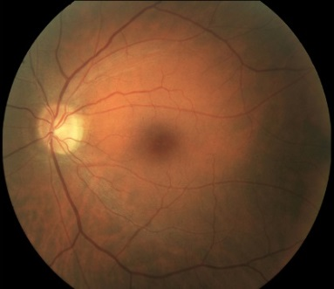
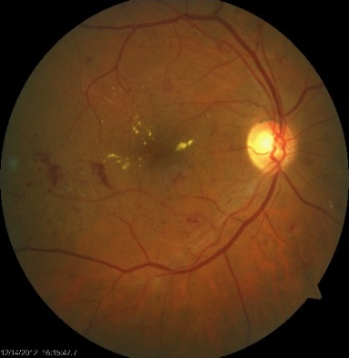
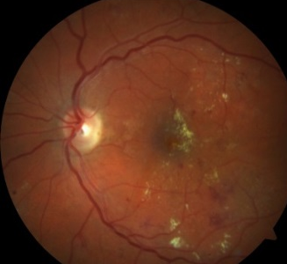
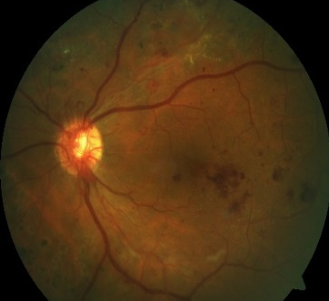
Retinal Manifestations of Diabetes
Macular Edema
(may occur at any stage of DR)
MACULAR CHANGES
No DR
Mild DR
Moderate DR
Severe DR
SEVERITY
No DR
Endothelial leukocyte adhesion
Basement membrane thickening
Pericyte loss
Altered retinal blood flow
VEGF upregulation
Biochemical changes
NPDR
(nonproliferative diabetic retinopathy)
PDR
(proliferative diabetic retinopathy)
STAGE
BDR
(background diabetic retinopathy)
PPDR
(preproliferative diabetic retinopathy)
Notes:
Diabetic retinopathy progresses through a spectrum of disease severity, ranging from no disease and no signs or symptoms, through nonproliferative diabetic retinopathy with mild, moderate, or severe signs, to proliferative diabetic retinopathy and possible severe vision loss due to neovascularization.¹ Macular edema may occur at any stage of DR.²
The fundus photographs show examples of the various severity levels of DR.
References
American Academy of Ophthalmology Retina/Vitreous Panel. Preferred Practice Pattern® Guidelines. Diabetic Retinopathy. San Francisco, CA: American Academy of Ophthalmology; 2008 (4th printing 2012). www.aao.org/ppp. Accessed November 26, 2013.
Brownlee M, Aiello LP, Cooper ME, Vinik AI, Nesto RW, Boulton AJM. Complications of diabetes mellitus. In: Melmed S, Polonsky KS, Larsen PR, Kronenberg HM, eds. Williams Textbook of Endocrinology. 12th ed. Philadelphia, PA: Elsevier Saunders; 2011;1462-1551.

Slide 41
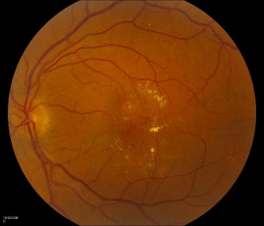
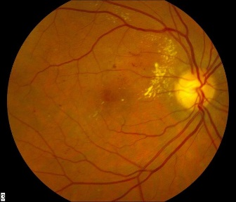
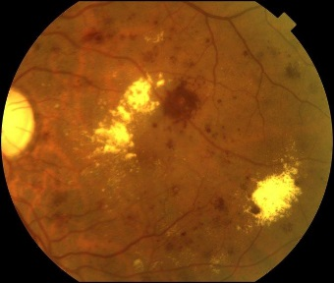
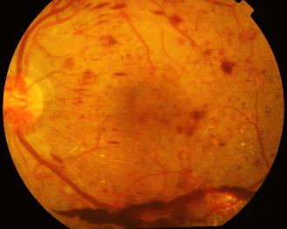
Diabetic Retinopathy Severity Scale
Mild NPDR
Moderate NPDR
Severe
NPDR
PDR
Risk of Vision Loss Increases
Notes:
Speaker Guide
Here we can see how each of these levels of severity look in comparison with one another

Slide 42
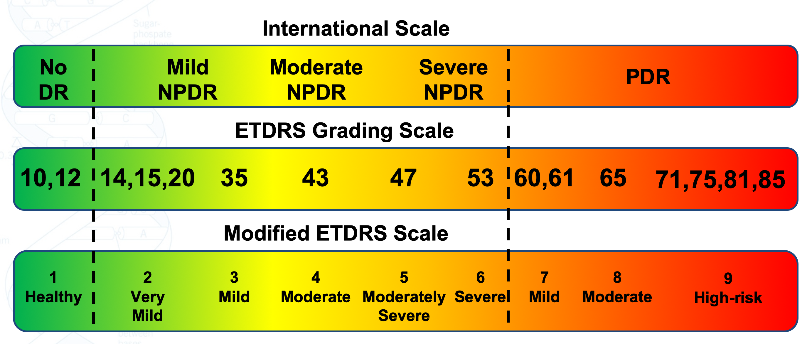
History of DR Severity Scales –
ETDRS, Modified ETDRS, and International
ETDRS Grading Scale¹
1. Early Treatment Diabetic Retinopathy Study (ETDRS) Research Group. Ophthalmology. 1991;98(5 Suppl):823-33. 2. Ip MS, et al. Arch Ophthalmol. 2012;130(9):1145-52. 3. American Academy of Ophthalmology. www.icoph.org/dynamic/attachments/resources/diabetic-retinopathy-detail.pdf. Accessed Nov 1, 2018.

Slide 43
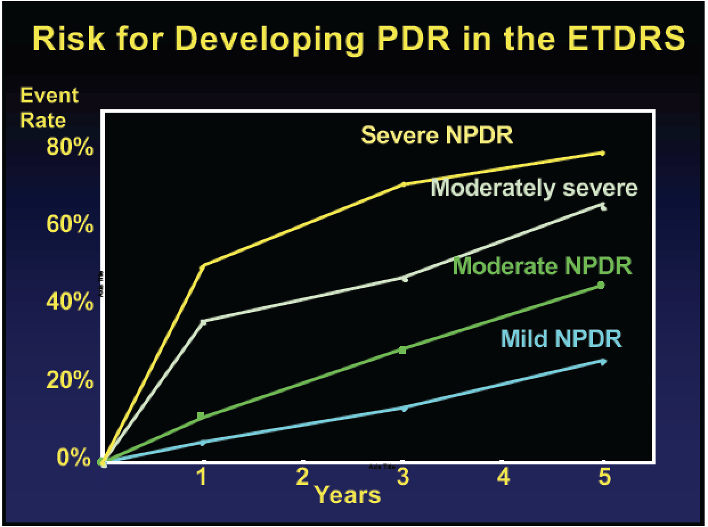

Slide 44
Are Patients with DM Coming in Annually?

Slide 45
THE IMPORTANCE OF COMPREHENSIVE EYE EXAMS
People With Diabetes Reporting Not
Having An Eye Exam In The Last Year¹
~40%
of patients with diabetes feel that a comprehensive eye exam is not needed²
The National Eye Institute recommends patients with diabetes receive a comprehensive dilated eye exam at least once a year³
  1. Centers for Disease Control and Prevention. https://gis.cdc.gov/grasp/diabetes/DiabetesAtlas.html#. Accessed June 11, 2018. 2. Chou et al. Diabetes Care. 2014;37:180. 3. National Eye Institute. Facts About Diabetic Eye Disease. https://nei.nih.gov/health/diabetic/retinopathy. Accessed June 11, 2018.
Notes:
Speaker Guide
In 2015, an average of 38.4% of people with diabetes had not had an eye exam in the last year¹
This is a rate 9.1% greater than it was 10 years ago
A study found that roughly 40% of patients feel that a comprehensive eye exam is not needed²
Because patients may not recognize DR until vision loss occurs, the National Eye Institute recommends patients with diabetes receive a comprehensive dilated eye exam at least once a year³
Additional Information²
“No need” consisted of “have not thought of it” and “no reason to go”
References
Centers for Disease Control and Prevention. https://gis.cdc.gov/grasp/diabetes/DiabetesAtlas.html#. Accessed June 11, 2018.
Chou et al. Diabetes Care. 2014;37:180.
National Eye Institute. Facts About Diabetic Eye Disease. https://nei.nih.gov/health/diabetic/retinopathy. Accessed June 11, 2018.
Content pulled from Diabetic Retinopathy Management piece
LUC/092617/0079j Page 5

Slide 46
Why Patients Don’t Receive Annual Eye Exams
As reported by patients diagnosed with diabetes who are not receiving annual eye exams
Patients with visual impairments are more likely to cite “cost or lack of insurance” as a reason for not receiving an eye exam and less likely to report “no need”
Other
No eye doctor, no transportation, or could not get appointment
No need*
Cost/lack
of insurance
*Consisted of “have not thought of it” and “no reason to go”
Notes:
Nearly 1 of 4 patients with diabetes, 40 years old and older, is not complying with the recommended yearly eye exam.
The 2 most common reasons for not getting exams:
Not seeing a need for it
“No need” consisted of “have not thought of it” and “no reason to go”
Those who reported “no need” as a barrier were most likely to be aged ≥65 years
Older adults might not be aware of their vision impairment, because symptoms progress slowly or they might consider vision impairment to be a normal part of aging
Men were more likely than women to report “no need” to seek eye care
Those with visual impairment were more likely to report “cost or lack of insurance” as a barrier and less likely to report “no need”
Given that “no need” was the most commonly cited reason for not seeking eye care, diabetes eye health education programs or interventions that increase the awareness of the need for eye care among people with diabetes may be important in preventing vision loss.
The cost of exams or a lack of health insurance
Other reasons:
Not having an eye doctor
Not being able to make an appointment with a doctor
Not having transportation to an appointment
People aged ≥65 years were more likely to report “no need” as their main reason for being noncompliant, whereas those aged 40-64 years and women were more likely to report “cost or lack of insurance” as their main reason.
Reference
Chou CF, Sherrod CE, Zhang X, et al. Barriers to eye care among people aged 40 years and older with diagnosed diabetes, 2006-2010. Diabetes Care. 2014;37:180-188.

Slide 47
ONLY A FRACTION OF DIABETIC RETINOPATHY PATIENTS RECEIVE TREATMENT
84 million with prediabetes^{1,a}
>30 million diabetics^{1,a}
~7.7 million with diabetic retinopathy^{2,b}
~2 million diagnosed³
~620k treated⁴
ªAs of 2015, ^{b}As of 2010
1. Centers for Disease Countrol and Prevention. National Diabetes Statistics Report. 2017. 2. National Eye Institute. www.nei.nih.gov/eyedata/diabetic/tables. Accessed June 11, 2018. 3. Bresler et al. JAMA Opthalmol. 2014;132:168. 4. Data on file. Genentech, Inc. South San Francisco, CA.
Notes:
Speaker Guide
In the United States, there are approximately 84 million Americans with prediabetes and over 30 million with diabetes¹
About 7.7 million of those diabetics have diabetic retinopathy but only 2 million are actually diagnosed, and then only about 620 thousand are treated²⁻⁴
Discussion Questions
Why do you think only a fraction of patients receive treatment?
What are some of the barriers to treatment?
References
Centers for Disease Control and Prevention. National Diabetes Statistics Report. 2017.
National Eye Institute. www.nei.nih.gov/eyedata/diabetic/tables. Accessed June 11, 2018.
Bresler et al. JAMA Opthalmol. 2014;132:168.
Data on file. Genentech, Inc. South San Francisco, CA.

Slide 48
Prevalence of DME in the US
Approximately 8 million (21%) of people with diabetes have DR¹
5.8 million are diagnosed¹⁻³
2.3 million have DME³
8.0MM¹
5.8MM¹⁻³
2.3MM³
1.5MM³
≈400K⁴
≈240K⁴
Notes:
In the United States, approximately 21% of people with diabetes, or 8 million individuals, have DR.¹ Only about 5.8 million of these are diagnosed¹⁻³
Of these 8 million people, about 2.3 million have DME, 1.5 million are diagnosed, and 750,000 have clinically significant macular edema (CSME)^{1,3}
Of these, only about 400,000 are receiving treatment for DME, and only about 240,000 are being treated with anti-VEGF therapies.⁴ This represents an important gap in our treatment of DME
References
NHANES 2005-2008, projected to 2012 US population.
Centers for Disease Control and Prevention. www.cdc.gov. Accessed June 9, 2014. Saaddine JB, et al. Arch Ophthalmol. 2008;126(12):1740–1747.
BioTrends Research Group. TreatmentTrends®: Diabetic Retinopathy/Diabetic Macular Edema (US) 2013.
Proprietary Quantitative Market Research (n=103 retina specialists, n=23,994 DME eyes with central involvement); fielded November 2013.

Slide 49
DME in the US
Nearly 800,000 Americans suffer from DME but remain undiagnosed¹
Another 1.1 million are diagnosed with DME
but are not receiving treatment^{1,2}
2.3MM¹
800K
Undiagnosed¹
~1.1MM
Diagnosed,
Untreated^{1,2}
1.5MM
Diagnosed¹
~400K Treated²
Notes:
DR leading cause of new cases of blindness in US adults ages 20-74¹
DME is the most common cause of vision loss among patients with diabetes²
References
Centers for Disease Control and Prevention. National diabetes fact sheet: national estimates and general information on diabetes and prediabetes in the United States, 2011. Atlanta, GA: US Department of Health and Human Services, Centers for Disease Control and Prevention, 2011. http://www.cdc.gov/diabetes/pubs/pdf/ndfs_2011.pdf. Accessed March 25, 2014.
Danis RP. Diabetic macular edema. In: Albert DM, Miller JW, Azar DT, Blodi BA, eds. Albert & Jakobiec's Principles and Practice of Ophthalmology. 3rd ed. Philadelphia, PA: WB Saunders; 2008:1793-1806.

Slide 50
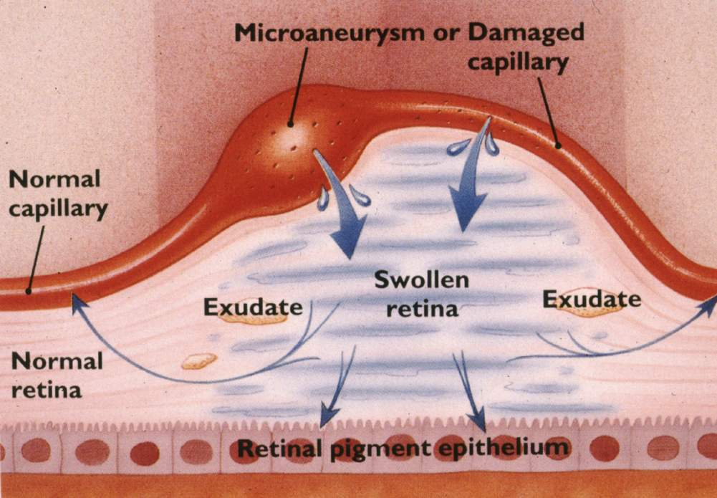
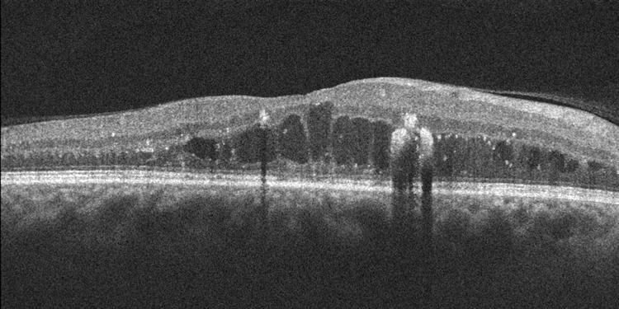
Diabetic Macular Edema (DME)
Thickening of the retina
Secondary to leaky microaneurysms
90% of visual loss in diabetes

Slide 51
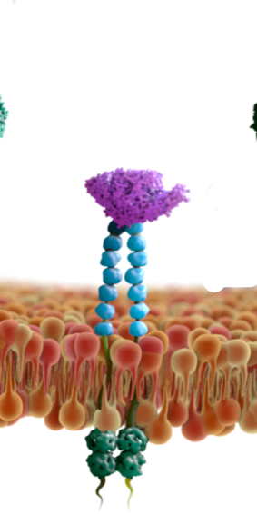
VEGF is a key player in DME pathophysiology
VEGF is a master regulator of angiogenesis, driving pathological neovascularization and blood-retina barrier breakdown¹
Anti-VEGF treatment can provide rapid and sustained improvements in vision in patients with DME^{2,3}
  Ranibizumab (Lucentis) and aflibercept (Eylea) act primarily by inhibiting VEGF
However, DME is a multifactorial disease with an inflammatory component that anti-VEGF treatments do not completely address
VEGF
VEGFR
1. Ferrara N, Adamis AP. Nat Rev Drug Discov. 2016;15(6):385-403. 2. Nguyen QD et al. Ophthalmology. 2012;119(4):789-801; 3. Brown DM et al. Ophthalmology. 2015;122(10):2044-2052. Ranibizumab and aflibercept are FDA-approved for the treatment of DME. DME, diabetic macular edema. VEGF, vascular endothelial growth factor; VEGFR, vascular endothelial growth factor receptor.
Notes:
VEGF plays a key role in angiogenesis, driving pathological neovascularization and diabetic blood-retina barrier breakdown [Ferrari 2016]
The anti-VEGF therapies, ranibizumab and aflibercept, are currently the standard of care for DME, and can provide rapid and sustained improvements in vision.
However, DME is a multifactorial disease with an inflammatory component that anti-VEGF treatments do not completely address.
Note: Bevacizumab not included above as an anti-VEGF treatment as it is not FDA approved and used off-label for the treatment of DME. Ranibizumab and aflibercept are FDA-approved for the treatment of DME.

Slide 52
How we diagnose diabetic macular edema is changing
ETDRS definition has been modified in the era of OCT and anti-VEGF therapy

Slide 53
Diabetic Macular Edema (DME)
CSME
Center involved vs. Not center involved

Slide 54
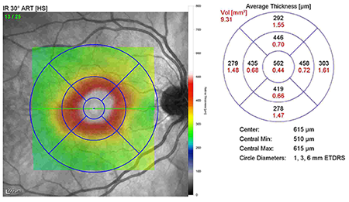
2017 DME Classification:
Center Involved of Not?
ETDRS definition of “clinically significant macular edema” modified in era of OCT
Randomized clinical trials of anti-VEGF agents used presence of DME in OCT central subfield
Central
subfield
Nguyen, Quan Dong, et al. "Ranibizumab for diabetic macular edema: results from 2 phase III randomized trials: RISE and RIDE." Ophthalmology 119.4 (2012): 789-801.
Brown, David M., et al. "Intravitreal aflibercept for diabetic macular edema: 100-week results from the VISTA and VIVID studies." Ophthalmology 122.10 (2015): 2044-2052.

Slide 55
The ABC’s of DME
DRCR.net
  Protocol I
  Protocol T
RISE
RIDE
READ
VISTA
VIVID
Bolt
Regeneron
Genentech
Essentially establishing the effectiveness of all the anti-VEGF drugs for the treatment of DME

Slide 56
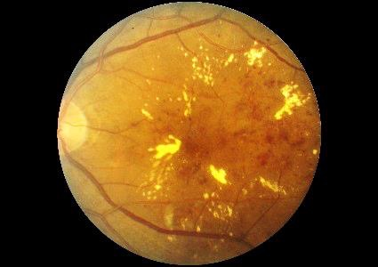
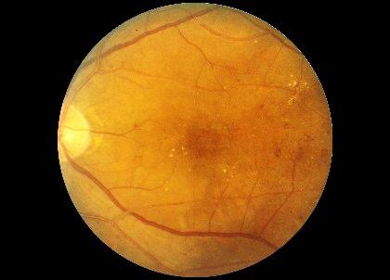
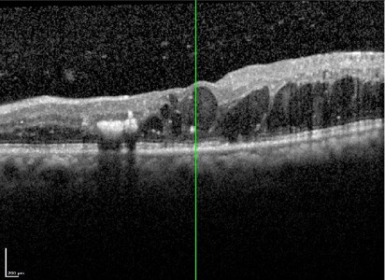
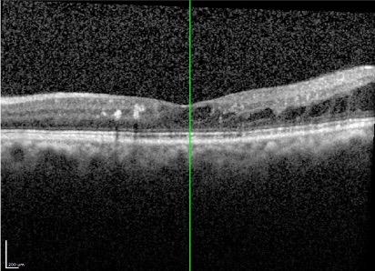
DME Pre Treatment
Anti-VEGF Treatment
DME Post Treatment

Slide 57
“The Fate of 47…”

Slide 58
The Debate…
Is it better to treating early – before they develop PDR?
  Would earlier treatment result in better visual outcomes?
  Would it result in less # of injections?
  Does the cost/burden of treatment warrant early treatment?

Slide 59
PANORAMA
Phase 3 double-masked, randomized Prospective Study
Efficacy and safety of intravitreal aflibercept (IAI) in patients with moderately severe to severe NPDR
  DRSS 47 & 53
Primary Endpoint:
  Week 24
  Proportion of patients improving ≥2 steps on DRSS
  IAI groups combined
Follow up through week 100

Slide 60
Phase 3 Double-masked, Randomized Prospective Study
Efficacy and Safety of Intravitreal Aflibercept (IAI) in Patients with Moderately Severe to Severe NPDR (DRSS Level 47 and 53) N=402
Sham
N=133
Group 1
IAI 2mg Q16 weeks*
N=135
Group 2
IAI 2mg Q8 weeks**
N=134
Week 24
Primary Endpoint
Proportion of patients improving ≥2steps on DRSS
Groups 1 & 2 Combined
Follow up through Week 100
    *after 3 initial monthly doses and one Q8 week interval
    **after 5 initial loading doses; flexible treatment schedule after week 52
Wykoff, CC. Key points from the Phase 3 PANORAMA Study. (July 2018) American Society of Retina Specialists, Annual Meeting, Vancouver, BC, CA.

Slide 61
Proportion of Patients with ≥2-Step Improvement from Baseline in DRSS
Group 1: 3monthly doses followed by one Q8 interval then Q16
Group2: 5monthly doses followed by Q8
*P<.0001 vs. Sham
Wykoff, CC. Key points from the Phase 3 PANORAMA Study. (July 2018) American Society of Retina Specialists, Annual Meeting, Vancouver, BC, CA.

Slide 62
Proportion of Patients with ≥2-Step Improvement from Baseline in DRSS: 52 Weeks
Group 1: 3 monthly doses followed by one Q8 interval then Q16
Group2: 5 monthly doses followed by Q8
*P<.0001 vs. Sham
Wykoff, CC. Key points from the Phase 3 PANORAMA Study. (July 2018) American Society of Retina Specialists, Annual Meeting, Vancouver, BC, CA.

Slide 63
Diabetic Retinopathy Severity Score (DRSS)
Level* | ETDRS DRSS Severity | Description
1 | 10 and 12 | DR absent
2 | 14, 15, 20 | DR questionable, microaneurysms only
3 | 35 | Mild NPDR
4 | 43 | Moderate NPDR
5 | 47 | Moderately severe NPDR
6 | 53 | Severe NPDR
7 | 60, 61 | Mild PDR
8 | 65 | Moderate PDR
9 | 71 | High-risk PDR
10 | 75 | High-risk PDR
2-step improvement in DRSS
From DRSS level 53, Severe NPDR (level6)
To DRSS level 43, Moderate NPDR (level 4)
The Diabetes Control and Complications Trial. Arch Ophthalmol. 1995;113:36-51; Aiello LM. Am J Ophthalmol. 2003;136:122-135
Notes:
THIS SLIDE CONTAINS AN ANIMATION
* Used to determine step change in the diabetic retinopathy severity score
DR: diabetic retinopathy; ETDRS: Early Treatment Diabetic Retinopathy Study; NPDR: nonproliferative diabetic retinopathy; PDR: proliferative diabetic retinopathy
The Diabetes Control and Complications Trial. Arch Ophthalmol. 1995, Aiello. Am J Ophthalmol. 2003, Jonas. ETDRS report number 10. Ophthalmology. 1991

Slide 64
PANORAMA
Week 52 Results
Vision threatening complications were reduced by 82% to 85% compared with sham injection
Development of CI-DME was reduced by 68% to 74% compared with sham

Slide 65
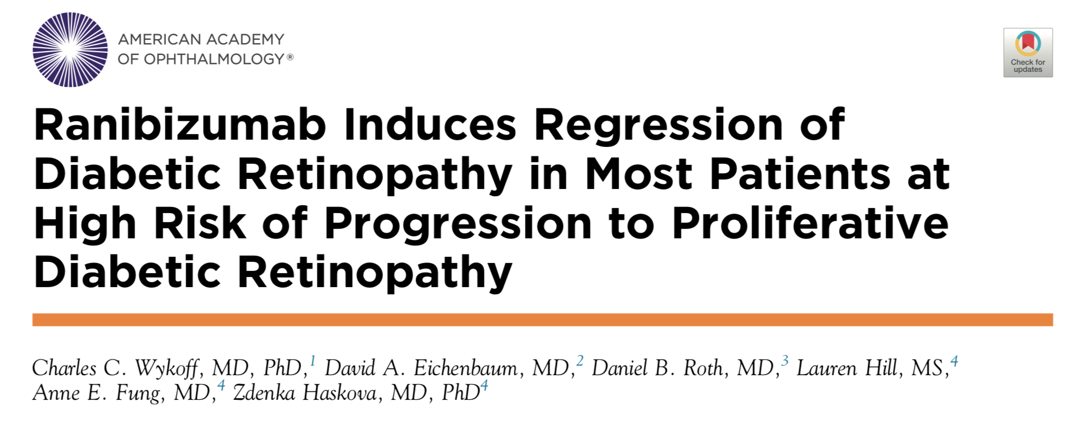
Ophthalmology Retina October 2018
The main objective of this exploratory post hoc analysis of the RIDE and RISE clinical trials was to examine DR outcomes in patients who were at highest risk for progressing to PDR (baseline DRSS levels 47/53).

Slide 66
RISE AND RIDE POST HOC ANALYSIS
PATIENTS WHO HAD NPDR AND PDR WITH DME
Post hoc analysis:
Included 746 patients (LUCENTIS 0.3 mg, n=245; LUCENTIS 0.5 mg, n=247; sham, n=254) who had DR with DME and were randomized for treatment in RISE & RIDE
DR outcomes with LUCENTIS were evaluated in patients along the spectrum of the severity scale (baseline ETDRS levels 10–75)
Patients with prior panretinal photocoagulation (PRP) were not included in this analysis
Wykoff et al. Ophthalmology Retina. 2018.
Notes:
Speaker Guide
The post hoc analysis included 746 patients (LUCENTIS 0.3 mg, n=245; LUCENTIS 0.5 mg, n=247; sham, n=254) who had DR with DME and were randomized for treatment in RISE & RIDE
DR outcomes with LUCENTIS were evaluated in patients along the spectrum of the severity scale (baseline ETDRS levels 10–75)
Patients with prior PRP were not included in this analysis
Reference
Wykoff et al. Ophthalmology Retina. 2018.

Slide 67
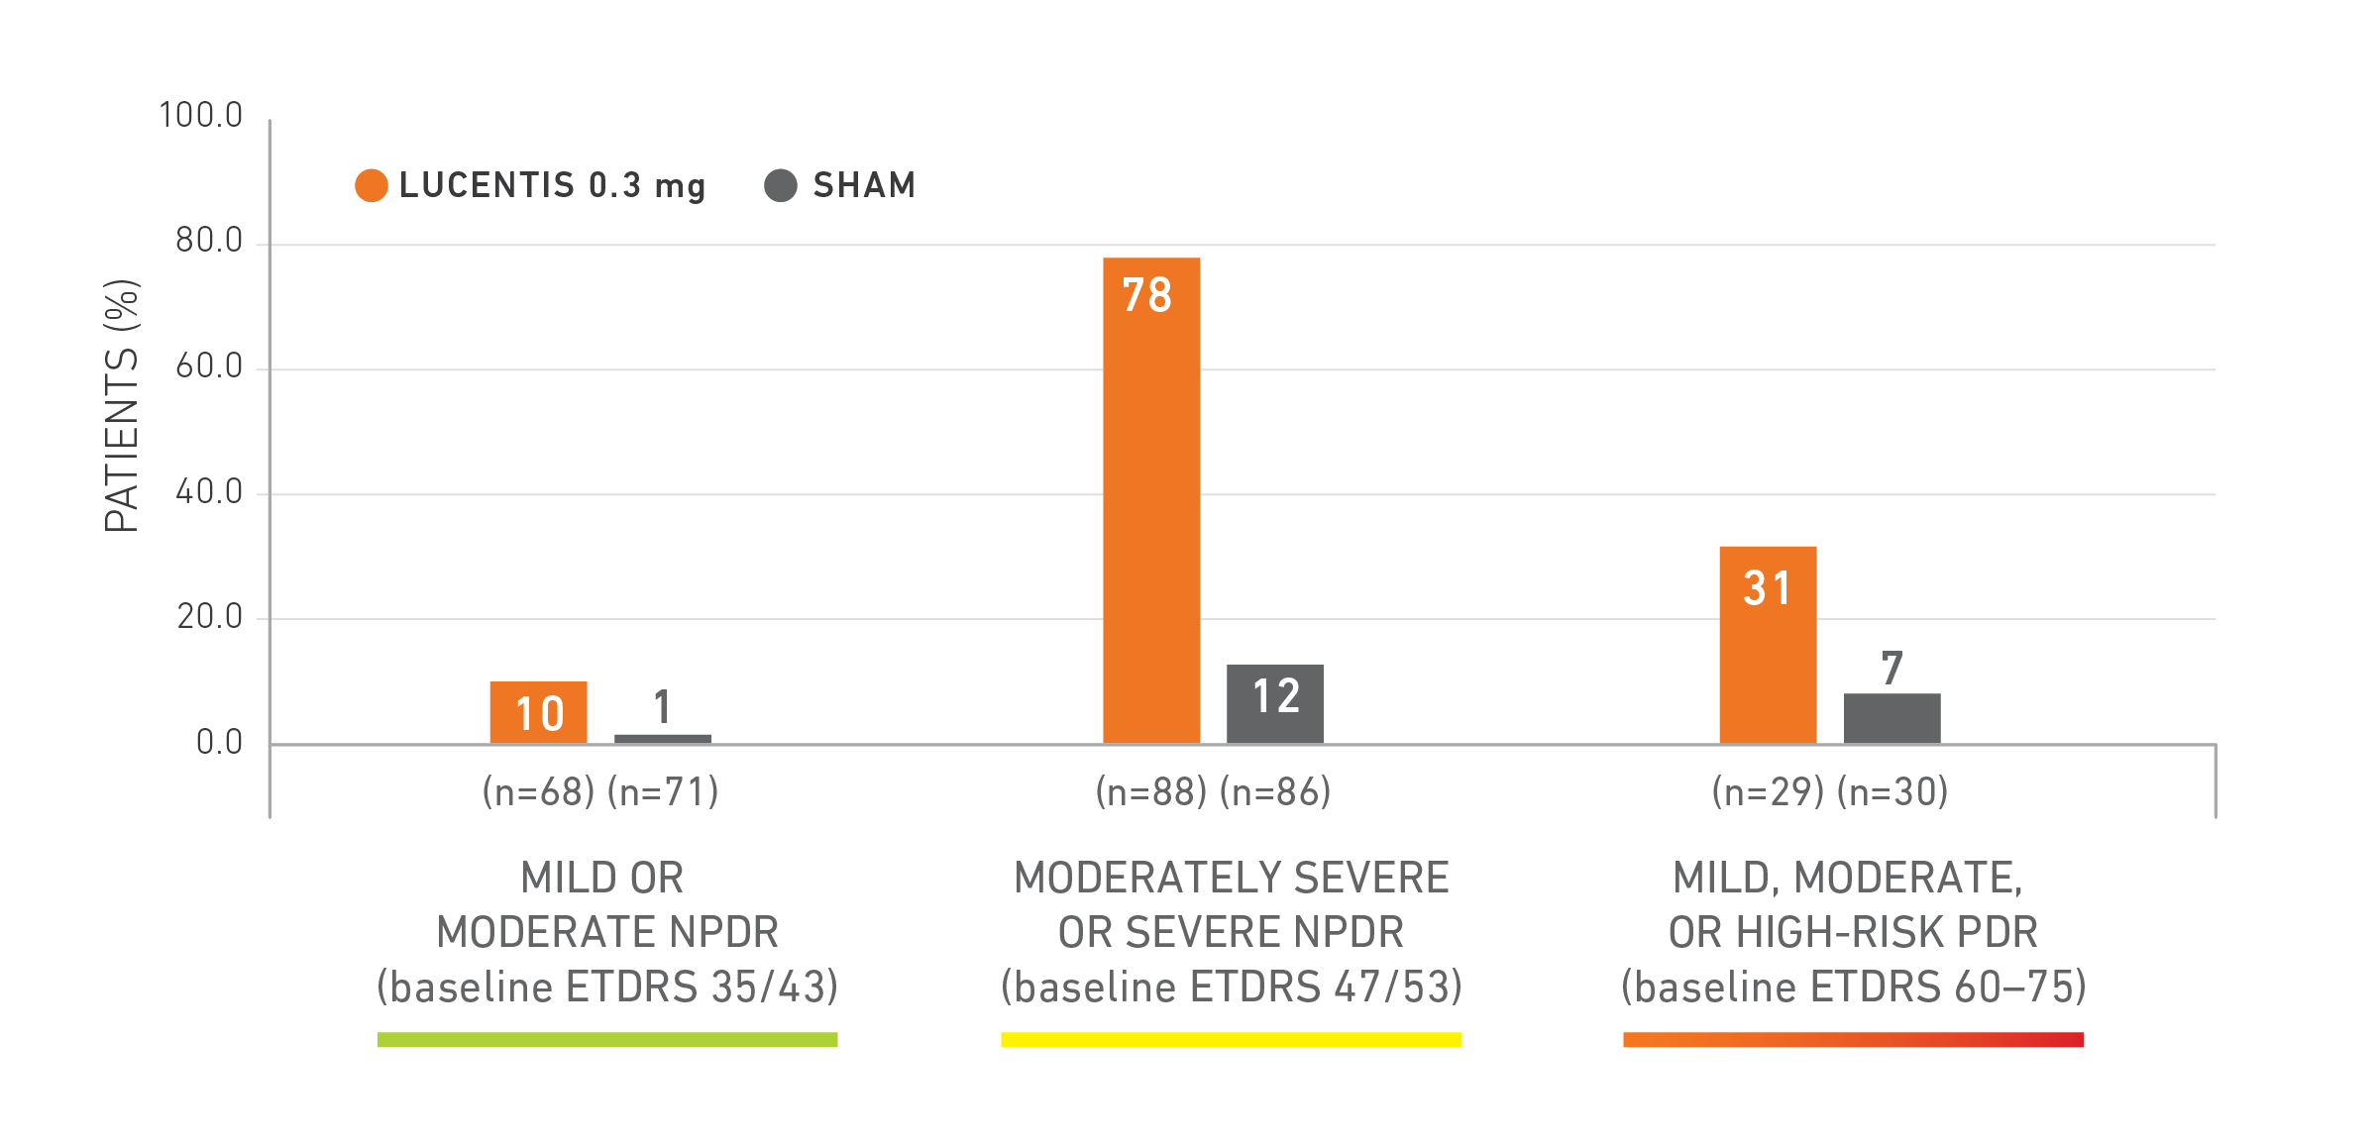
RISE AND RIDE POST HOC ANALYSIS
≥2-STEP REGRESSION IN DR AT 2 YEARS
Ranibizumab
Limitations of this analysis include that it is post hoc (ie, not prespecified in protocols). The statistical significance of these results cannot be determined, and the clinical significance of these results is unknown. Results between groups should not be compared.
Wykoff et al. Ophthalmology Retina. 2018.
Notes:
Speaker Guide
For mild or moderate NPDR, 10% of patients treated with LUCENTIS experienced a ≥2-step regression in DR at 2 years. 1% of patients receiving sham experienced a ≥2-step regression in DR at 2 years
For moderately severe or severe NPDR, 78% of patients treated with LUCENTIS experienced a ≥2-step regression in DR at 2 years. 12% of patients receiving sham experienced a ≥2-step regression in DR at 2 years
For mild, moderate, or high-risk PDR, 31% of patients treated with LUCENTIS experienced a ≥2-step regression in DR at 2 years. 7% of patients receiving sham experienced a ≥2-step regression in DR at 2 years
Limitations of this analysis included that it is post hoc (ie, not prespecified in protocols). The statistical significance of these results cannot be determined, and the clinical significance of these results is unknown. Results between groups should not be compared
Reference
Wykoff et al. Ophthalmology Retina. 2018.

Slide 68
Ranibizumab induces Regression of Diabetic Retinopathy
Wycoff et al, Ophthalmology Retina October 2018
At month 24, DR levels 47/53 80% of eyes had a 2-step improvement in ranibizumab treated eyes vs 12% in the sham treated eyes
The regression of DR was not seen in earlier in less severe DR or in more severe DR
Study Conclusion: In patients with baseline DR levels 47/53, ranibizumab treatment reduced the probability of patients experiencing a new proliferative event at month 36 by 3 times vs. sham treatment

Slide 69
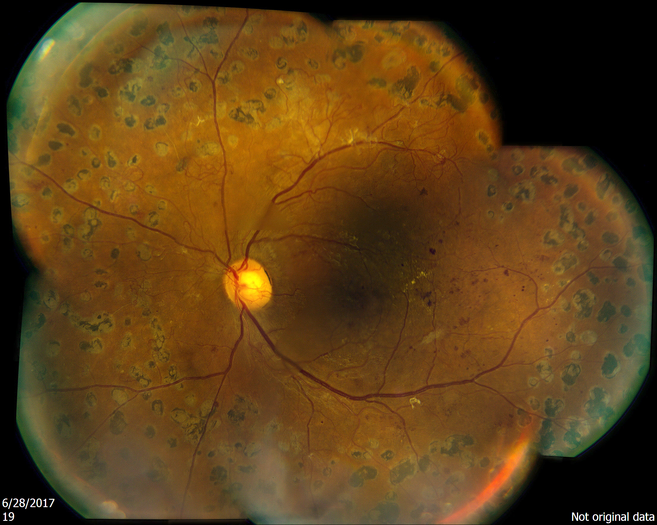
Vision Loss in Diabetic Retinopathy
NPDR
PDR
Visual
Acuity
Mild
Moderate
Severe
Severe
Vision
Loss
DME can develop at any stage – more likely to present as DR progresses
Slow
Progression
Rapid
Progression
Therapeutics (e.g. Anti VEGFs)

Slide 70
Looking More Carefully
DME -> get referred for treatment
PDR -> gets referred for treatment
Most patient with severe NPDR often have DME
So it leaves a very small percentage

Slide 71
Important Clinical Trials to Be Aware
These trials may soon influence when to treat and refer
DRCR.net
  Protocol T
  Protocol S

Slide 72
DRCR.net
The Diabetic Retinopathy Clinical Research Network (DRCR.net) is a collaborative network dedicated to facilitating multicenter clinical research of diabetic retinopathy, diabetic macular edema and associated conditions
  Principal emphasis is placed on clinical trials
Formed in September 2002 and currently includes over 115 participating sites (offices) with over 400 physicians throughout the US
Funded by NEI

Slide 73
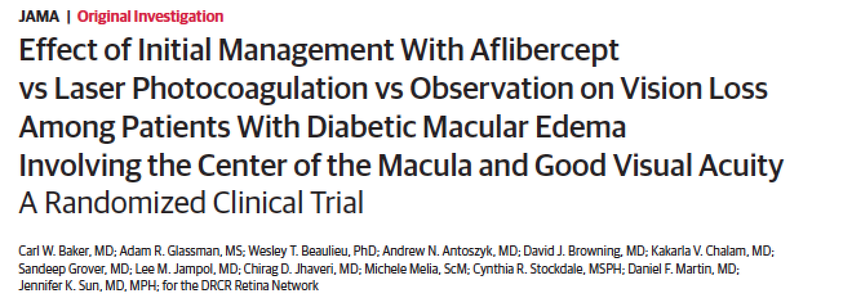
DRCR.net Protocol V: Treatment vs. Observation
702 participants with CI-DME and VA 20/25 or better were randomly assigned to initial Tx with Eylea (n = 226), laser photocoagulation (n = 240) or observation (n = 236)
At 2 years, the rates of VA loss of > 5 letters did not differ significantly between groups
JAMA. 2019;321(19):1880-1894. doi:10.1001/jama.2019.5790
Published online April 29, 2019.

Slide 74



The Diabetic Retinopathy Clinical Research Network
Protocol T
Comparative Effectiveness Study of Aflibercept, Bevacizumab and Ranibizumab for DME

Slide 75
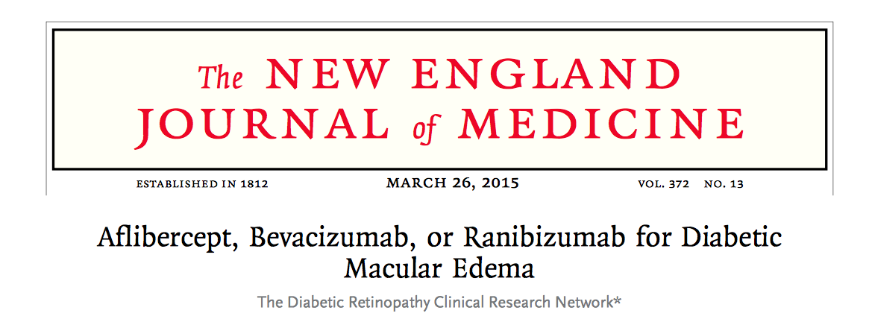
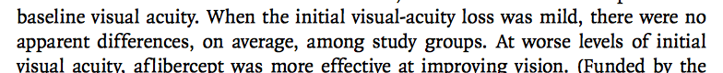

Slide 76
DRCR.net: Protocol T
At 1 yr
  Aflibercept (Eylea) group gained 13.3 letters,
  Ranibiumab (Lucentis) group gained 11.2 letters
  Bevacizumab (Avastin) group gained 9.7 letters
There were no statistically significant differences among subgroups of patients starting the trial with visual acuity between 20/32 and 20/40
Wells JA, Glassman AR, Ayala AR, et al. Aflibercept, bevacizumab, or ranibizumab for diabetic macular edema [published online ahead of print February 18, 2015]. N Engl J Med. doi:10.1056/NEJMoa1414264.

Slide 77
Mean Change in Visual Acuity Letter Score, Full Cohort
52 Week Treatment Group Comparison*:
Aflibercept vs. Bevacizumab P<0.001
Aflibercept vs. Ranibizumab P = 0.034
Ranibizumab vs. Bevacizumab P = 0.12
+13
+11
+10
* P-values adjusted for baseline visual acuity and multiple comparisons
Notes:
Changed animation to Fade
Primary Analysis: Markov chain Monte Carlo method of multiple imputation (100 imputations) used to estimate missing 1 year change in visual acuity

Slide 78
If VA was 20/50 or worse…
DRCR.net
Aflibercept gained 18.9 letter
Ranibizumab gained 14.2 letters
Bevacizumab gained 11.8 letters

Slide 79
Mean Change in Visual Acuity Letter Score
Baseline Visual Acuity 20/50 or Worse
~ 50% of Cohort
+19
+14
+12
1-Year Treatment Group Comparison*:
Aflibercept vs. Bevacizumab P<0.001
Aflibercept vs. Ranibizumab P = 0.0031
Ranibizumab vs. Bevacizumab P = 0.21
* P-values adjusted for baseline visual acuity and multiple comparisons
Notes:
Capitalized P
No space after P for <
Made fade

Slide 80
Mean Change in Visual Acuity Over 2 Years
Full Cohort
+13.3
+12.8
+11.2
+12.3
+10.0
+9.7
104-Week Treatment Group Comparison*:
Aflibercept vs. Bevacizumab P = 0.02
Aflibercept vs. Ranibizumab P = 0.47
Ranibizumab vs. Bevacizumab P = 0.11
* P-values adjusted for baseline visual acuity and multiple comparisons

Slide 81
Mean Change in Visual Acuity Over 2 Years
Baseline Visual Acuity 20/50 or Worse
~50% of Cohort
+18.1
+18.9
+16.1
+14.2
+13.3
+11.8
104-Week Treatment Group Comparison*:
Aflibercept vs. Bevacizumab P = 0.02
Aflibercept vs. Ranibizumab P = 0.18
Ranibizumab vs. Bevacizumab P = 0.18
* P-values adjusted for baseline visual acuity and multiple comparisons

Slide 82
DRCR.net: Protocol S
Is Lucentis as good (noninferior) as traditional PRP for patients with PDR?
55 U.S. clinical sites
203 eyes were randomly assigned to receive PRP (completed in 1 to 3 visits) and 191 eyes received 0.5 mg intravitreous ranibizumab at baseline and as frequently as every 4 weeks (based on a structured re-treatment protocol)
Primary endpoint: mean change in VA letter score from baseline to 2 years.
JAMA. 2015; 314(20):2137-2146. doi: 10.1001/jama.2015.15217 (Published).

Slide 83
DRCR.net: Protocol S
At 2 years, VA improved by 2.8 letters from baseline in the ranibizumab group vs. improvement of 0.2 letters from baseline in the PRP group
There was more peripheral VF loss and more vitrectomy’s in the PRP group vs. Lucentis
  VF Loss: 213 dB in the ranibizumab group vs. 531 dB in the PRP group
  PPV: 15% with PRP vs. 4% with Lucentis
When DME present, Lucentis did a better job treating
JAMA. 2015; 314(20):2137-2146. doi: 10.1001/jama.2015.15217 (Published).

Slide 84
5 Year: Mean Changes in VA From Baseline Over Time
- Overall Cohort
Adjusted Mean Difference at 5 Years: +0.6 letters
95% Confidence Interval: (-2.3, +3.5), P = .68
+3.1
+3.0
N = 117
N = 203
N = 123
N = 191

Slide 85
Change in VA Letter Score at 5-Years
 | Ranibizumab (N = 117) | PRP (N = 123) | Adjusted Difference (95% CI)
≥ 15 letters improvement, % | 26% | 23% | 1% (-12%, 15%)
≥ 10 letters improvement, % | 52% | 41% | 6% (-10%, 21%)
≥ 10 letters worsening, % | 6% | 9% | -3% (-11%, 5%)
≥ 15 letters worsening, % | 6% | 6% | -1% (-7%, 5%)

Slide 86
DRCR Protocol S: PRP Vrs. Ranibizumab for PDR
Treatment with 0.5-mg ranibizumab met primary non-inferiority outcome for VA being no worse than PRP
Mean change in VA from baseline to 2-years with ranibizumab, no worse than with PRP
Superior mean VA over course of 2 years (area under the curve analysis)
Superior mean visual field outcomes
Decreased occurrence of vitrectomies
Decreased development of central-involved DME
PRP rarely given for failure or futility of ranibizumab

Slide 87

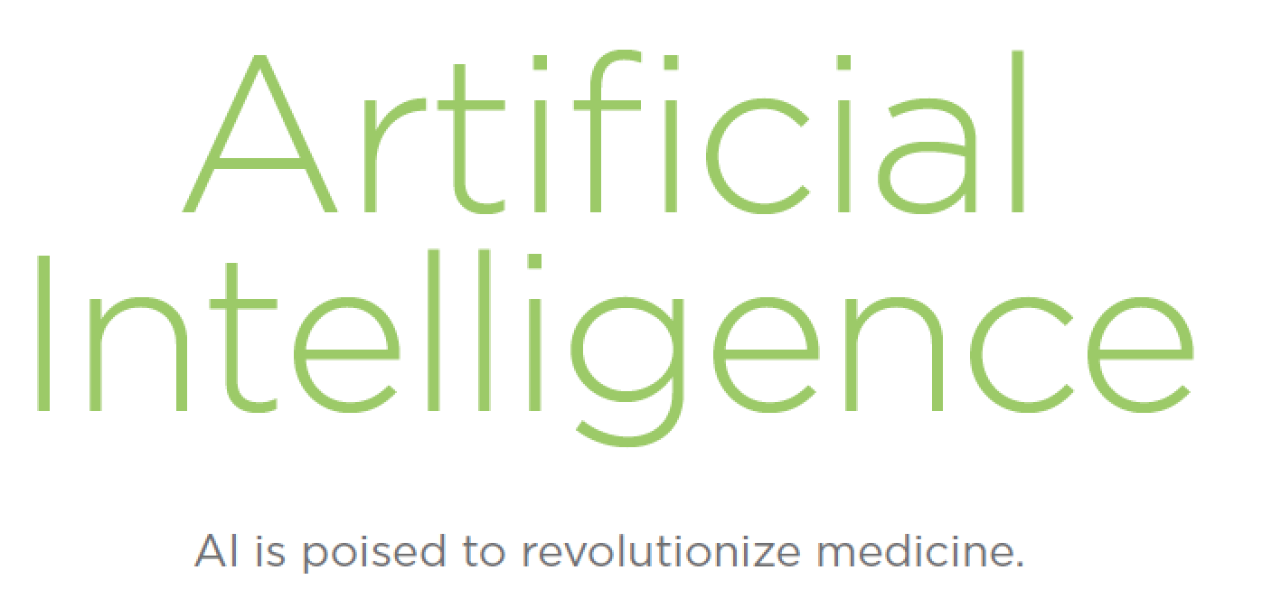
November 2017

Slide 88
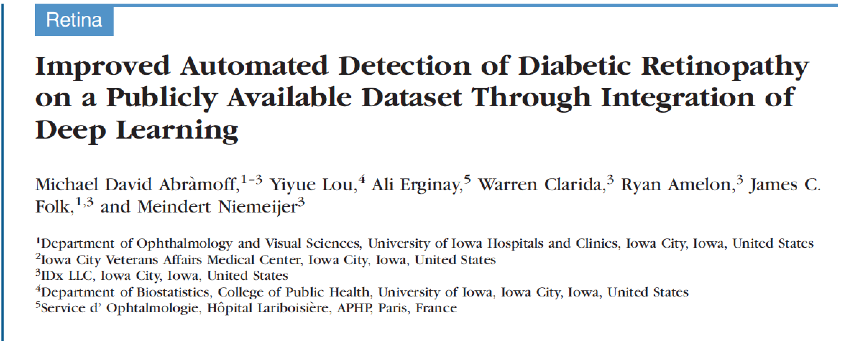
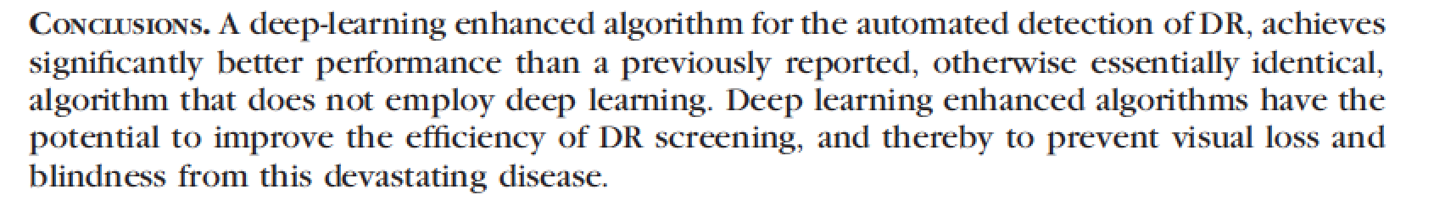
IOVS Dec 2016

Slide 89
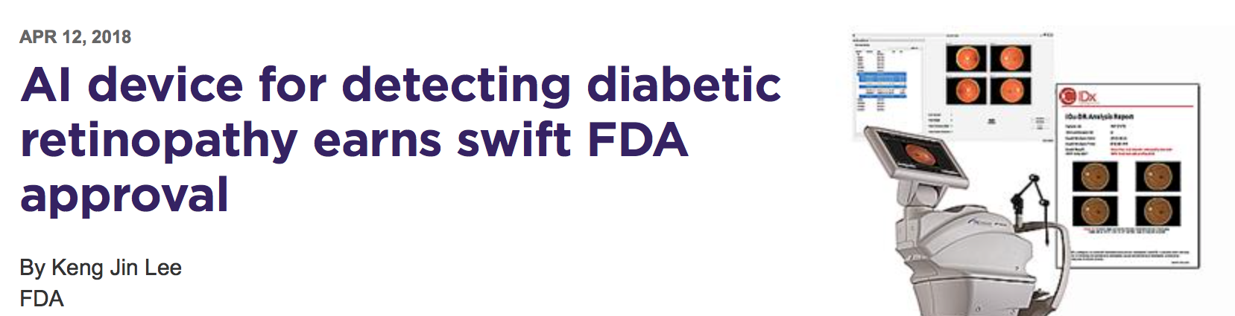
Images captured by Topcon NW400 non-mydriatic retinal camera
Images sent to a cloud-based server that utilizes the IDx-DR software and a ‘deep learning’ algorithm
The technology was 87% sensitive and 90% specific for detecting more than mild diabetic retinopathy
The algorithm correctly identified 100% of with ETDRS level 43 or higher (moderate NPDR)

Slide 90
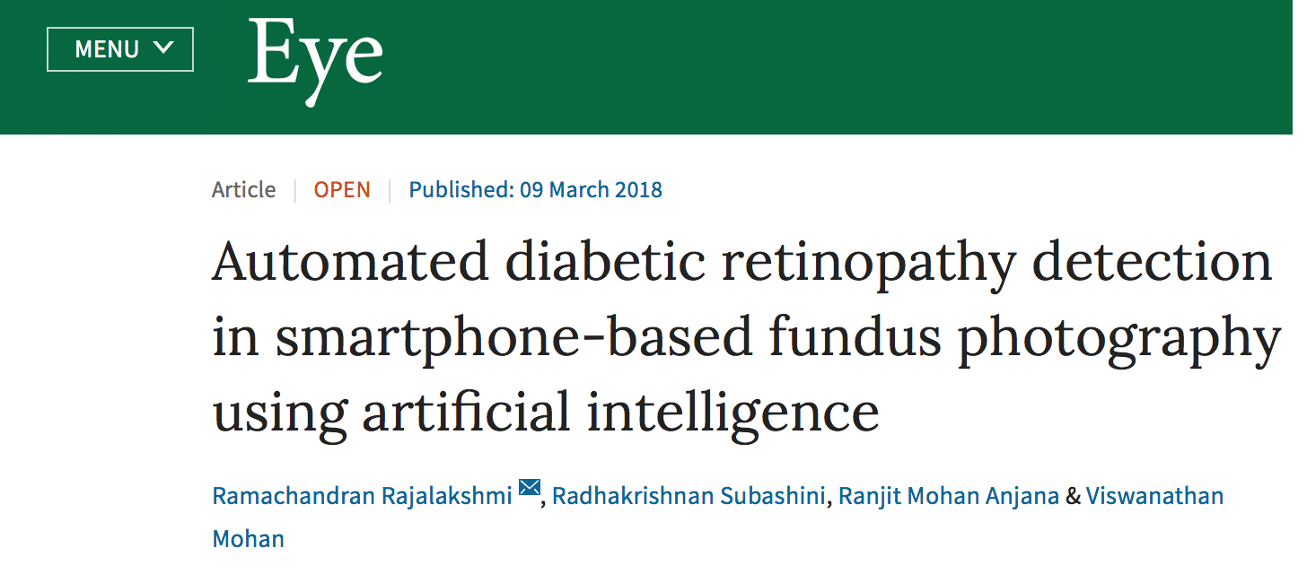
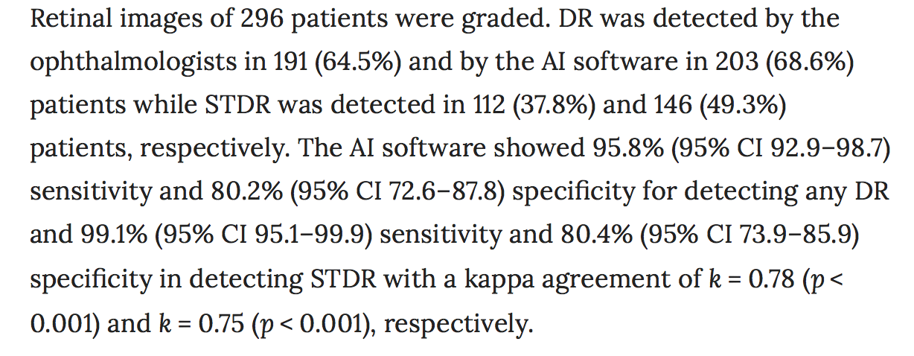

Slide 91
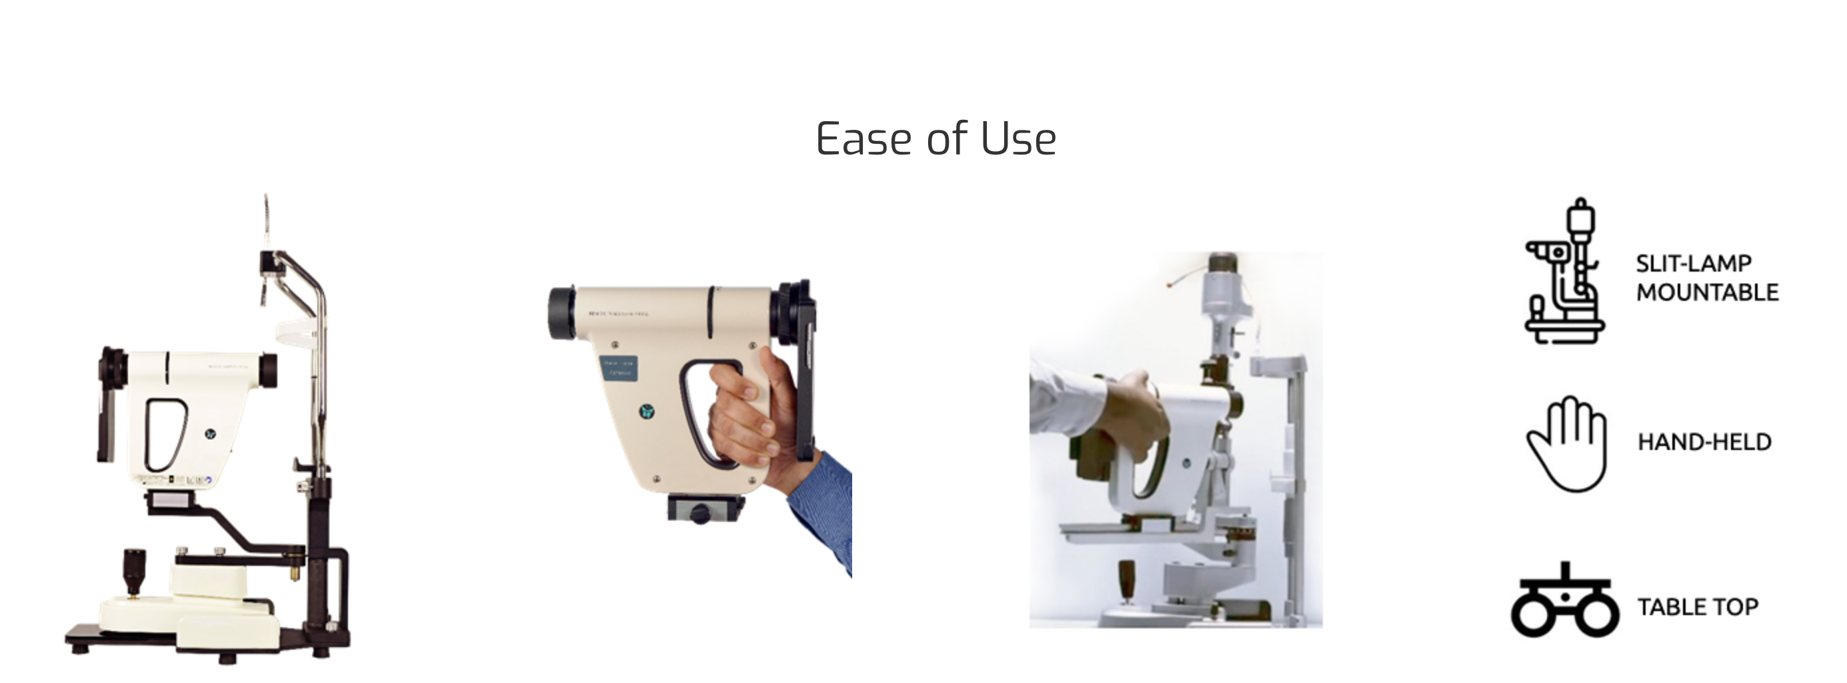
Remidio ‘Fundus on phone’ (FOP), a smartphone-based device

Slide 92
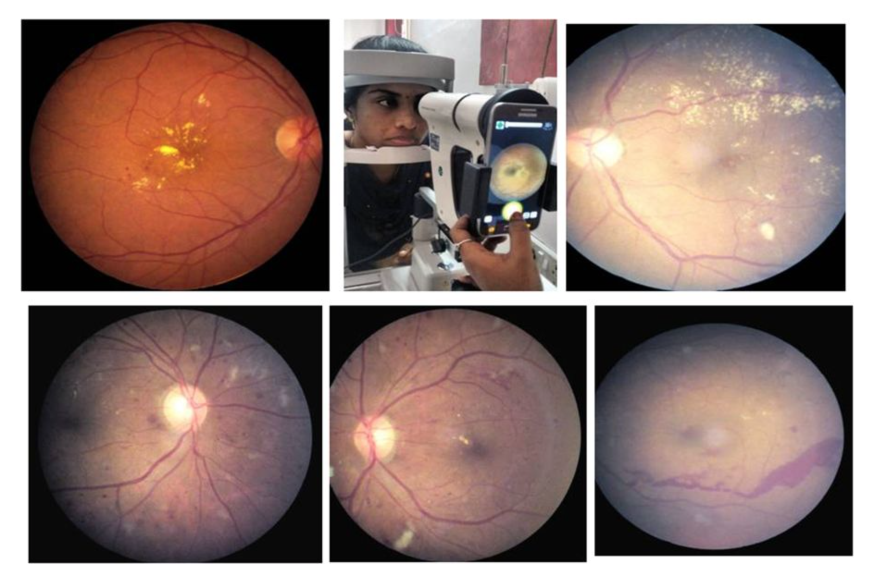

Slide 93
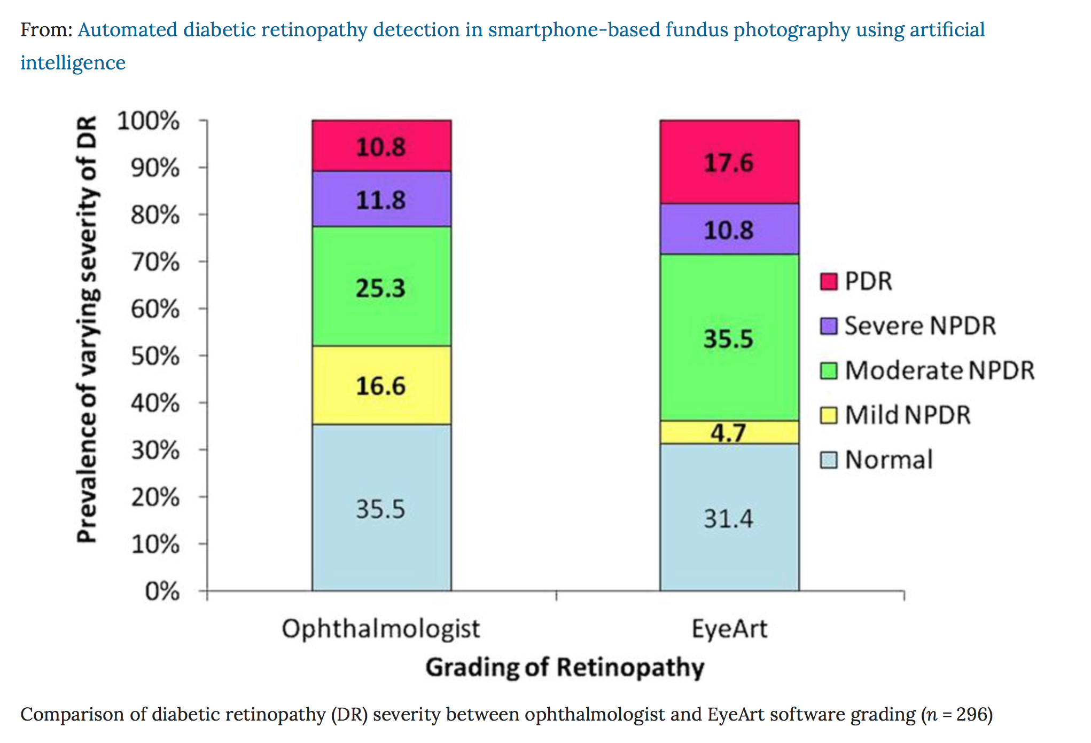

Slide 94
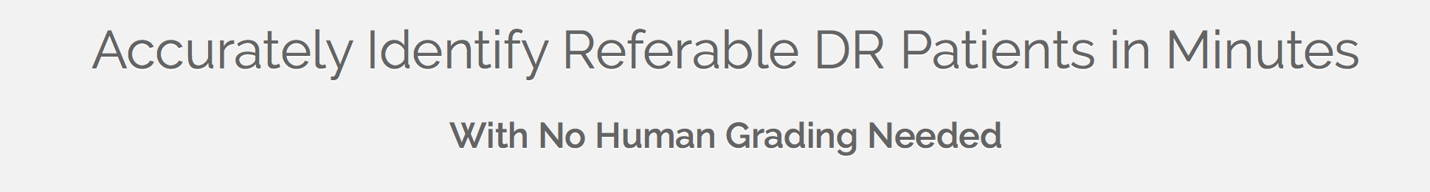
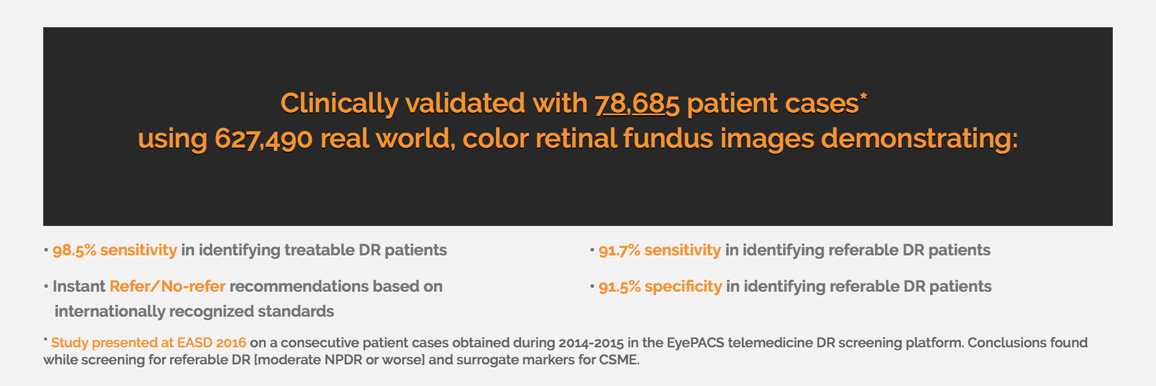
EyeArt

Slide 95
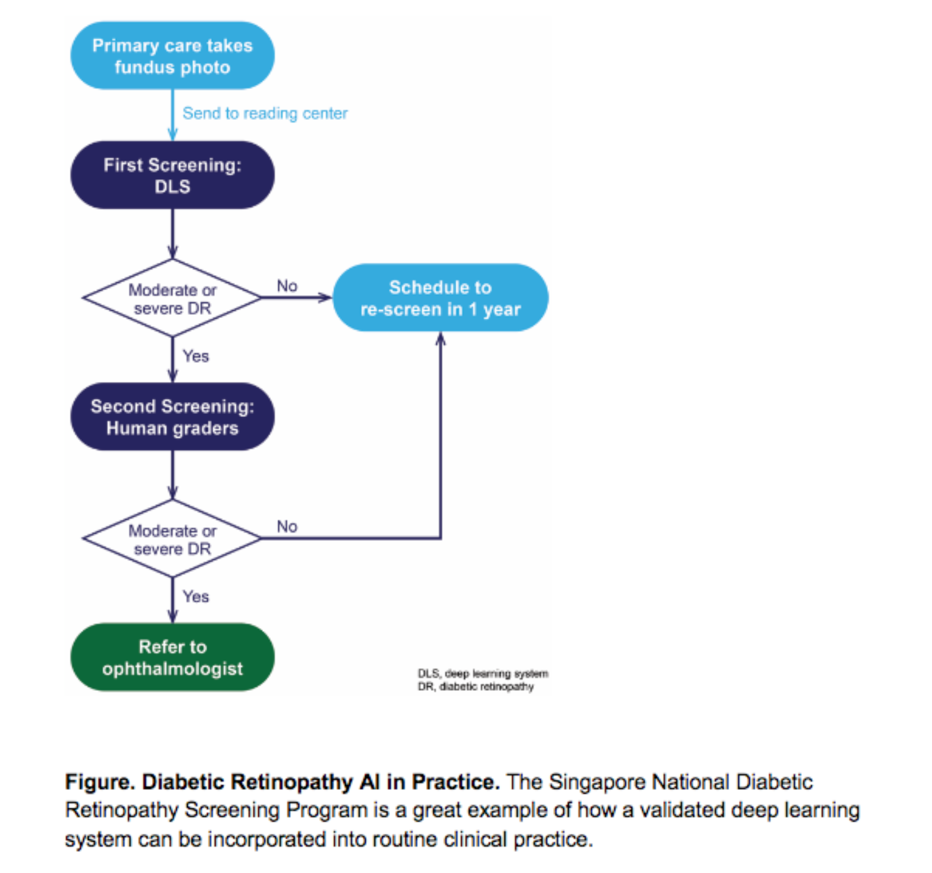
Using Artificial Intelligence to Automated Screening for Diabetic Retinopathy

Slide 96
Why this is important
Lack of adherence to dilated eye examinations worldwide
Patients not getting in to see an eyecare provider
Lack of patient knowledge regarding of need
  DR is often asymptomatic nature of diabetes related eye disease and male gender
Greater accessibility of diagnostic AI in rural or remote settings, as well as areas with poor health literacy might remove

Slide 97
Conclusion
Diabetes has reached epidemic proportions
Optometrists play a key role in the management of diabetes
  Educating/informing patients
  Detecting the presence of DR and DME
  Communication with PCP/Endocrinologist
  Timely referral for treatment
Anti-VEGF therapy has resulted in better VA outcomes and improved quality of life
There appears to be a trend in treating early
AI will play a key role in detecting DR earlier and may impact the primary care provider

